Slide 1


Effect of a High Deductible Health Plan on Patients Willingness to Undergo Indicated Breast Imaging
Michael Ngo, MD, BUMC
Geunwon Kim, M.D., Ph.D., Atrius Health
Muhammad Qureshi, M.B.B.S., M.P.H., BUMC
Priscilla J. Slanetz, M.D., M.P.H., BUMC

Slide 2
Disclosure
None of the authors have any relevant disclosures related to this work.

Slide 3
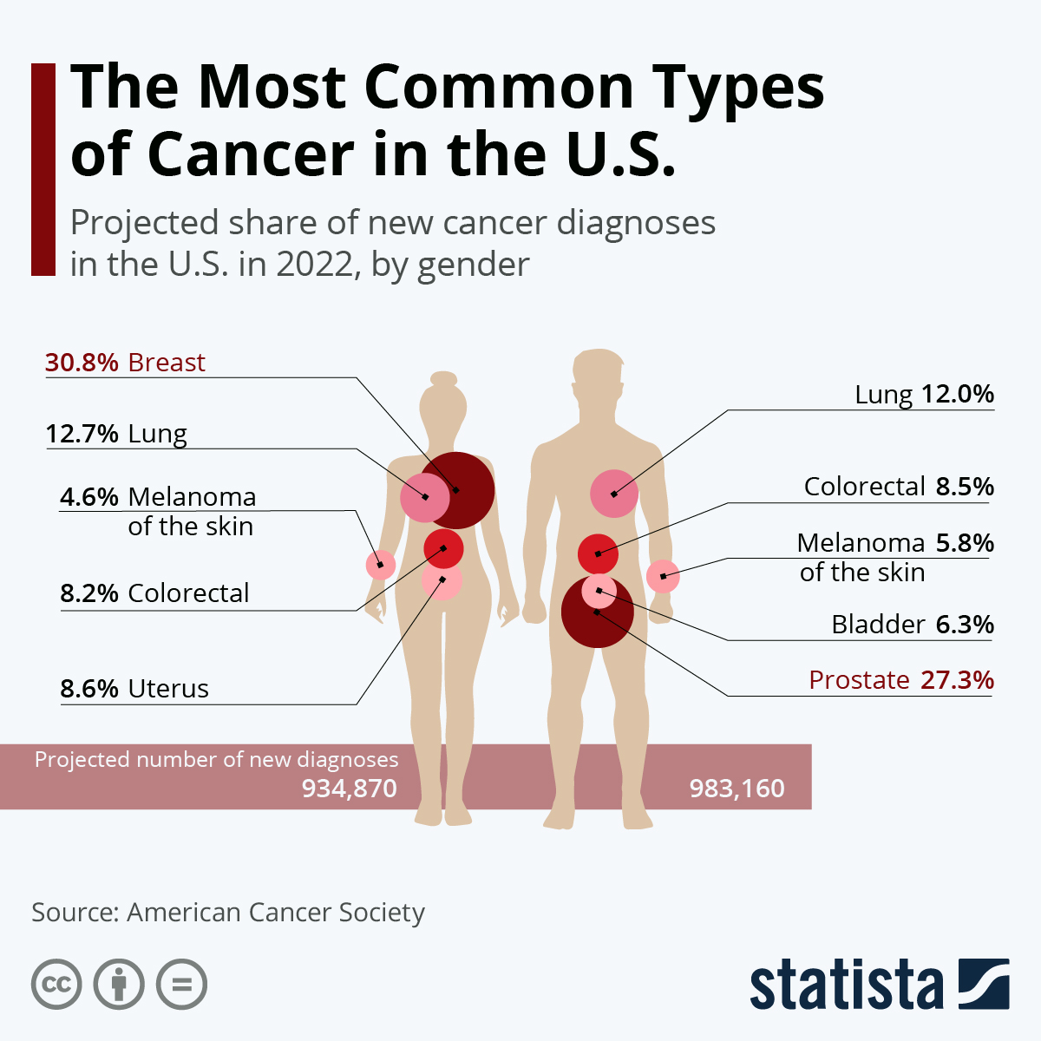
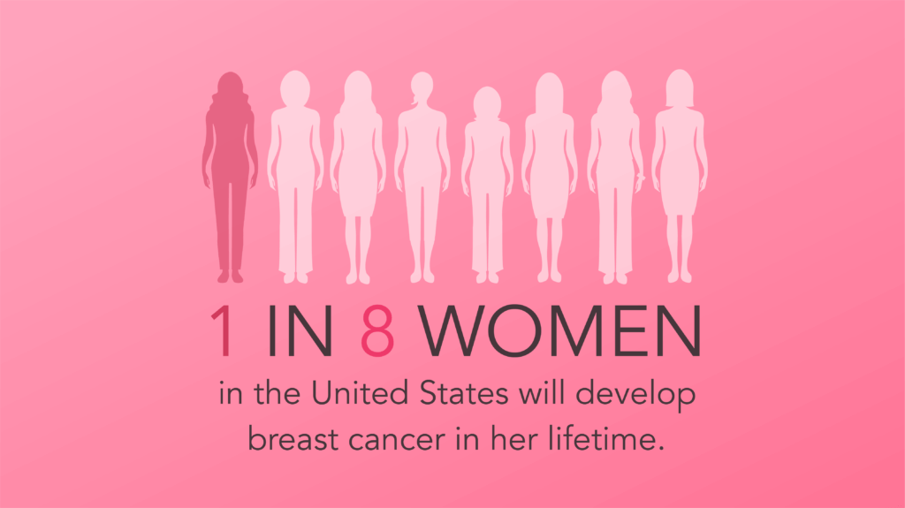
Breast Cancer
Most common cancer in women
Ranks 2nd for cancer mortality
Breast cancer facts and Statistics. www.Breastcare.org.uk

Slide 4
Screening Mammography Decreases Mortality Rates from Breast Cancer
Early detection decreases breast cancer death for women ages 40 to 75 by 30-40%
Longer duration of screening correlates with greater mortality reduction
Monticciolo DL, et al. J Am Coll Radiol. 2017;14(9):1137-1143.

Slide 5
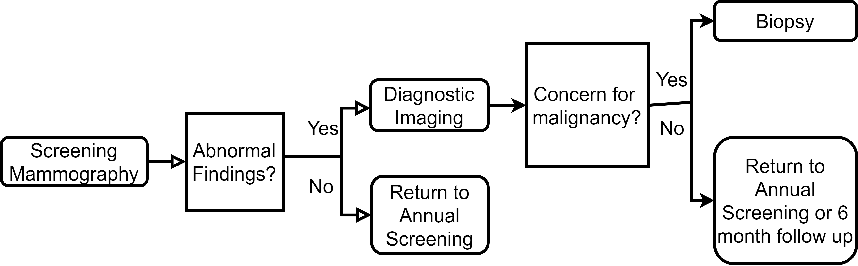
Breast Cancer Detection Process
Usually requires copayment or deductible
Covered by most insurance plans under the Affordable Care Act

Slide 6
Gaps in Coverage
Well-established that nominal copayment deters some patients from attending screening mammography
Affordable Care Act has been widely successful in reducing out-of-pocket (OOP) costs for screening mammography
But, OOP costs still exist for diagnostic imaging (mammography + ultrasound) and biopsy
> 60% people who had follow-up testing for abnormal screening had OOP payments
Lower rate of subsequent screening than women without any OOP payment
OOP costs for additional diagnostic breast imaging are becoming more common and more expensive as high deductible health plan become more prevalent
Trivedi AN et al., N Engl J Med. 2008;358:375-383.
Pan IW, et al. J Natl Cancer Inst. 2022;114(2):254-262.
Lowry KP, et al. JAMA Netw Open. 2021;60(8):8-11.
Tran L, et al. J Am Coll Radiol. 2022;19(1):24-34.

Slide 7
Our Hypothesis
OOP payments will discourage patients from completing important indicated diagnostic imaging for abnormal findings seen on screening mammography.

Slide 8

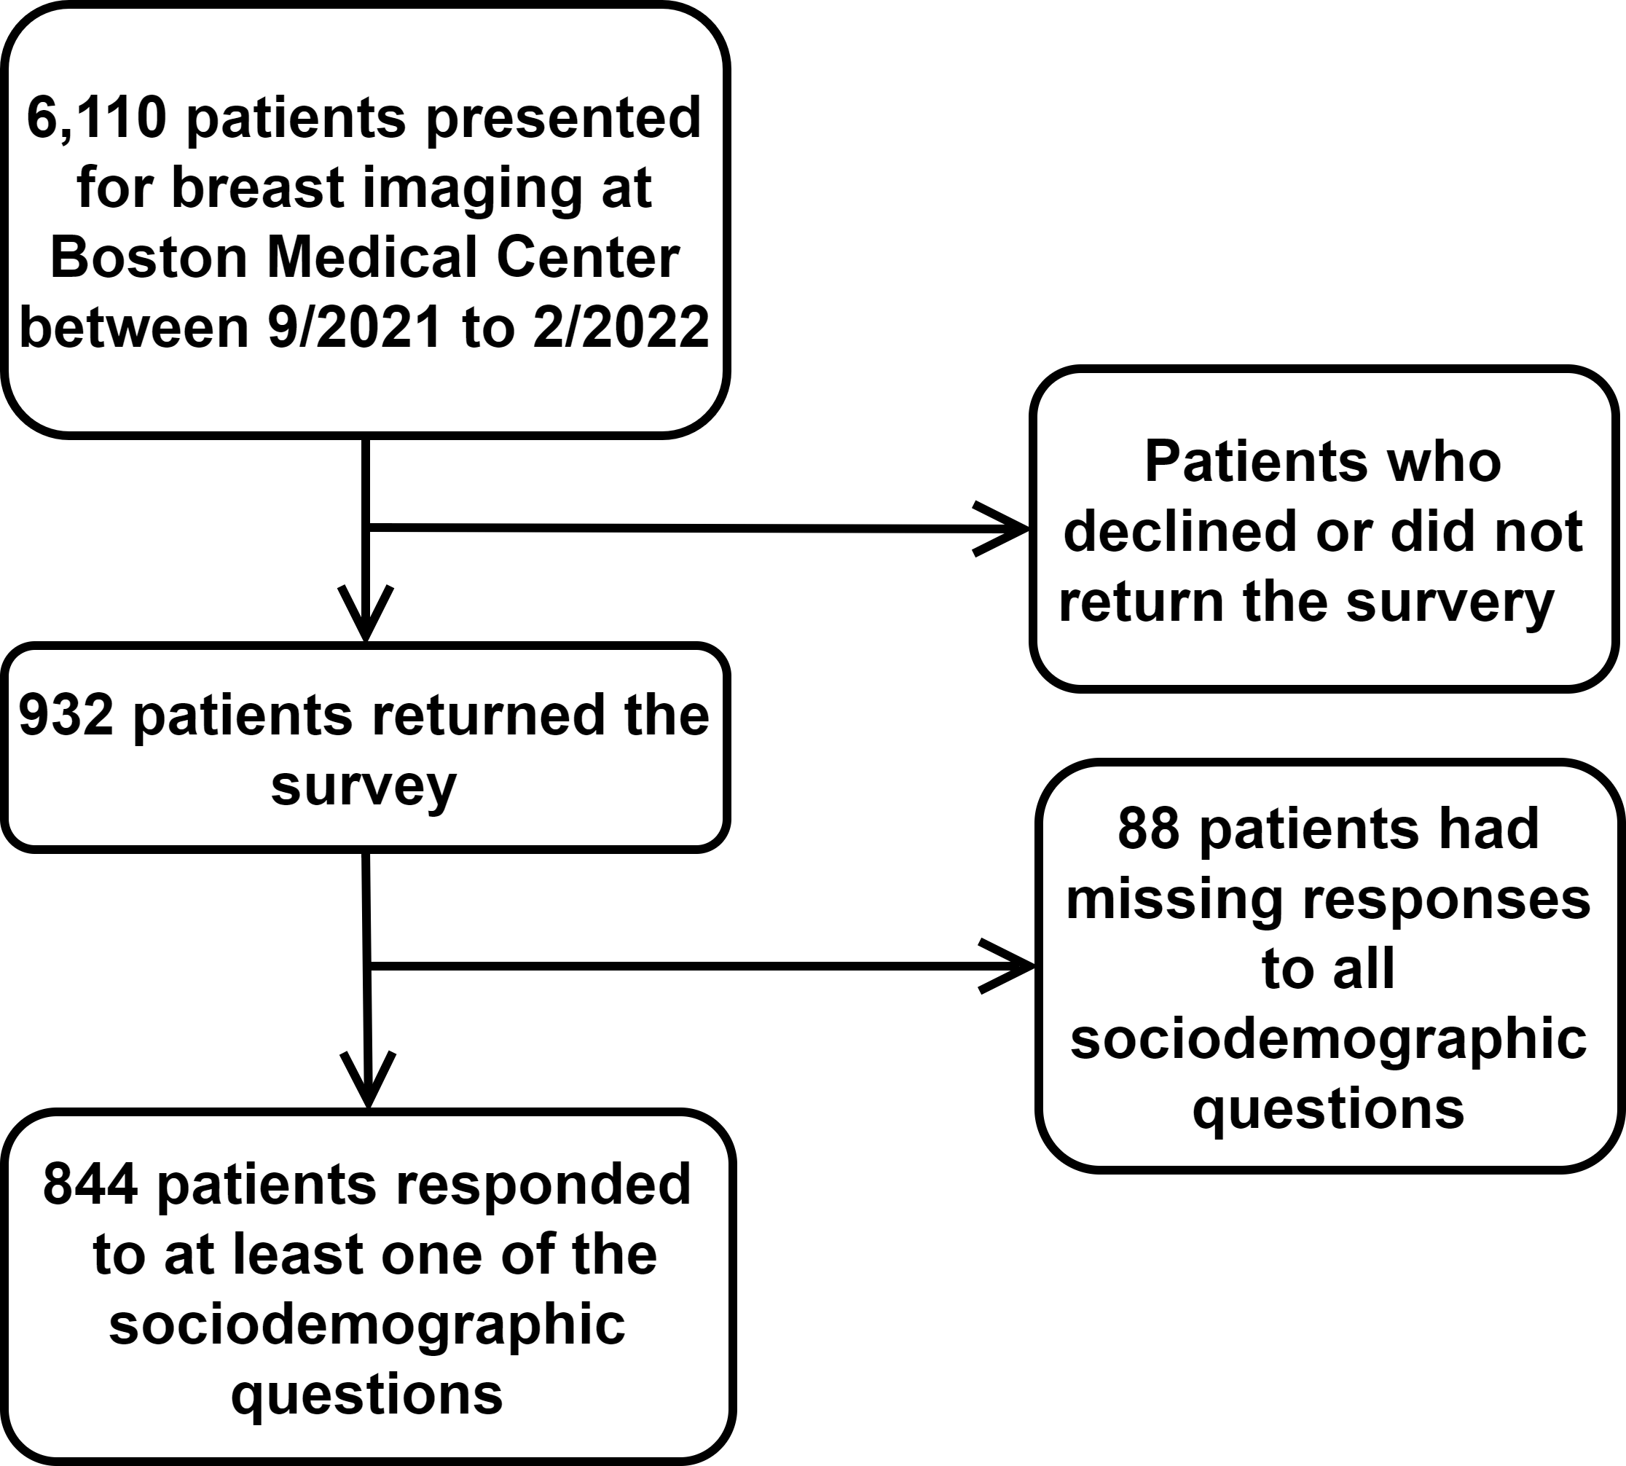
Methodology-Cross Sectional Study
Survey consisted of sociodemographic questions, hypothetical scenarios, and general breast health knowledge

Slide 9
Hypothetical Questions Asked
“Screening mammograms are covered 100% under the Affordable Care Act. However, on average, about 10% of women are called back for additional pictures to make sure the screening mammogram is normal. This additional testing is not covered by insurance until women pay their deductible. Assume that the radiologist needs additional pictures to make sure your screening mammogram is normal. Please answer the following questions/statements:”
Question 1: If I knew that I had to pay a deductible for the additional imaging, I would skip this additional imaging.
Question 2: If I knew that I had to pay a deductible for follow up tests, such as imaging or biopsy, after screening mammogram, I would not undergo screening for breast cancer.

Slide 10
Analysis
Chi-square test assessed differences in responses to the scenario questions by demographic factors:
Age
Race
Education
Insurance
Used a P-value of <0.05 for statistical significance

Slide 11
Demographics of Survey Respondents (N=844)
Age
 | <50 | 35.3% (298)
 | ≥50 | 57.2% (483)
 | Not disclosed | 7.5% (63)
Race
 | White | 32.2% (272)
 | Black | 38.6% (326)
 | Hispanic | 14.6% (123)
 | Other | 10.1% (85)
 | Not disclosed | 4.5% (38)
Education
 | ≤High School | 23.6% (199)
 | Some College/College | 48.9% (413)
 | Graduate | 18.6% (157)
 | Not disclosed | 8.9% (75)
Income
 | <$35,000 | 25.8% (218)
 | $35,000-<$80,000 | 22.5% (190)
 | ≥$80,000 | 19.4% (164)
 | Not disclosed | 32.2% (272)
Insurance
 | Employer | 40.9% (345)
 | Medicare | 13.0% (110)
 | Marketplace | 5.7% (48)
 | Medicaid /Uninsured | 31.3% (264)
 | Not disclosed | 9.1% (77)

Slide 12
Question 1: If I knew that I had to pay a deductible for the additional imaging, I would skip this additional imaging.

Slide 13
Demographics of the Respondents

Slide 14
Demographics of the Respondents
Notes:
Slide 14 and 17 should be split into two slides so you can make the pie charts bigger. But do we need both of them?

Slide 15
p<0.0001

Slide 16
Question 2: If I knew that I had to pay a deductible for follow up tests, such as imaging or biopsy, after screening mammogram, I would not undergo screening for breast cancer.
Notes:
Put pie charts of people who would say no
Bar graph of the percentage of the different races (put p-value somewhere)
Education, income, and insurance payor

Slide 17
Demographics of the Respondents

Slide 18
Demographics of the Respondents

Slide 19
p<0.0001

Slide 20
Limitations
Missing response rates to individual survey questions ranged from 4.5% to 32.2%
No major differences between imputed and non-imputed analysis
Study did not capture individuals who either missed their appointment or chose not to undergo screening or diagnostic imaging
Possible underestimation of patients with financial barriers
Assessed theoretical patient’s behavior

Slide 21
Conclusions
Having a deductible for diagnostic imaging discourages:
21% of women from returning for indicated diagnostic work up
18% of women from receiving the initial screening mammogram
Disproportionally affects populations already at risk for adverse health outcomes from lower adherence to recommended preventative services. This includes:
Racial minorities
Lower income bracket
Less educated
Medicaid/uninsured

Slide 22
Implications
Financial barriers to indicated diagnostic imaging must be addressed through legislative mandates
Increase access to indicated care
Mitigate existing healthcare disparities
Improve overall outcomes for all women, but especially those in vulnerable groups
Seven states (NY, CT, IL, GA, TX, LA, CO) have already passed bills covering diagnostic imaging at first dollar
https://densebreast-info.org/legislative-information/state-legislation-map/

