Slide 1
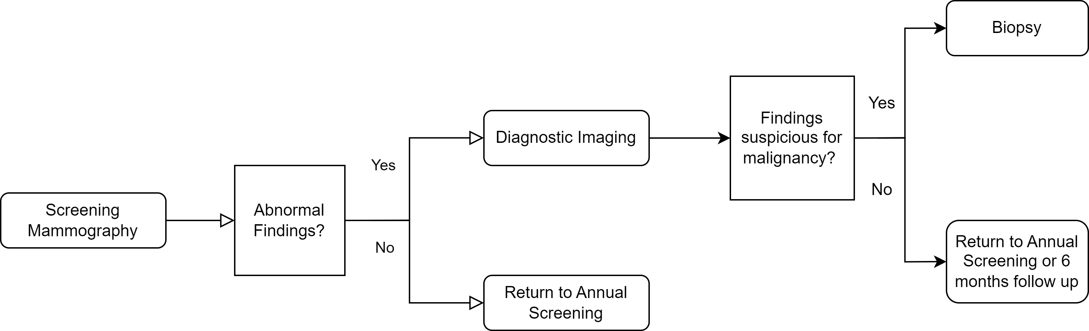
May require copayment or deductible
Covered by most insurance plans under the Affordable Care Act

Slide 2
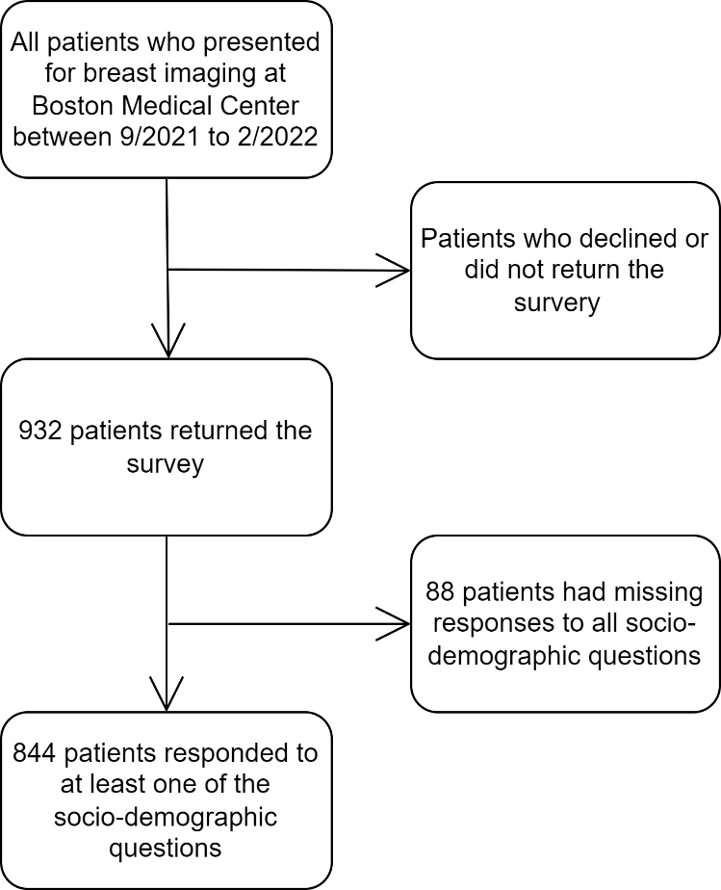
Flowchart of eligible patients for the study

Slide 3
Demographics of Survey Respondents
Characteristics |  | Patients (N=844)
Age
 | <50 | 35.3% (298)
 | ≥50 | 57.2% (483)
 | Not disclosed | 7.5% (63)
Race
 | White | 32.2% (272)
 | Black | 38.6% (326)
 | Hispanic | 14.6% (123)
 | Other | 10.1% (85)
 | Not disclosed | 4.5% (38)
Education
 | ≤High School | 23.6% (199)
 | Some College/College | 48.9% (413)
 | Graduate | 18.6% (157)
 | Not disclosed | 8.9% (75)
Income
 | <$35,000 | 25.8% (218)
 | $35,000-<$80,000 | 22.5% (190)
 | ≥$80,000 | 19.4% (164)
 | Not disclosed | 32.2% (272)
Insurance
 | Employer | 40.9% (345)
 | Medicare | 13.0% (110)
 | Marketplace | 5.7% (48)
 | Medicaid /Uninsured | 31.3% (264)
 | Not disclosed | 9.1% (77)

Slide 4
Responses to the question: “If I knew that I had to pay a deductible for the additional imaging, I would skip this additional imaging.”

Slide 5
Percentage of women who would agree to the following statement: "If I knew that I had to pay a deductible for the additional imaging, I would skip this additional imaging" by insurance payor (p<0.0001), income (p<0.0001), education (p=0.001), and race (p=0.003).

Slide 6
Responses to the question: “If I knew that I had to pay a deductible for follow up tests, such as imaging or biopsy, after screening mammogram, I would not undergo screening for breast cancer.”

Slide 7
Medicaid/Uninsured
Marketplace
Medicare
Employer
≥$80,000
$35,000-<$80,000
<$35,000
College Graduate
Some College
≤ High School
Other
Hispanic
Black
White
Percentage of women who would agree to the following statement: “If I knew that I had to pay a deductible for follow up tests, such as imaging or biopsy, after screening mammogram, I would not undergo screening for breast cancer.” by insurance payor (p<0.0001), income (p<0.0001), education (p=0.0002), and race (p=0.004).

