Slide 1
ULTRASOUND GUIDED HYDRODISSECTION FOR TREATMENT OF CARPAL TUNNEL SYNDROME: A PROSPECTIVE RANDOMIZED CONTROL TRIAL
DR ANUPAMA TANDON
DR ANINDITA BOSE
DR SIDDHARTH MAHESHWARI DR ADITYA N AGGARWAL DR GOPESH MEHROTRA
Department of Radiology and Orthopedics
University College Of Medical Sciences And Guru Teg Bahadur Hospital, Delhi, India
Department of Neurology
Institute of Human Behaviour and Allied Sciences, Delhi, India

Slide 2
INTRODUCTION
CTS- one of the most common nerve entrapment syndromes
3-6% of adult population affected
Important cause of workplace morbidity- caused by strain and repeated movements
(‘biomechanical overload’)
CAUSE: Overuse/strain/abnormal posture → micro vascular insufficiency→ ischemia→ scaring, fibrosis, adhesions→ nerve entrapment→ reduced mobilty of nerve
SYMPTOMS- Sensory first (tingling, numbness, pain, feeling of clumsiness) followed by motor ( reduced grip, varying functional disability)
DIAGNOSIS-
1. Clinical-
2. Electro-diagnostic test- “GOLD STANDARD” (Nerve conduction studies)
3. Imaging: Ultrasound - nerve parameters, doppler studies
MRI- limited

Slide 3
TREATMENT OPTIONS
Conservative- medications, splints, lifestyle
Steroid injections
Surgical- carpal tunnel release surgery
Minimally invasive and image guided procedures-
US guided steroid injections
US hydrodissection techniques

Slide 4
RATIONALE
Likely, nerve entrapment is caused by adhesions resulting in nerve fixation to surrounding structures causing reduced mobility
This technique uses ultrasound-guided peri-neural fluid injection to separate the median nerve from surrounding structures with the aim to release these adhesions and to restore function to the nerve.
In the published work so far it remains remains unclear if the hydrodissection mechanism truly causes improvement in clinical outcome or the results are due to anti-inflammatory action of steroids.
This prospective, randomised control trial evaluates the effectiveness of true hydrodissection for treatment of CTS.

Slide 5
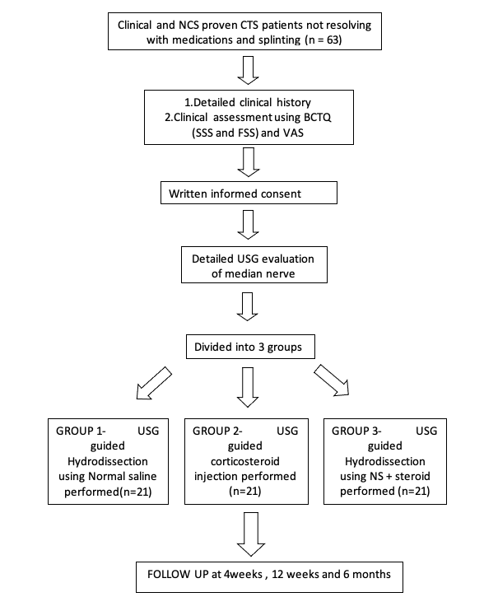
STUDY DESIGN

Slide 6
Subject Selection
INCLUSION CRITERIA
63 wrists with NCS proven CTS OF > 3 months duration refractory to conservative treatment like splints, medication etc
EXCLUSION CRITERIA
-Patients with other neurological causes like polyneuropathies, thoracic outlet syndrome, cervical radiculopathy
--Patients in whom ultrasound will reveal ed secondary causes of carpal tunnel syndrome like Ganglion cysts, accessory muscles etc
-Patients with underlying coagulopathies /on anti-coagulant medicationsatientand with local site infection
-Patients who have received prior corticosteroid injection or have undergone carpal tunnel release surgery
-Patients with thenar atrophy

Slide 7
Randomization
Patients were randomly divided into 3 groups of 21 each, using computer generated randomization
1
US guided hydrodissection with Normal saline
2
US guided corticosteroid inj. (No Hydrodissection)
Injectate: 2ml (1ml of 40% triamcinolone +1ml of 1% lignocaine)
3
US guided hydrodissection with NS + steroid
Injectate: 7-10ml (1ml of 40% triamcinolone +1ml of 1% lignocaine +NS)
Injectate= 7-10ml NS

Slide 8
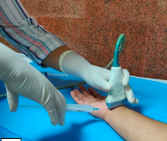
PROCEDURE TECHNIQUE
Under sterile preparation
Needle placed both above and below the nerve
Slowly injection of fluid around the nerve under ultrasound guidance
Fluid injected till nerve is separated from surrounding tissue
Notes:
(depending upon the completeness of the laminar separation) of the hydrodissection fluid slowly injected under real time visualisation to the median nerve, ensuring its complete separation from the surrounding tissues.

Slide 9
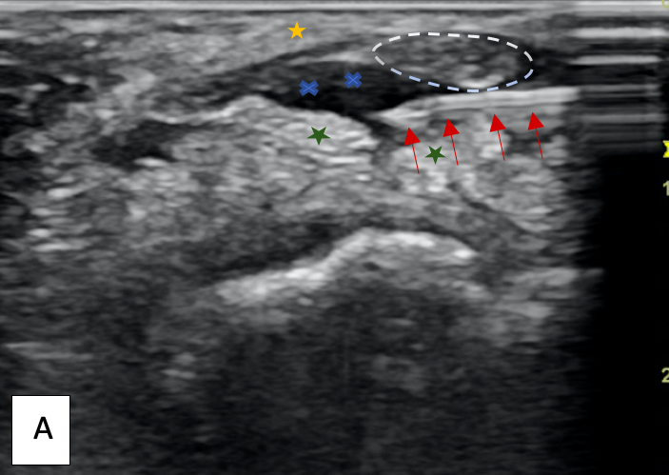
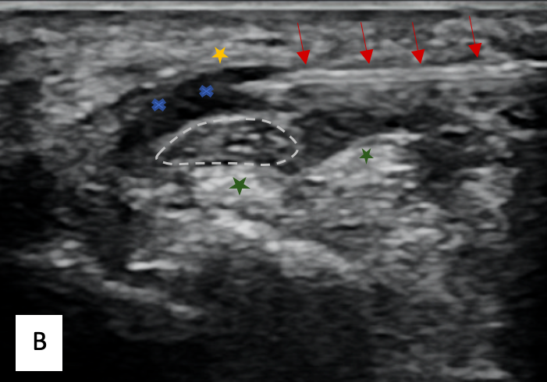
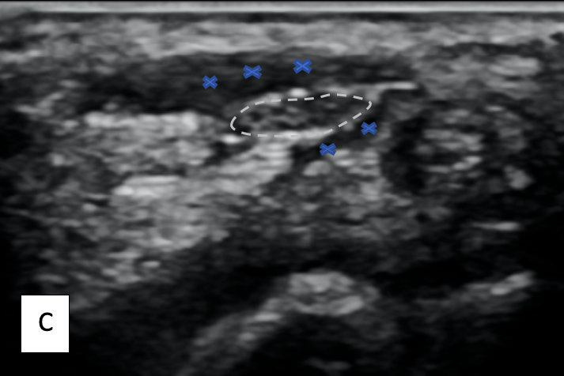
ULTRASOUND GUIDED HYDRODISSECTION Sonograms depicting the procedure of hydrodissection in a patient with CTS using in-plane approach. (A) needle placed below the median nerve with fluid dissecting the nerve from the underlying flexor tendons (Green star) (B) needle placed above the median nerve with fluid dissecting the nerve away from the flexor retinaculum (Yellow star) (C) image at completion of procedure depicting the dissected median nerve with fluid all around.

Slide 10
No hospital admission
Minimal cost
Average procedure time: 5-10 minutes
Minimal pain and swelling (maximum for a duration of 30 minutes)
No major complications; mild tingling/ discomfort for a few hours

Slide 11
Post-procedure instructions
Analgesics were prescribed to be taken on SOS basis
Patients were advised to minimally use the wrist for 2 hours
Not to massage or apply hot/cold compresses to the wrist
To report SOS if they have any fresh complaints

Slide 12
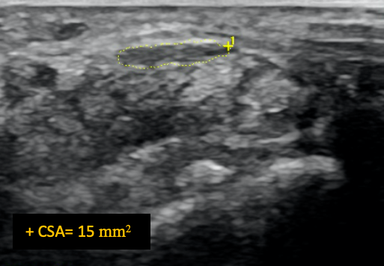
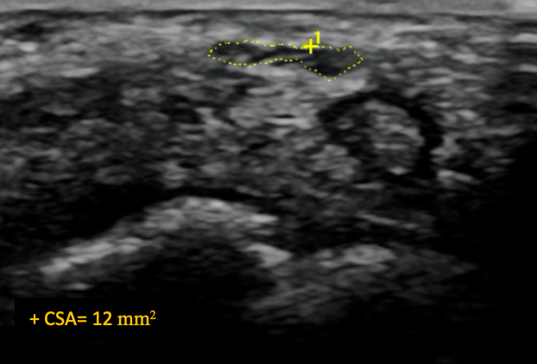
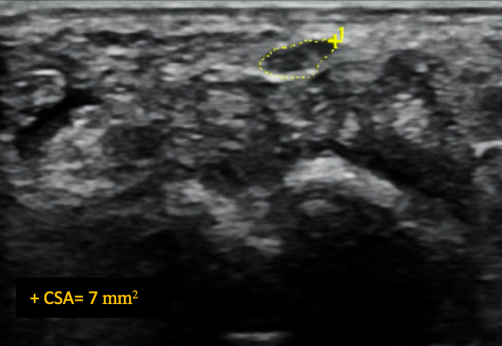
Transverse sonogram of median nerve of a patient with CTS who underwent hydrodissection (pre-procedure, at 4 weeks and 12weeks)
Pre-procedure
At 4 weeks
At 12 weeks

Slide 13
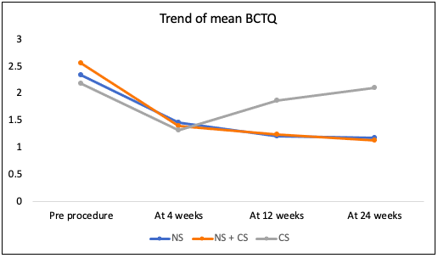
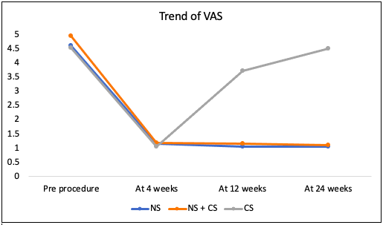
COMPARISON OF CLINICAL SYMPTOMS BETWEEN THREE GROUPS AT DIFFERENT TIME POINTS

Slide 14
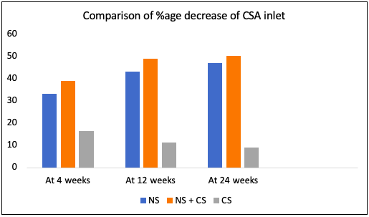
COMPARISON OF CROSS SECTIONAL AREA OF NERVE BETWEEN THREE GROUPS AT DIFFERENT TIME POINTS

Slide 15
CONCLUSION
US guided hydrodissection of median nerve with Normal Saline alone, provided a significant and persistent clinical and morphological improvement in CTS.
Addition of steroid to the injectate did not offer any significant benefit, indicating, that the therapeutic effect was primarily due to hydrodissection.
Steroid alone group without hydrodissection, only had transient improvement.
Hydrodissection, therefore, has the potential to be an effective treatment option in refractory CTS and can alleviate the need for surgery.

Slide 16
THANK YOU

