Slide 1
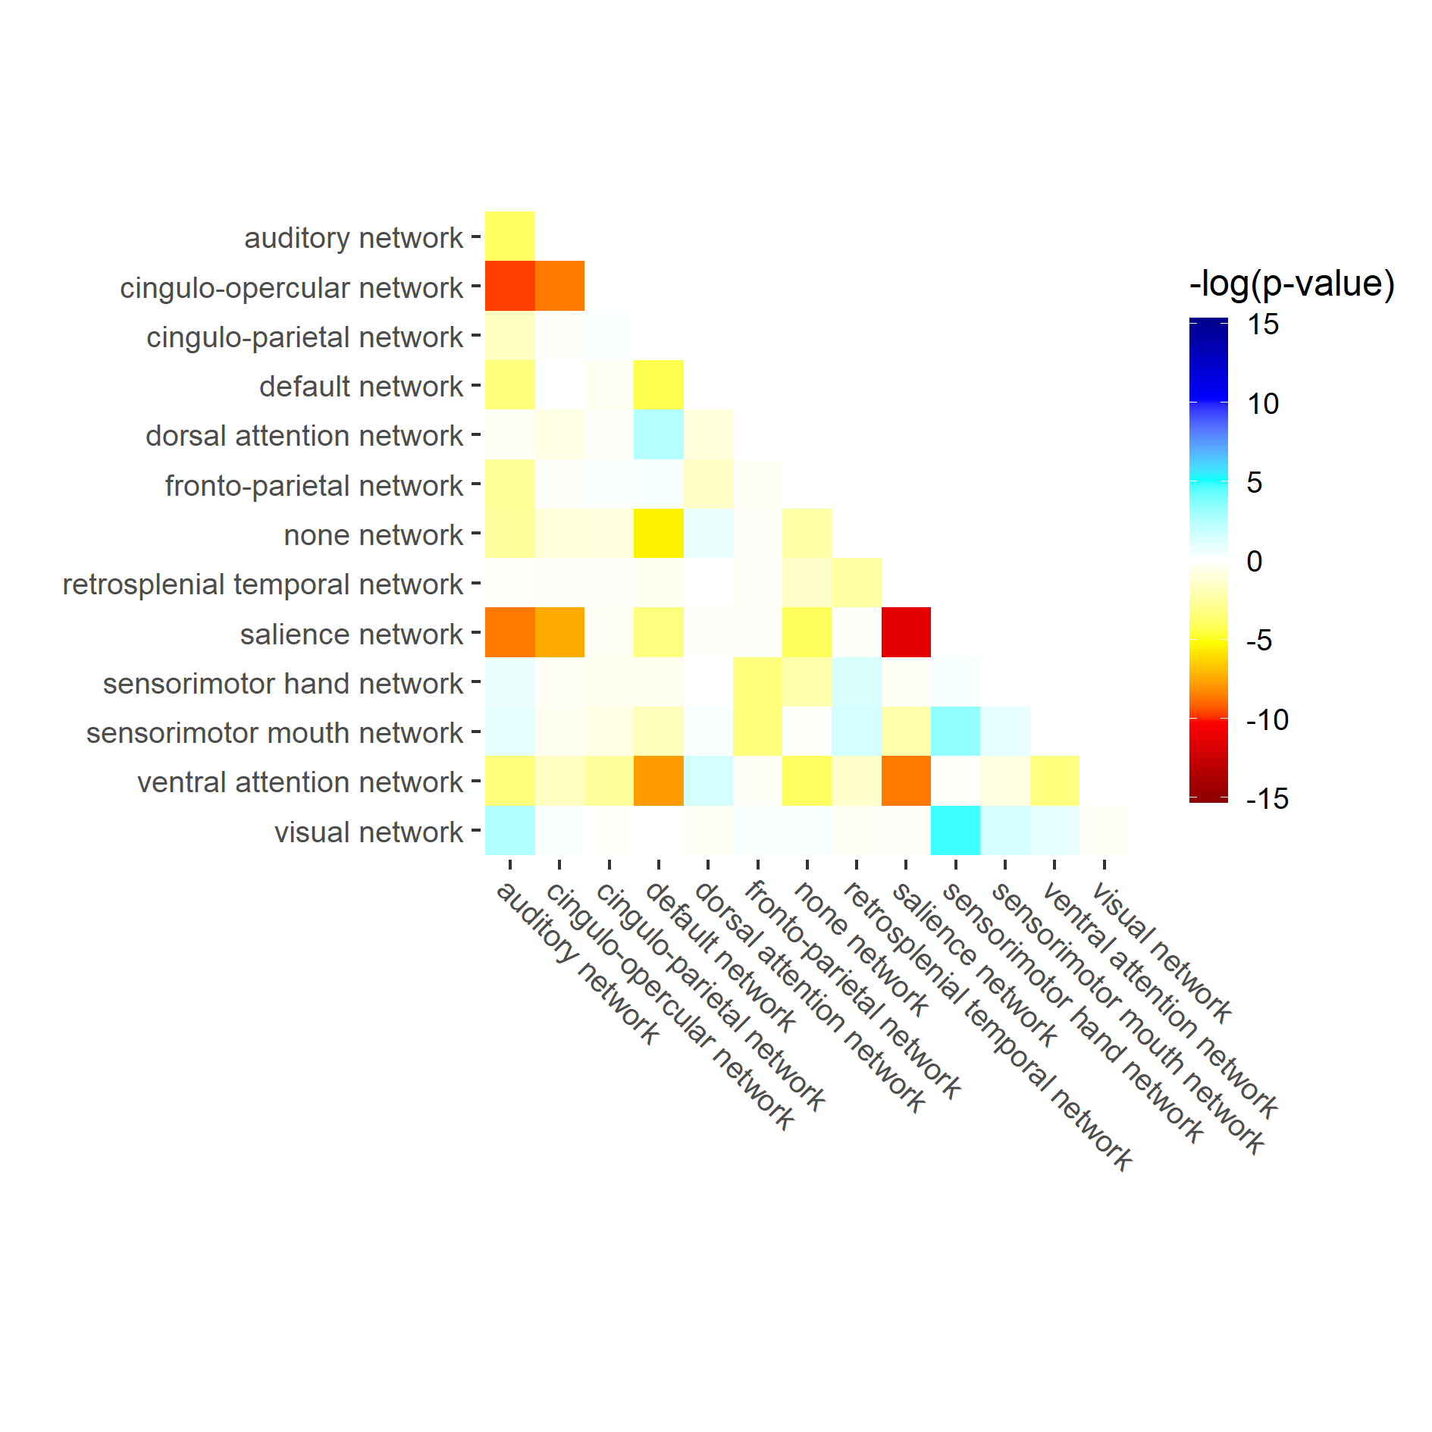
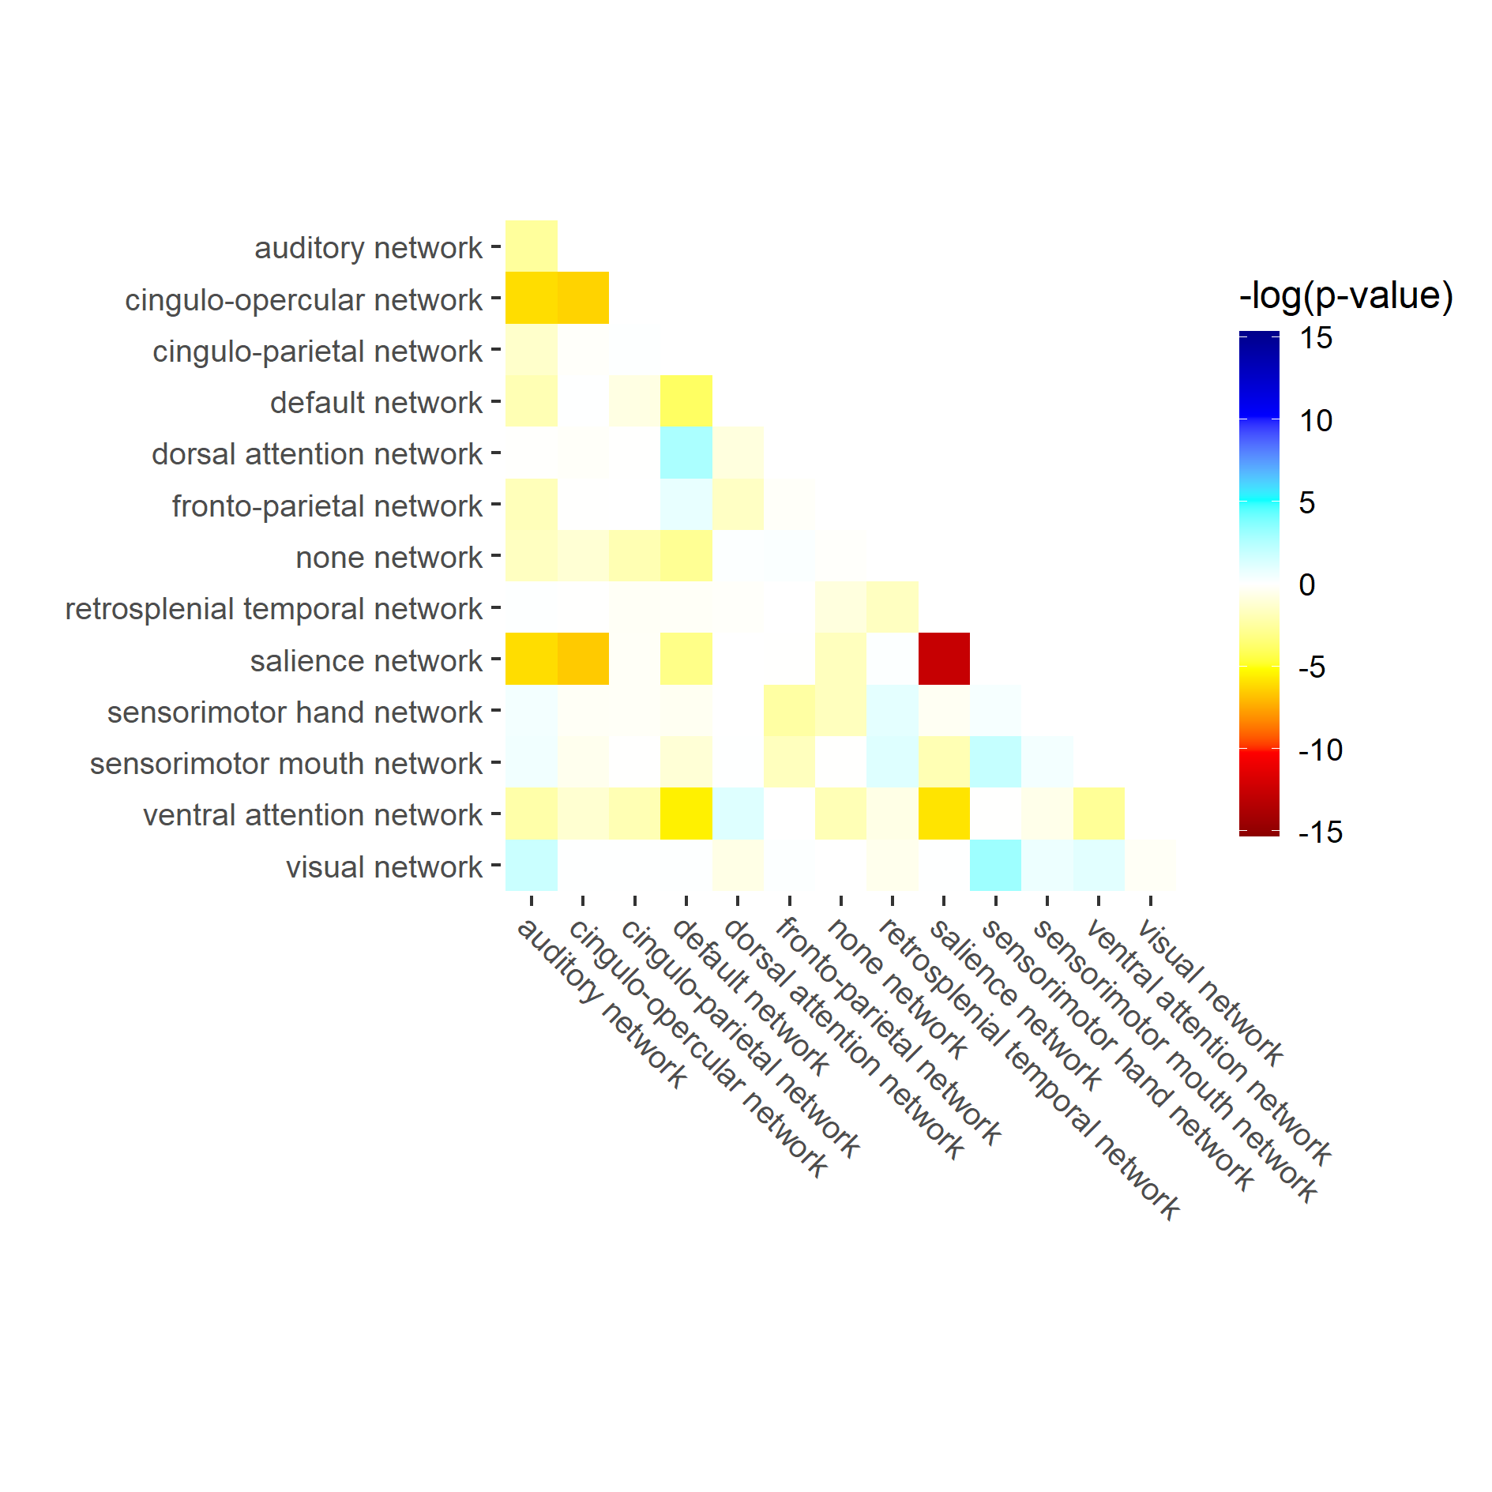
(A) Weight
(B) BMI-z-scores
-log10(p-value)
The connectivity of functional networks is associated with weight and BMI variations. Most and negatively affected are the so-called “salience” and “cingulo-opercular” networks that are related to inhibitory control, motivation and reward-based decision making. Blue is used for positive and red for negative associations.

Slide 2
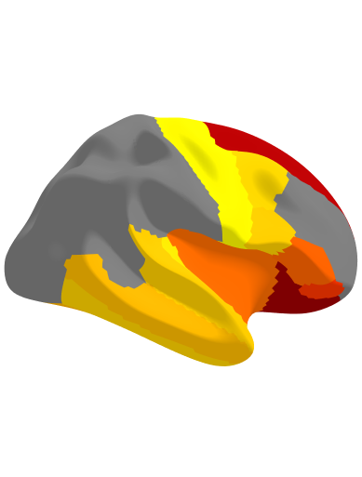
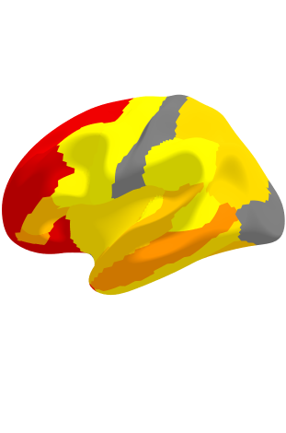
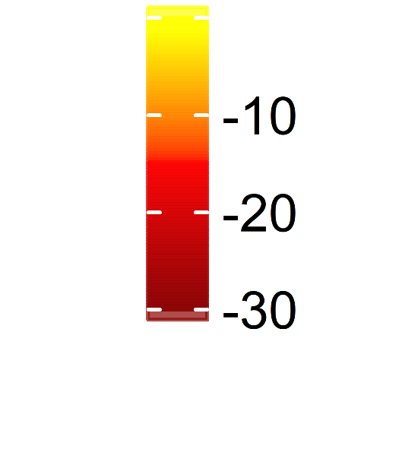
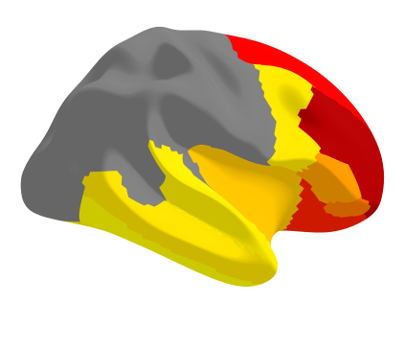
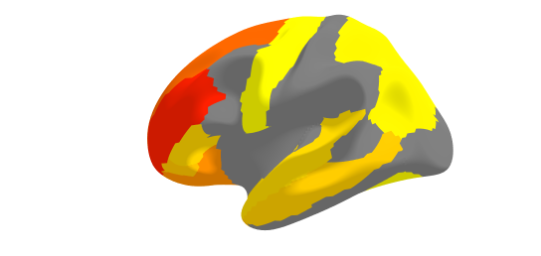
Right hemisphere
Left hemisphere
(A) Weight
-log10(p-value)
(B) BMI-z-scores
The cortical thickness of especially prefrontal regions is negatively associated with weight and BMI measurements meaning that higher weight and BMI are related to lower cortical thickness.

Slide 3
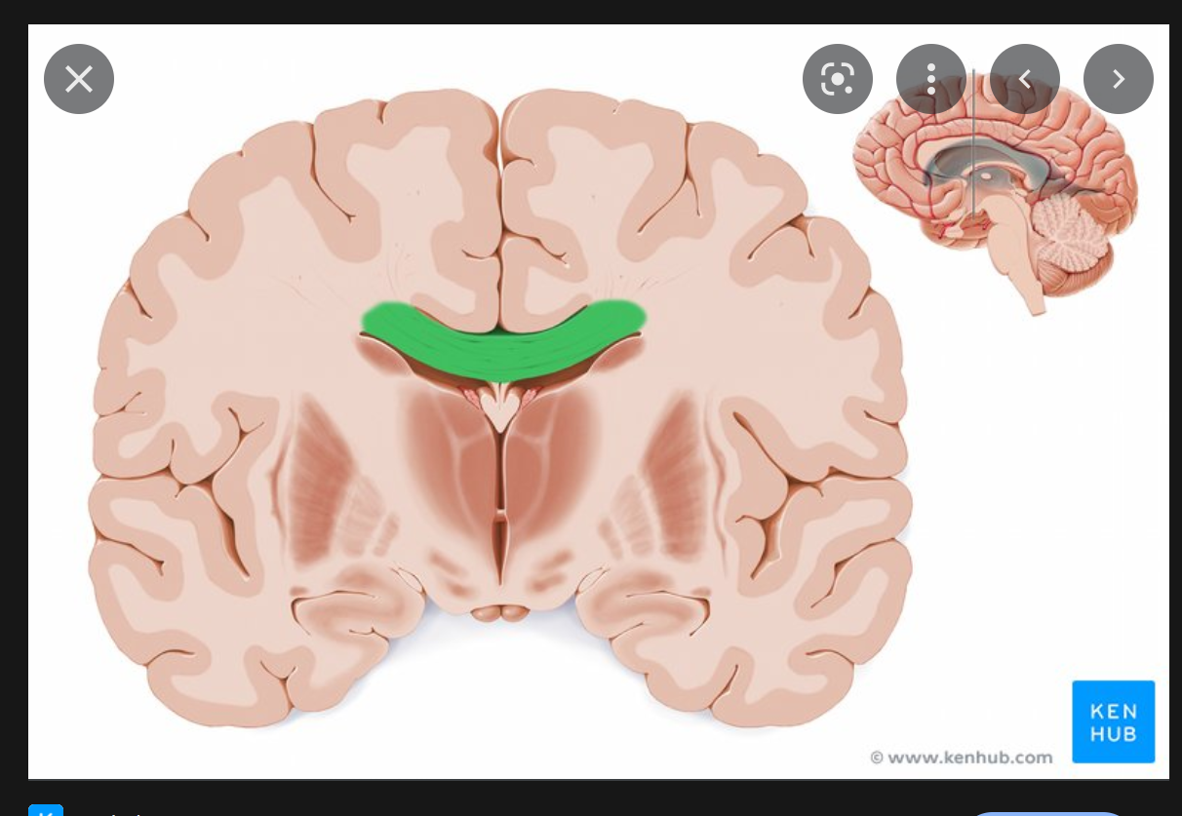
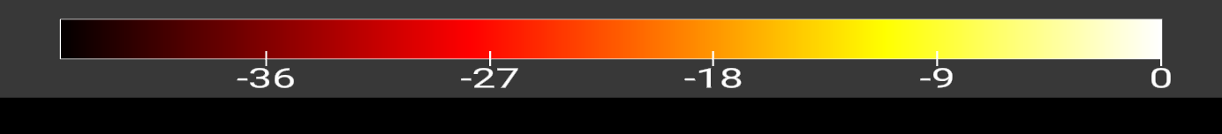
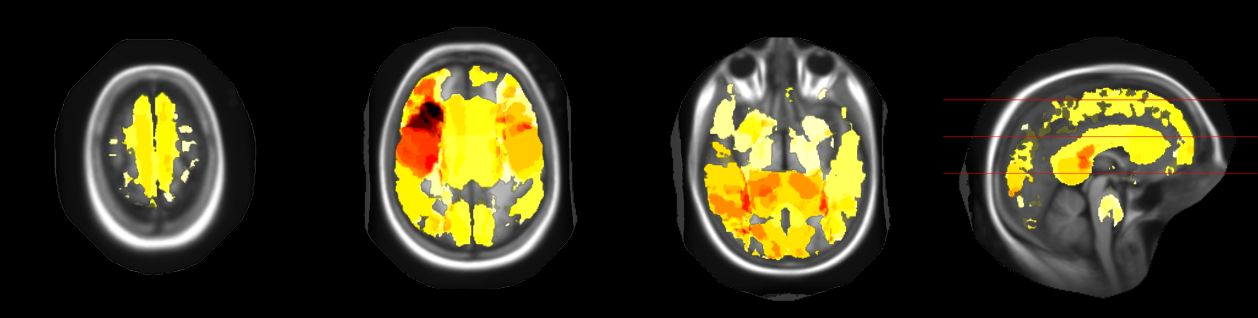
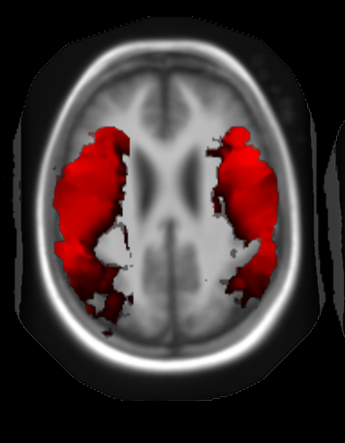
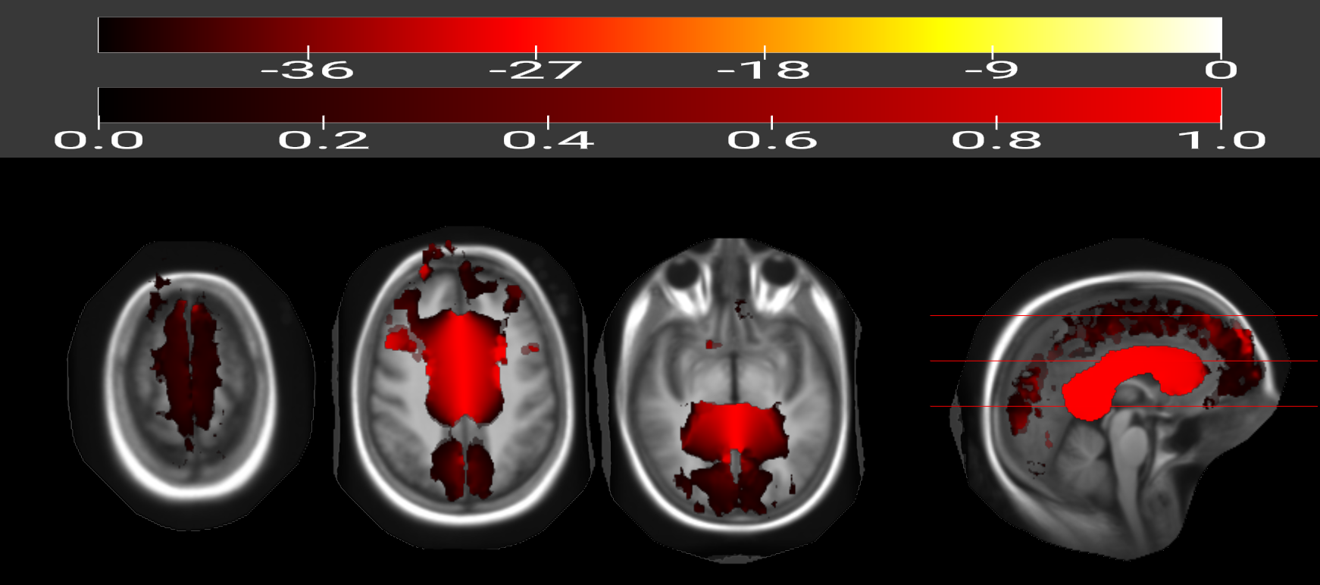
Superior longitudinal fasciculus
Corpus callosum
The integrity of the white matter is extensively impaired with higher BMI in children. Most affected are the corpus callosum which is the main connector of the both brain hemispheres and the superior longitudinal fasciculus that connects several (frontal, occipital, parietal, and temporal) lobes.

