Slide 1

SARS-CoV-2 infection during pregnancy: Does fetal MRI show signs of impaired fetal brain developement?
Department of Radiology, LMU Munich
V. Koliogiannis, T. Prester, N. Fink, U. Hasbargen, C. Hübener, T. Kolben, M. Jegen, J. Dinkel,
O. Dietrich, A.W. Flemmer, M. Delius, S. Mahner, J. Ricke, S. Stoecklein

Slide 2
Introduction
SARS-CoV-2 infection during pregnancy
Pregnant women are especially vulnerable to SARS-CoV2 infections with potential complications for the unborn child¹
The virus has a high affinity to the placenta²
Reports of transmission of SARS-CoV2 to the fetus have raised concerns³
Known adverse effects on fetal brain development of other viral infections during pregnancy (e.g. Zica virus, cytomegalovirus)
➾
But: Currently lack of a systematic assessment of the impact of SARS-CoV2 infection on fetal brain development.
¹ Schwartz et al., Viruses 2020
² Patane et al., Am J Obstet Gynecol 2020
³ Kotlyar et al., Am J Obstet Gynecol 2021

Slide 3
Introduction
Purpose
➾
to evaluate if fetal brain development is affected by SARS-CoV2 infection during pregnancy using fetal MRI

Slide 4
Patient cohort
33 pregnant women with SARS-CoV2 infection during pregnancy (PCR proven)
Mean gestational age at scan: 28.4 weeks (range 18-39)
Mean gestational age at onset of symptoms: 18.3 weeks GA (range 4-34)
Mild to moderate symptoms
No hospitalization
Otherwise healthy

Slide 5
Methods
Image Acquisition & Analysis
Fetal MRI at 1.5 Tesla without contrast agent
Two board-certified radiologists (experienced in fetal MRI)
evaluated the brain’s surface, the brain’s fluid filled spaces, potential signs of brain swelling, and brain calcifications
and quantified brain stem structures and compared them to age-adapted reference values*
* Dvorak et al., UOG, 2021

Slide 6
Results
Fetal brain development
Age-appropriate brain surface and folding in all fetuses
Age-appropriate cerebellar size in all fetuses
Age-appropriate size of all brain stem structures in all fetuses
No calcifications, signs of swelling or widening of the brain’s fluid-filled spaces

Slide 7
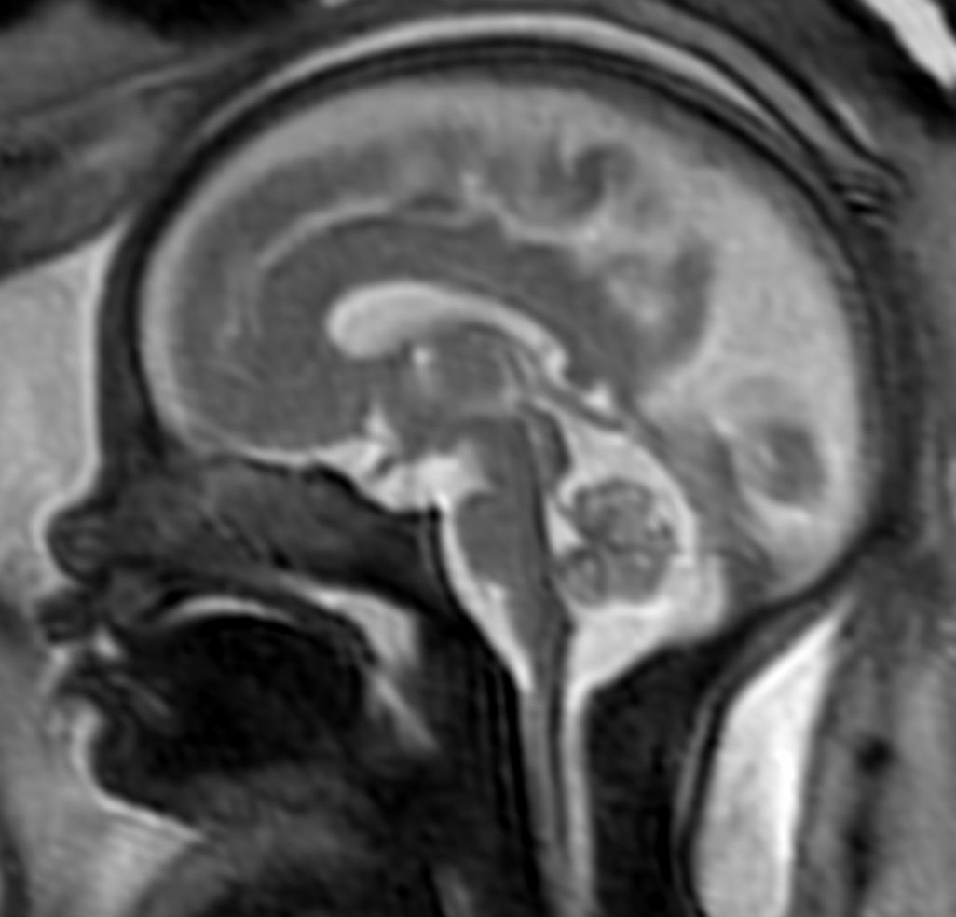
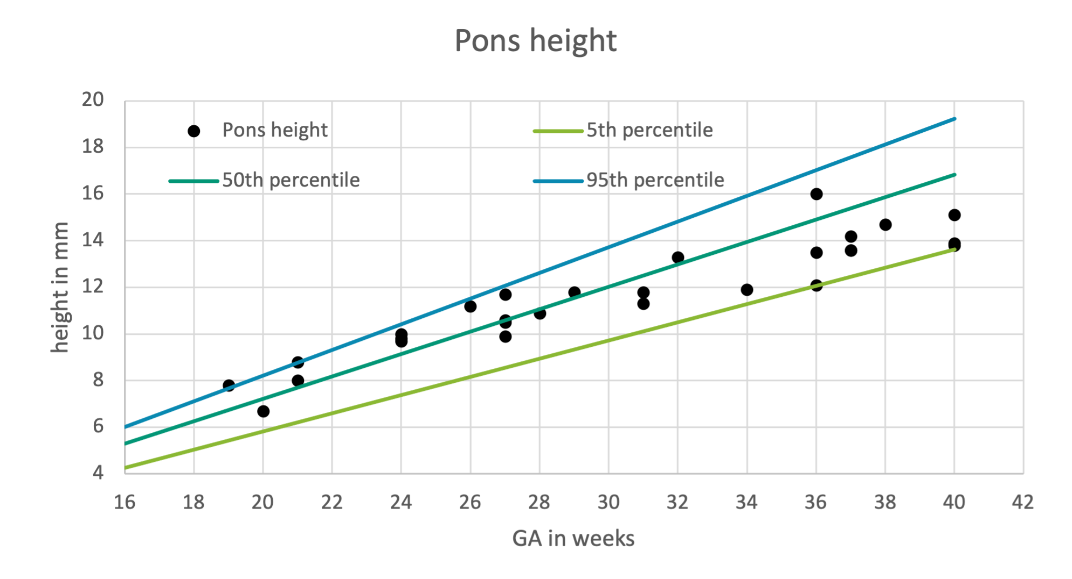
Results
Fetal brain development

Slide 8
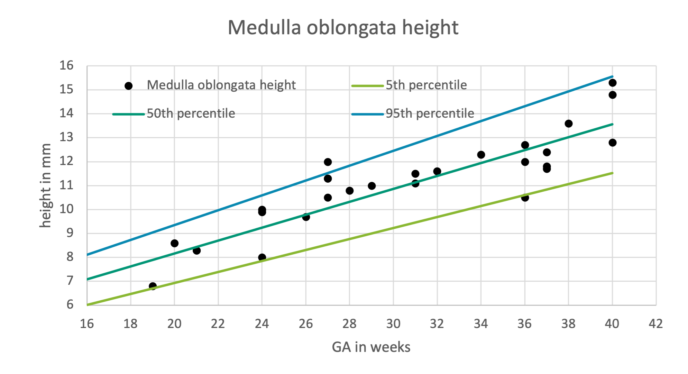
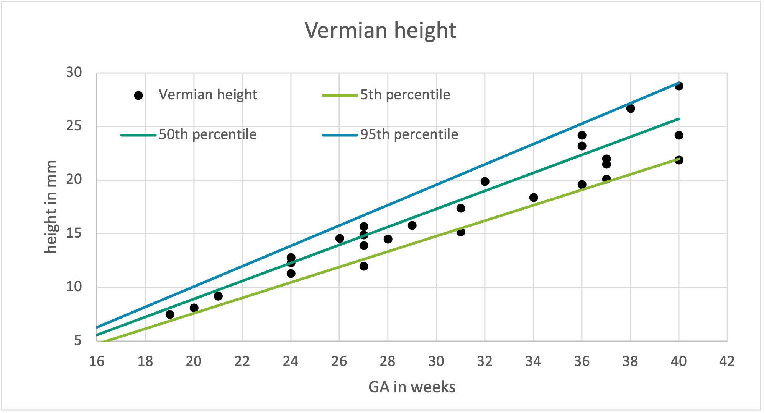
Results
Fetal brain development

Slide 9
Conclusion
All fetuses showed normal brain development
No findings indicative of infection of the fetal brain
➾
The study will is still recruiting and will follow-up all newborns longitudinally until the age of 5

Slide 10
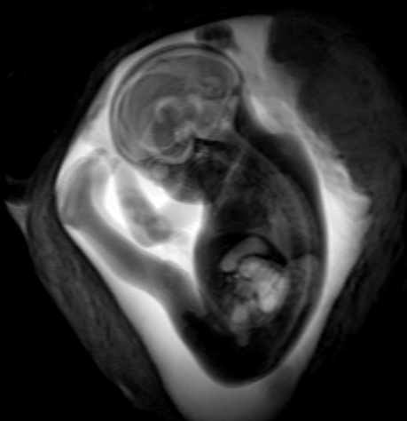
Thank you for your attention!
E-Mail:
Nicola.Fink@med.uni-muenchen.de
Sophia.stoecklein@med.uni-muenchen.de

