Slide 1


Age-related Changes in White Matter Microstructure in Autism Spectrum Disorder
Weber CF, Haider SP, Lake EMR, Scheinost D, Bamford NS, Constable T, Payabvash S
Radiological Society of North America, Chicago IL/USA
November 18th – December 3rd, 2021

Slide 2
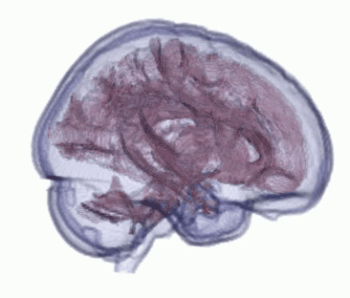
How is the brain of people with Autism Spectrum Disorder ”wired”?
→ Magnetic resonance imaging of different age cohorts to detect changes in white matter
White Matter
“wires” connecting grey matter computational units
Grey Matter
(here: cortex)
Neurons as computational units

Slide 3
Data from the National Database of Autism Research
We included four study cohorts from different studies in the National Database of Autism Research (NDAR). Each study reflects on a certain age group (right). Demographic information shown in table, studies are referenced below.
Study | median age (months), IQR | ASD:control | Percentage male
Longitudinal MRI Study of Infants at Risk of Autism (n=155) | 7 (6-7) | 34/121 | 65.8%
Biomarkers of Autism at 12 Months (n=102) | 32 (25-36) | 57/45 | 73.5%
Multimodal Developmental Neurogenetics (n=230) | 158 (123-186) | 106/124 | 50.9%
Atypical Late Neurodevelopment in Autism (n=96) | 229.5 (188-316.5) | 67/29 | 99.0%
“infants”
“toddlers”
“adolescents”
“young adults”
Atypical Late Neurodevelopment in Autism: A Longitudinal Clinical Phenotype and Multimodal Brain Imaging Study. PI: Janet Lainhart, Univ. Of Wisconsin-Madison. 207 subjects shared, 2016-2022
Biomarkers of Autism at 12 Months: From Brain Overgrowth to Genes. PI: Eric Courchesne, Univ. Of California, San Diego. 870 subjects shared, 2007-2014
A Longitudinal MRI Study of Infants at Risk for Autism (ACE2). PI: Joseph Piven, Univ. Of North Carolina Chapel Hill. 1,037 subjects shared, 2012-2017
Multimodal Developmental Neurogenetics of Females with ASD. PI: Kevin Pelphrey, George Washington University. 1,042 subjects shared, 2012-2022

Slide 4

Image Processing using FMRIB Software Library
Raw MRI images (Diffusion Tensor Imaging (DTI) and T1-weighted) were preprocessed using FSL Software:
Diffusion Tensor Imaging
T1 weighted images
Mean Diffusivity (MD)
Voxel–Based Morphometry
Radial Diffusivity (RD)
Axial Diffusivity (AD)
Fractional Anisotropy (FA)
=Mobility of water molecules → shows integrity of white matter tracts
FSL Tract-Based Spatial Statistics: finding centers of white matter tracts
→ Statistical analysis
➔
Edge Density (ED)
= Connectivity of brain regions

Slide 5
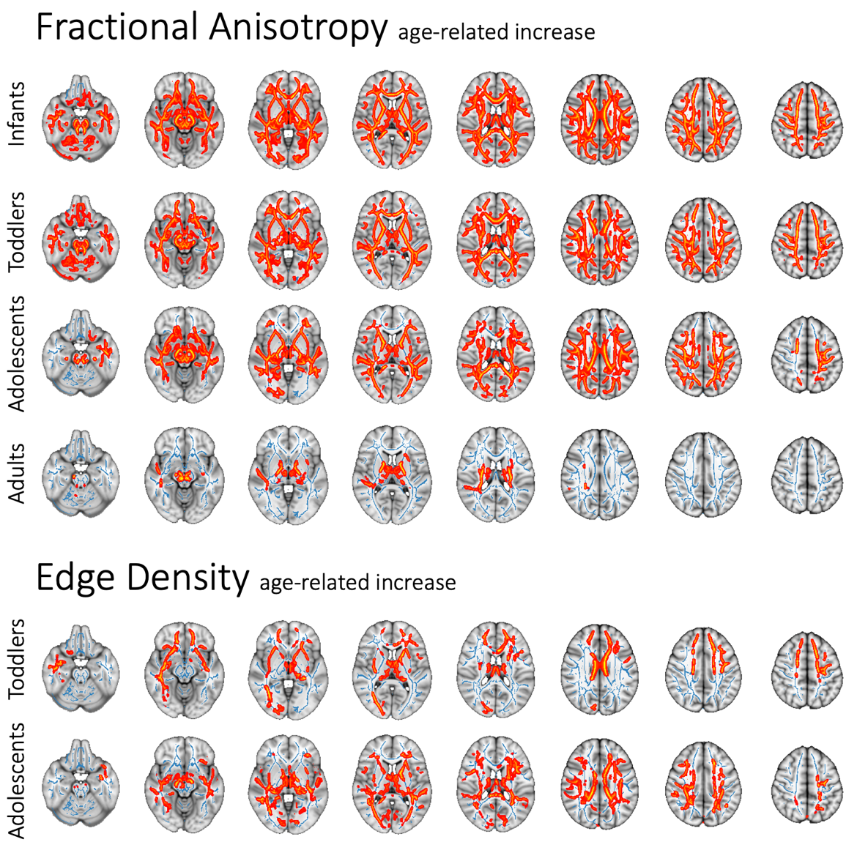
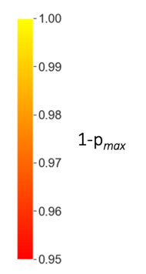
Age-related Effects in Diffusivity Metrics
Red areas show significant changes as specified in the title
Standard MNI152-brain template (grey)
TBSS-derived mean FA skeleton (blue)
Significant changes p<0.05 (red – yellow)

Slide 6
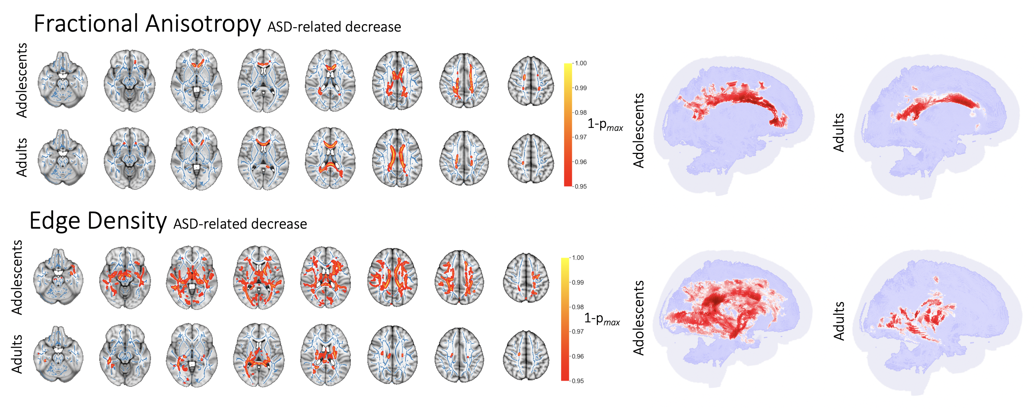
Autism-related Effects in Adolescents and Adults

Slide 7
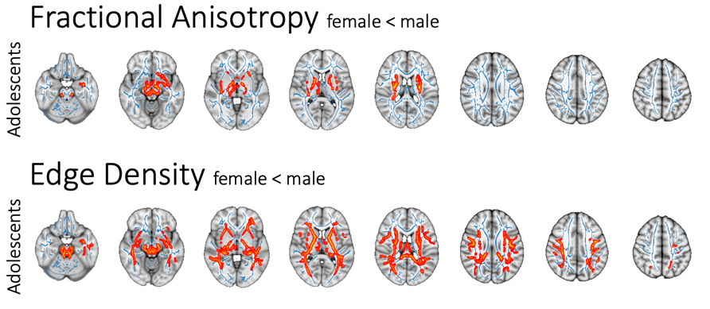
Sex-related Effects in Adolescents
Significant lower FA and ED in female vs male adolescents after controlling for age and ASD in General Linear Model
no significant changes in younger cohorts; adult cohort only included one female subject and could not be used for validation

Slide 8
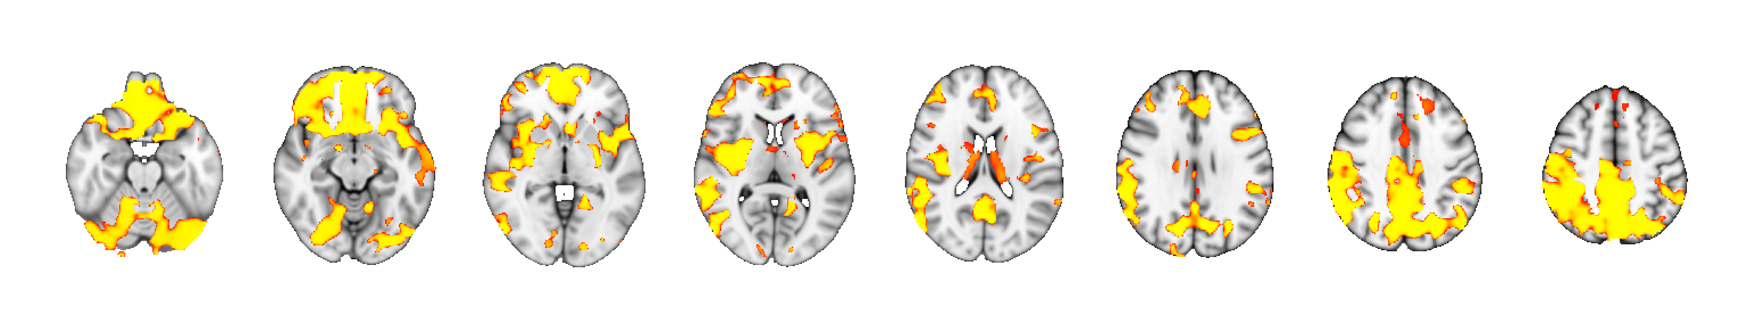
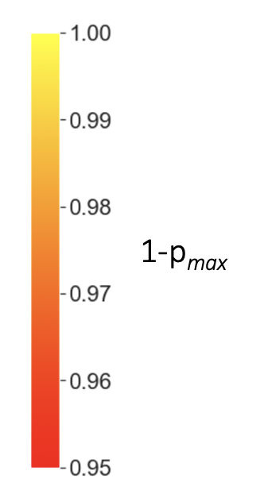
Voxel-Based Morphometry in Adults
Age-related Intensity Decrease
Interpretation as thinning of cerebral cortex with age
No significant influence of sex or ASD detectable
Analysis limited to adult cohort due to limited applicability of templates to younger cohorts

Slide 9
Summary
Autism-related changes in Diffusivity Metrics and Edge Density in Adolescents and Adults, but not Infants and Toddlers
Age-related changes in Diffusivity Metrics across all age groups, but only in Toddlers and Adolescents in Edge Density
Fractional Anisotropy and Edge Density Reduction in Female Adolescents
Cortical Thickness Decrease with Age, but no Influence of ASD or sex

Slide 10
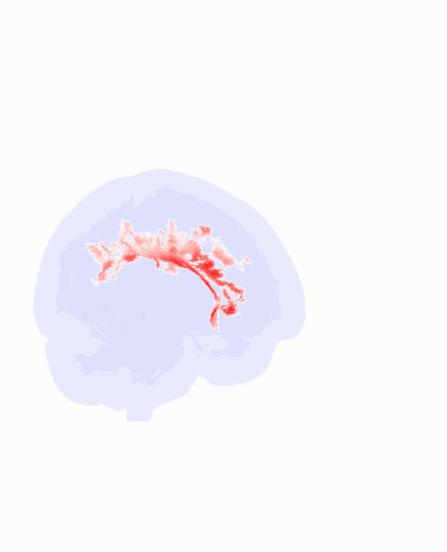
Thank you!
Presenter:
Clara F. Weber
Postgraduate Research Fellow
clara.weber@yale.edu
PI:
Sam Payabvash, MD
Assistant Professor of Radiology
sam.payabvash@yale.edu
Yale School of Medicine
Deparment of Radiology and Biomedical Imaging
Neuroradiology Section

