Slide 1
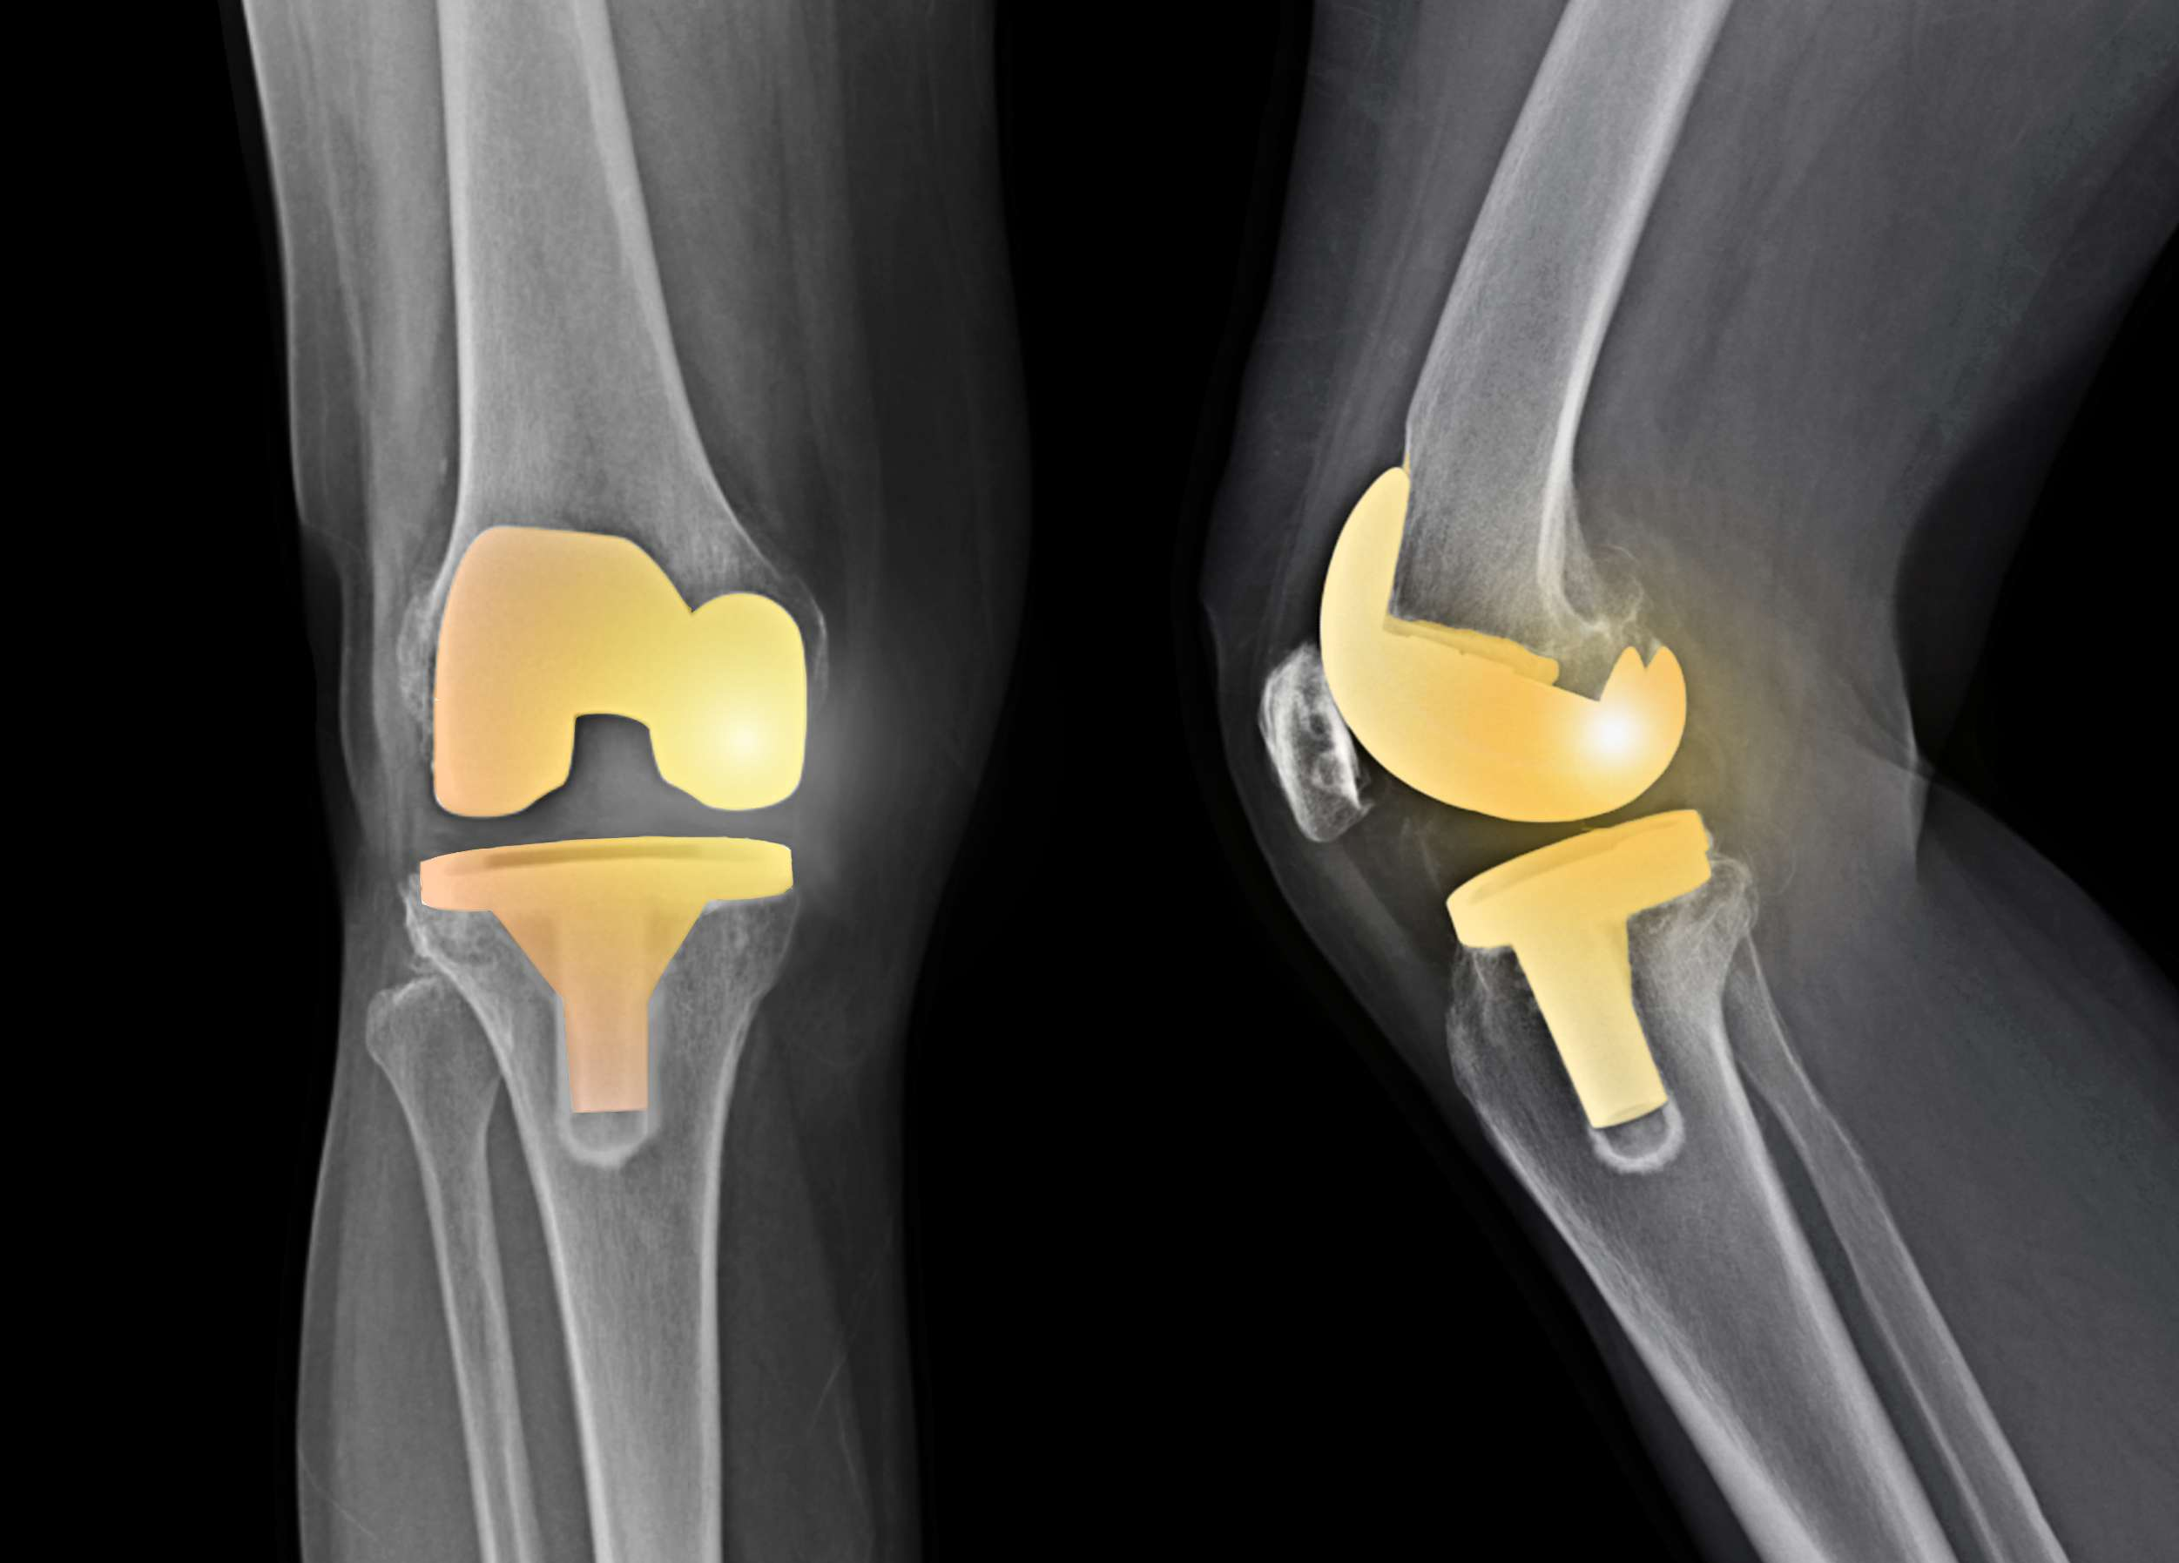

Management of Uncomplicated Total Knee Arthroplasty Chronic Pain and Stiffness Utilizing Cooled Radiofrequency Ablation: A single institution pilot study.
Felix M. Gonzalez¹, MD; Fiza M. Khan¹, DO; Mohammed F. Loya¹, MD; Zachary L. Bercu¹, MD; Nima Kokabi¹, MD; Andrew Tran, BS¹; Janice Newsome¹, MD; Nickolas B. Reimer², MD; Shervin Oskouei², MD, Mircea M. Cristescu¹ MD.
¹Department of Diagnostic and Interventional Radiology, Emory University School of Medicine, Atlanta, GA, USA
²Department of Orthopedic Surgery, Emory University School of Medicine, Atlanta, GA, USA
The authors of this scientific presentation have no relevant financial disclosures​

Slide 2
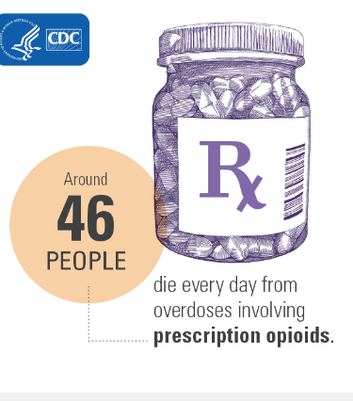
How BIG of a Problem are Chronic Pain and OA?
Drug Addiction and Opioid Abuse
From 1996 - 2016, more than 200,000 people died in the US from overdoses related to prescription opioids. Overdose deaths involving prescription opioids were 5x higher in 2016 than 1999. ^{4,5}
Prescription opioid drugs contribute to 40% of all US opioid overdose deaths.⁶
The US makes up 5 percent of the world’s population and consumes approximately 80 percent of the world’s prescription opioid drugs.⁷
4.Seth P, Scholl L, Rudd RA, Bacon S. Increases and Geographic Variations in Overdose Deaths Involving Opioids, Cocaine, and Psychostimulants with Abuse Potential – United States, 2015-2016. MMWR Morb Mortal Wkly Rep. ePub: 29 March 2018.
5. Seth P, Rudd RA, Noonan RK, Haegerich. Quantifying the Epidemic of Prescription Opioid Overdose Deaths. American Journal of Public Health 108, no. 4 (April 1, 2018): pp. 500-502.
6.“Prescription Opioid Overdose Data.” Centers for Disease Control and Prevention, August 1, 2017
7. Gusovsky, Dina. “Americans still lead the world in something: Use of highly addictive opioids.” CNBC, April 27, 2016.
Notes:
Many patients with chronic pain are prescribed pain killers….
These opioids are overprescribed in the US and has led to death

Slide 3
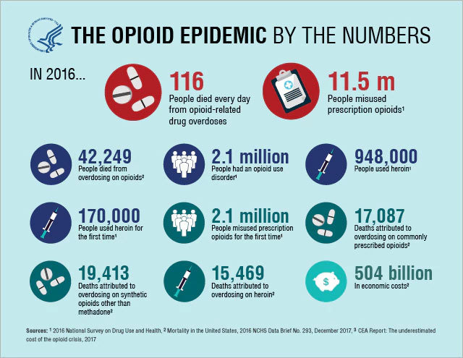

Slide 4
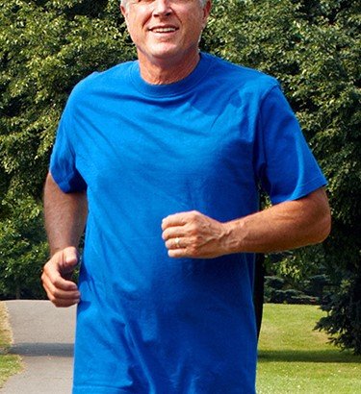

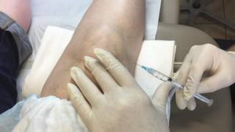
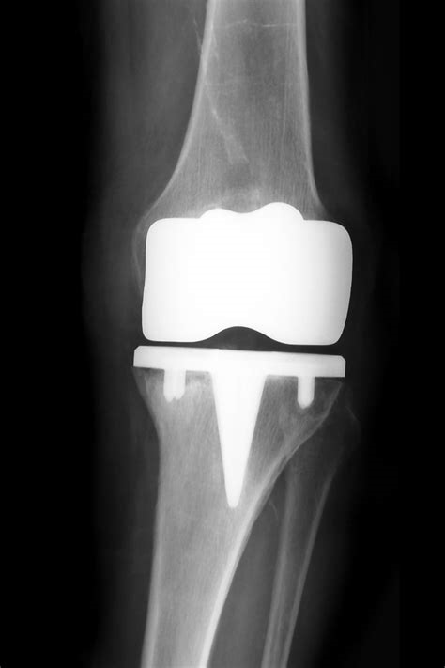

CURRENT TREATMENT ALGORITHM
Weight Loss/NSAIDs
PT
IA steroid/ Viscosupplementation
Knee Replacement
Knee and Hip patients suffer with Osteoarthritis an average of
9 YEARS
65 %
Have NOT had surgery
35 %
Have had surgery
Based on a survey of 811 patients with osteoarthritis of the knee and hip. SOURCE: OA Pain Landscape & Patient Journey: Research Results. KS&R, 2015. Page 11.

Slide 5

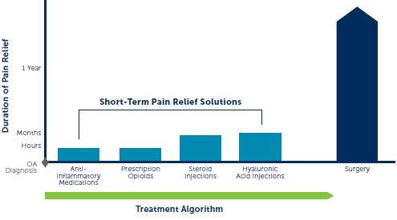
A gap in treatment options currently exists between short-term pain relief solutions and surgery
Notes:
<<< This image is from marketed material. >>>
The current treatment algorithm for knee pain includes NSAIDS, opioids, steroid injections and hyaluronic acid. These treatments are not long lasting and can have drawbacks. However, there are few long lasting treatment options for patients that are not yet ready for surgery either because they are putting it off for personal reasons or may have complications such as obesity or diabetes that do not make them good candidates for surgery. However, COOLIEF is a non-surgical, no-opioid treatment that lasts for up to a year.

Slide 6

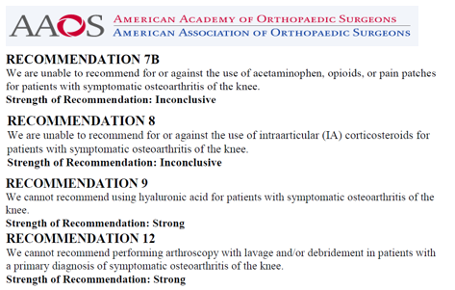
What are options for those with TKA contraindications or prior joint replacement?
Recommendation 7B
We are unable to recommend for or against the use of acetaminophen, opioids, or pain patches for patients with symptomatic osteoarthritis of the knee.
Recommendation: Inconclusive
Recommendation 8
We are unable to recommend for or against the use of intraarticular (IA) corticosteroids for patients with symptomatic osteoarthritis of the knee.
Recommendation: Inconclusive
Recommendation 9
We cannot recommend using hyaluronic acid for patients with symptomatic osteoarthritis of the knee.
Recommendation: Strong
Recommendation 12
We cannot recommend performing arthroscopy with lavage and/or debridement in patients with a primary diagnosis of symptomatic osteoarthritis of the knee.
Recommendation: Strong

Slide 7
GOAL: TO DISRUPT THE TRANSMISSION OF PAIN SIGNALS THROUGH NEUROLYSIS.
Neuroablation methods include: Thermal, physical, & chemical
Radiofrequency ablation uses electrical energy to cause frictional heating and cellular death
Utilized for ~30+ years in multiple areas of the body (cardiac, tumor, etc.), being applied to chronic pain
Thermal Ablation:
Standard Radiofrequency Ablation (SRFA)
Cooled Radiofrequency Ablation (CRFA)
Cryoablation uses the formation of ice crystals within cells to disrupt cell membranes & interrupt metabolism
Cooled Radiofrequency Ablation is NOT Cryoablation

Slide 8
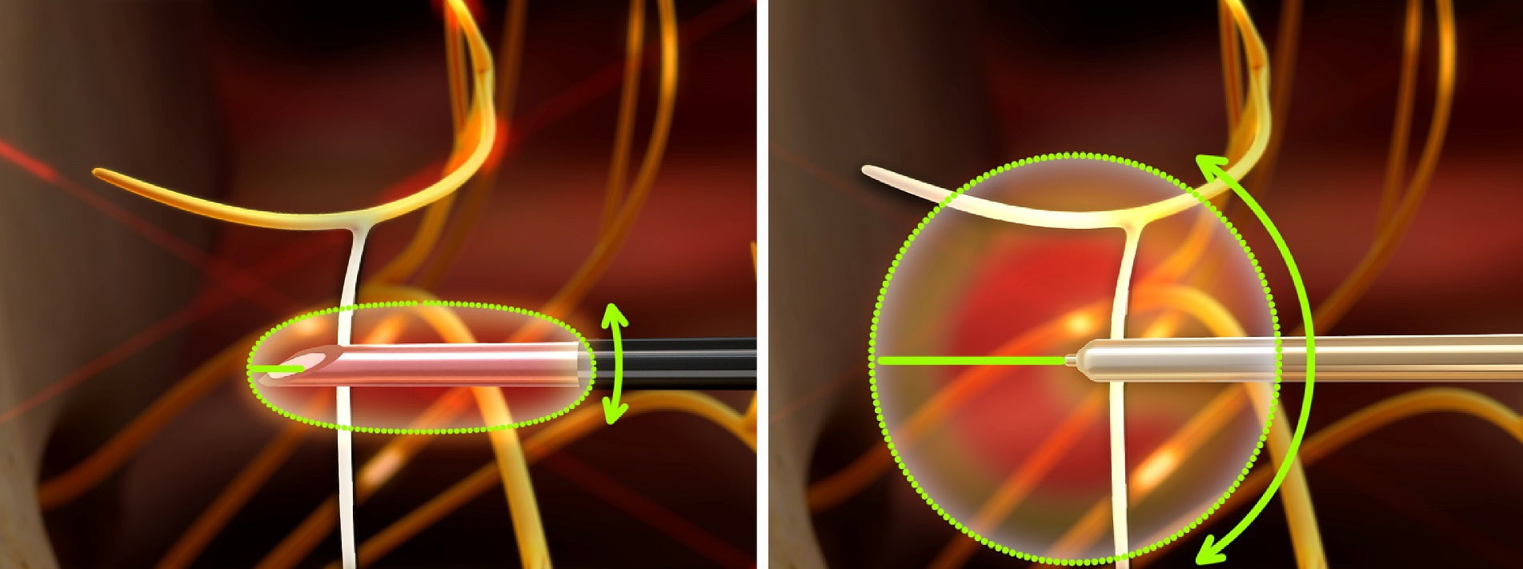
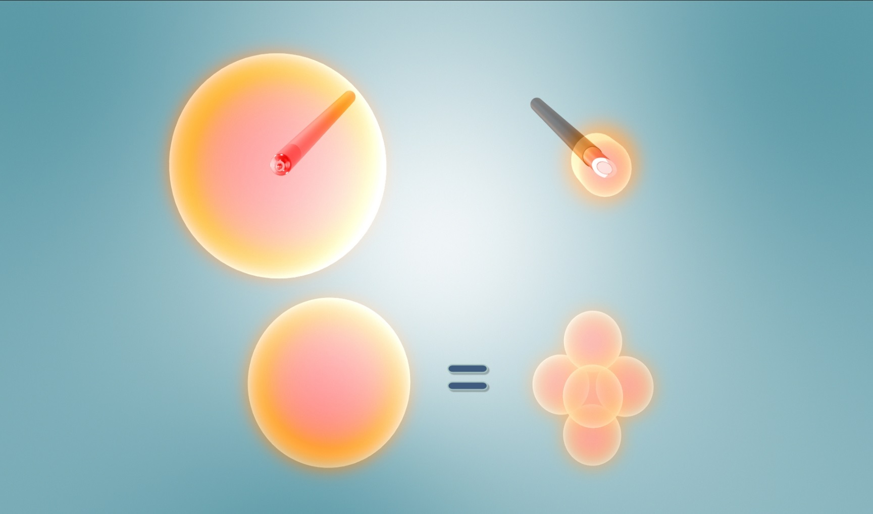
COOLED RF LESION PROPERTIES DIFFERENCES BETWEEN CRF AND CONVENTIONAL RF
Standard Radiofrequency Lesion
Cooled Radiofrequency Lesion
5 x Larger Lesion
Notes:
With Standard RF, compensating for nerve variabilities usually requires multiple lesions
Technologies requiring a parallel approach may reach target nerves, but are less likely to have a successful ablation when compared to the COOLIEF* Cooled RF technology and angle independent approach it provides.

Slide 9
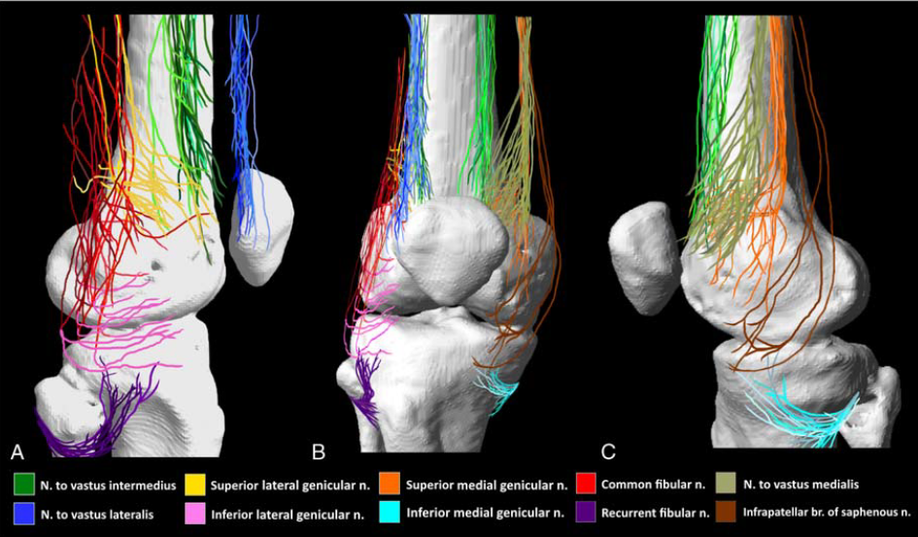
Why a Larger Lesion? - Nerve Variability
Anatomical Study of the Innervation of Anterior Knee Joint Capsule: Implication for Image-Guided Intervention.
Tran J Reg Anesth Pain Med. 2018 Mar 17. epub ahead of print epub ahead of print
Notes:
Need tran study reference

Slide 10
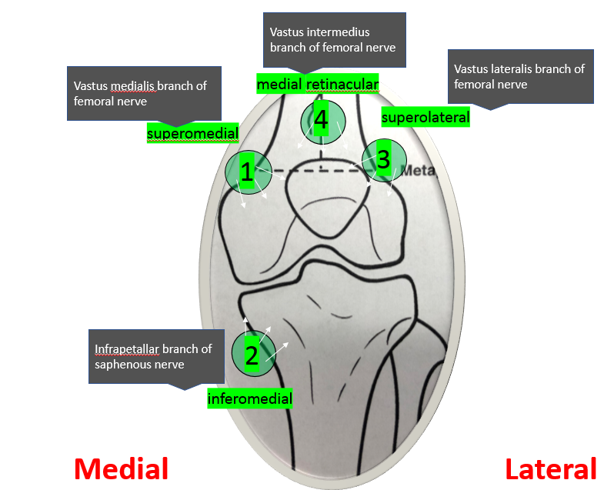
Genicular Neurotomy Targets

Slide 11
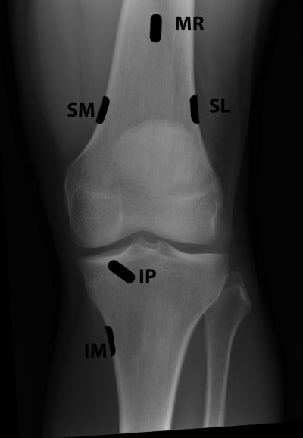
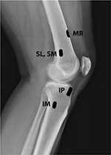
IM, inferomedial; IP, infrapatellar; MR, medial retinacular; SL, superolateral; SM, superomedial
Common Genicular Nerve Target Sites

Slide 12
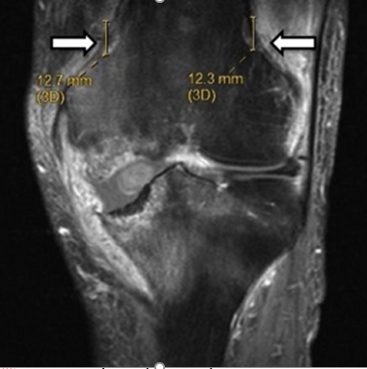
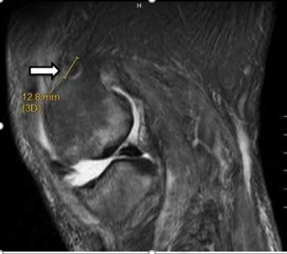
A Case Report: Demonstration of Lesions Produced by Cooled Radiofrequency Neurotomy for Chronic Osteoarthritic Knee Pain
This case provides the first in vivo images of the lesions created by cRF ablation and…offer a visual correlation for the success of cRF in the treatment of knee osteoarthritis…
Farrell ME, Gutierrez G, Desai MJ, Demonstration of Lesions Produced by Cooled Radiofrequency Neurotomy for Chronic Osteoarthritic Knee Pain: A Case Report, PM&R (2016), doi: 10.1016/j.pmrj.2016.09.001.

Slide 13
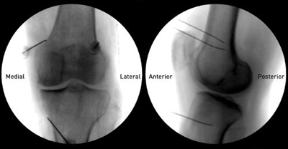
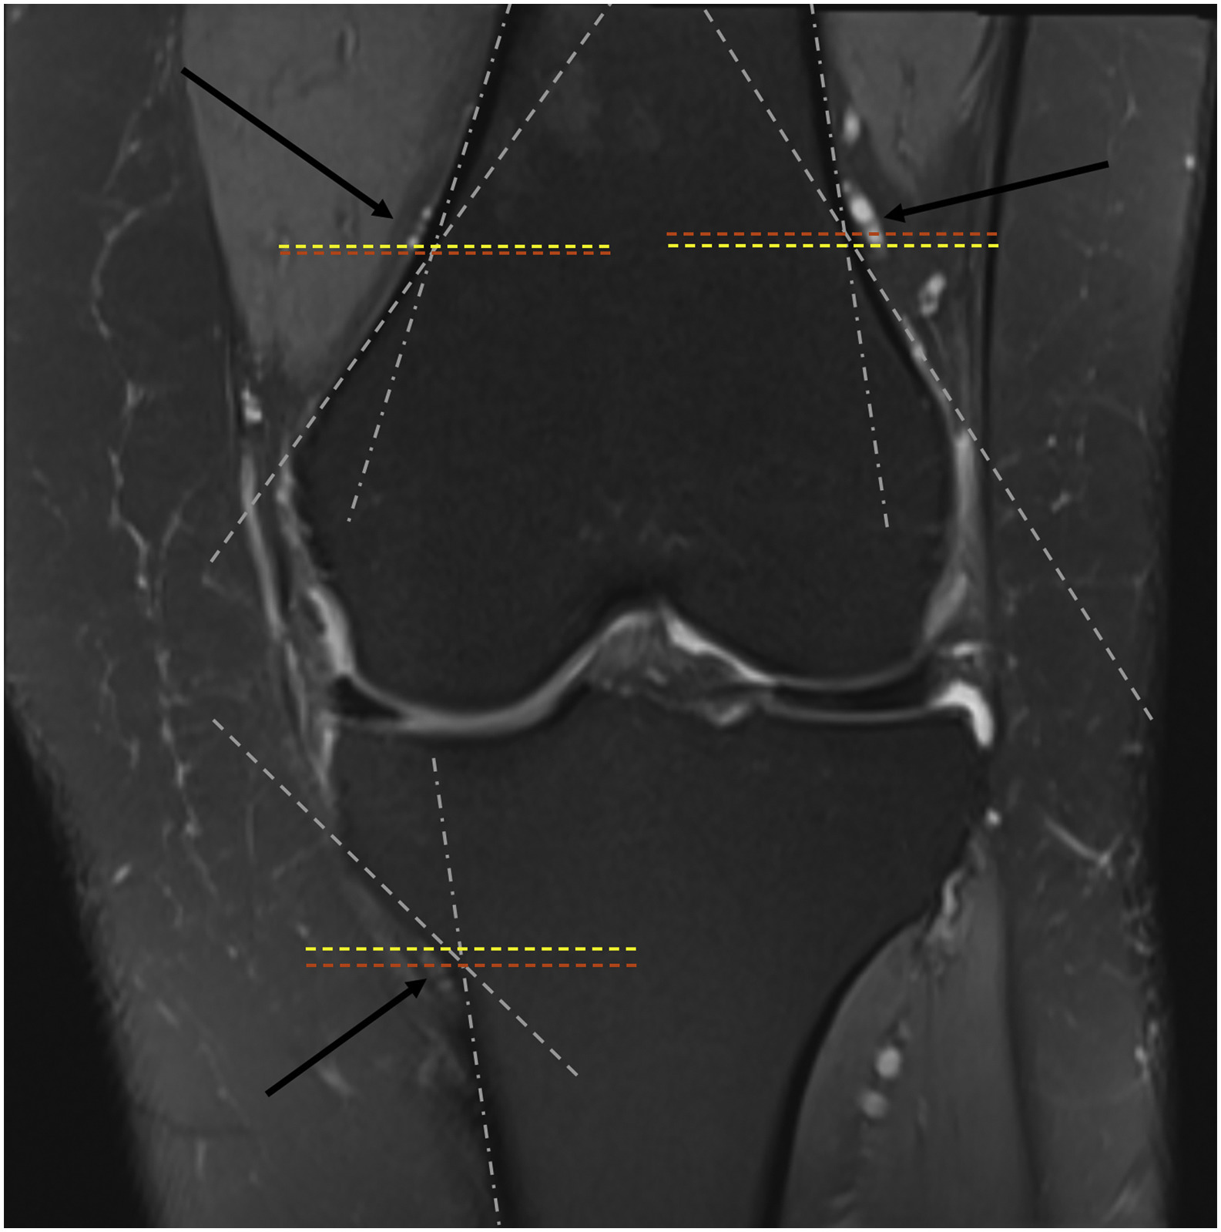

Expected Locations of the Genicular Nerves on Fluoroscopy
92% of SLGN, 88% of SMGN, and 100% IMGN lied exactly at or above the target point formed by a line parallel to the diaphysis and a separate line parallel to the metaphyseal flare along the cortical surface of femur and tibia
Clinical Imaging 2020 59, 78-83DOI: (10.1016/j.clinimag.2019.09.006)
Copyright © 2019 Elsevier Inc. Terms and Conditions
Notes:
The target of intersection marked by the dotted white lines; The neurovascular bundles marked by the black arrows. The orange dotted line is a parallel line drawn through the target intersection. The yellow dotted line is a parallel line drawn through the closest aspect (inferior for SLGN and SMGN and superior for IMGN) of the neurovascular bundles. (For interpretation of the references to color in this figure legend, the reader is referred to the web version of this article.)

Slide 14
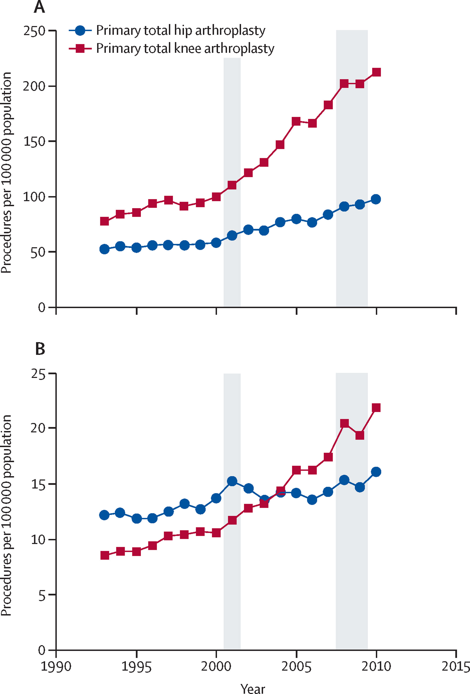
Total Joint Replacement
The main indication for surgery remains painful knee osteoarthritis with reduced function and quality of life.
Price AJ, Alvand A, Troelsen A, Katz JN, Hooper G, Gray A, Carr A, Beard D. Knee replacement. The Lancet. 2018 Nov 3;392(10158):1672-82.

Slide 15
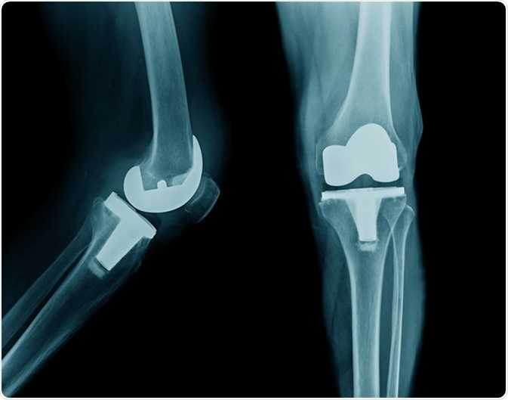
Total Knee Replacement Goals
Improves range of motion and ambulation
Reduce pain
Improves longevity

Slide 16

Total Knee arthroplasty (TKA) are the most common total joint procedure in United States with approximately 995,410 procedures performed over the last 7 years (1).
Approximately 20% of patients experience chronic pain after uncomplicated TKA (2).
Purpose of the study is to evaluate the efficacy, technical feasibility, and safety profile of image-guided cooled radiofrequency ablation (C-RFA) in the treatment of chronic pain and stiffness among patients with uncomplicated total knee arthroplasty.
Distribution of Arthroplasty Procedures, 2012-2019 (N=1,825,551)
Springer BD, Levine BR, Golladay GJ. Highlights of the 2020 American Joint Replacement Registry Annual Report. Arthroplast Today. 2021 Jun 21;9:141-142. doi: 10.1016/j.artd.2021.06.004. PMID: 34195318; PMCID: PMC8239429.
Wylde V, Beswick A, Bruce J, Blom A, Howells N, Gooberman-Hill R. Chronic pain after total knee arthroplasty. EFORT Open Rev. 2018;3(8):461-470. Published 2018 Aug 16. doi:10.1302/2058-5241.3.180004

Slide 17
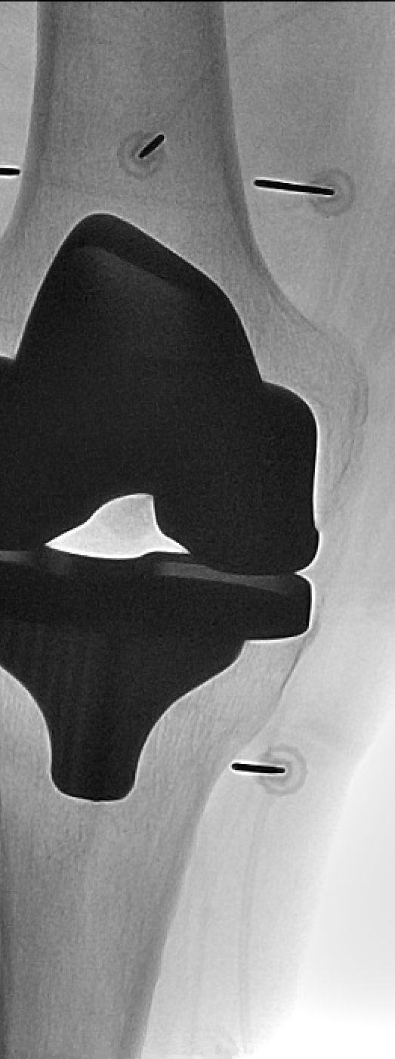
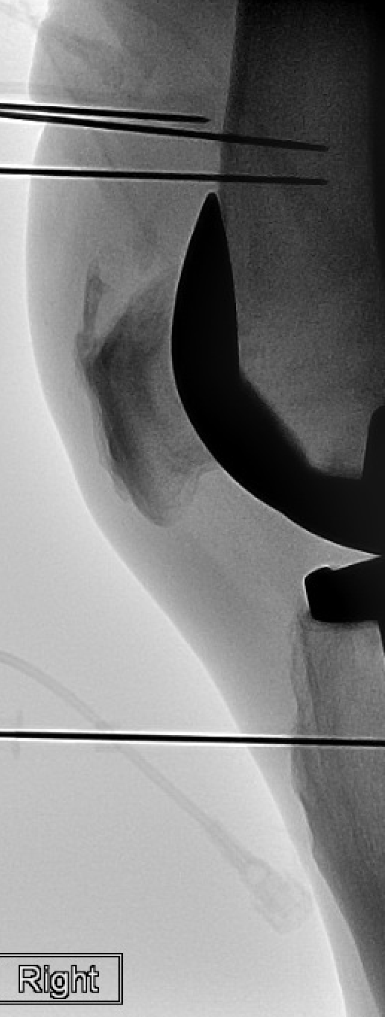
Methods and Material
Longitudinal-retrospective study conducted at a tertiary academic medical center between 2019 and 2020.
Inclusion criteria:
>65 years of age s/p TKA with persistent severe knee pain
No hardware complications such as infection or hardware loosening.

Slide 18
Methods and Material
All patients were referred to interventional MSK radiology after thorough evaluation by orthopedic surgery.
Patients initially underwent nerve blocks of the genicular nerve branches to determine C-RFA candidacy. If adequate response to the anesthetic blocks (>50% immediate pain relief), patients were subjected to C-RFA procedure 2-3 weeks later.

Slide 19
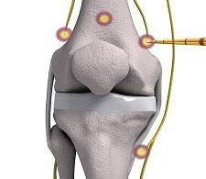
Study Design
Fluoroscopically Guided Diagnostic Lidocaine Induced Nerve blocks
22G 2.5 to 3.5 inch Whitacre spinal needles
1-2 cc of 1% lidocaine
Total procedure time of 15-20 mins`
Patient assessed within 15 mins of the nerve blocks by physical exam and ambulation
+ Response considered at least 50% pain reduction

Slide 20
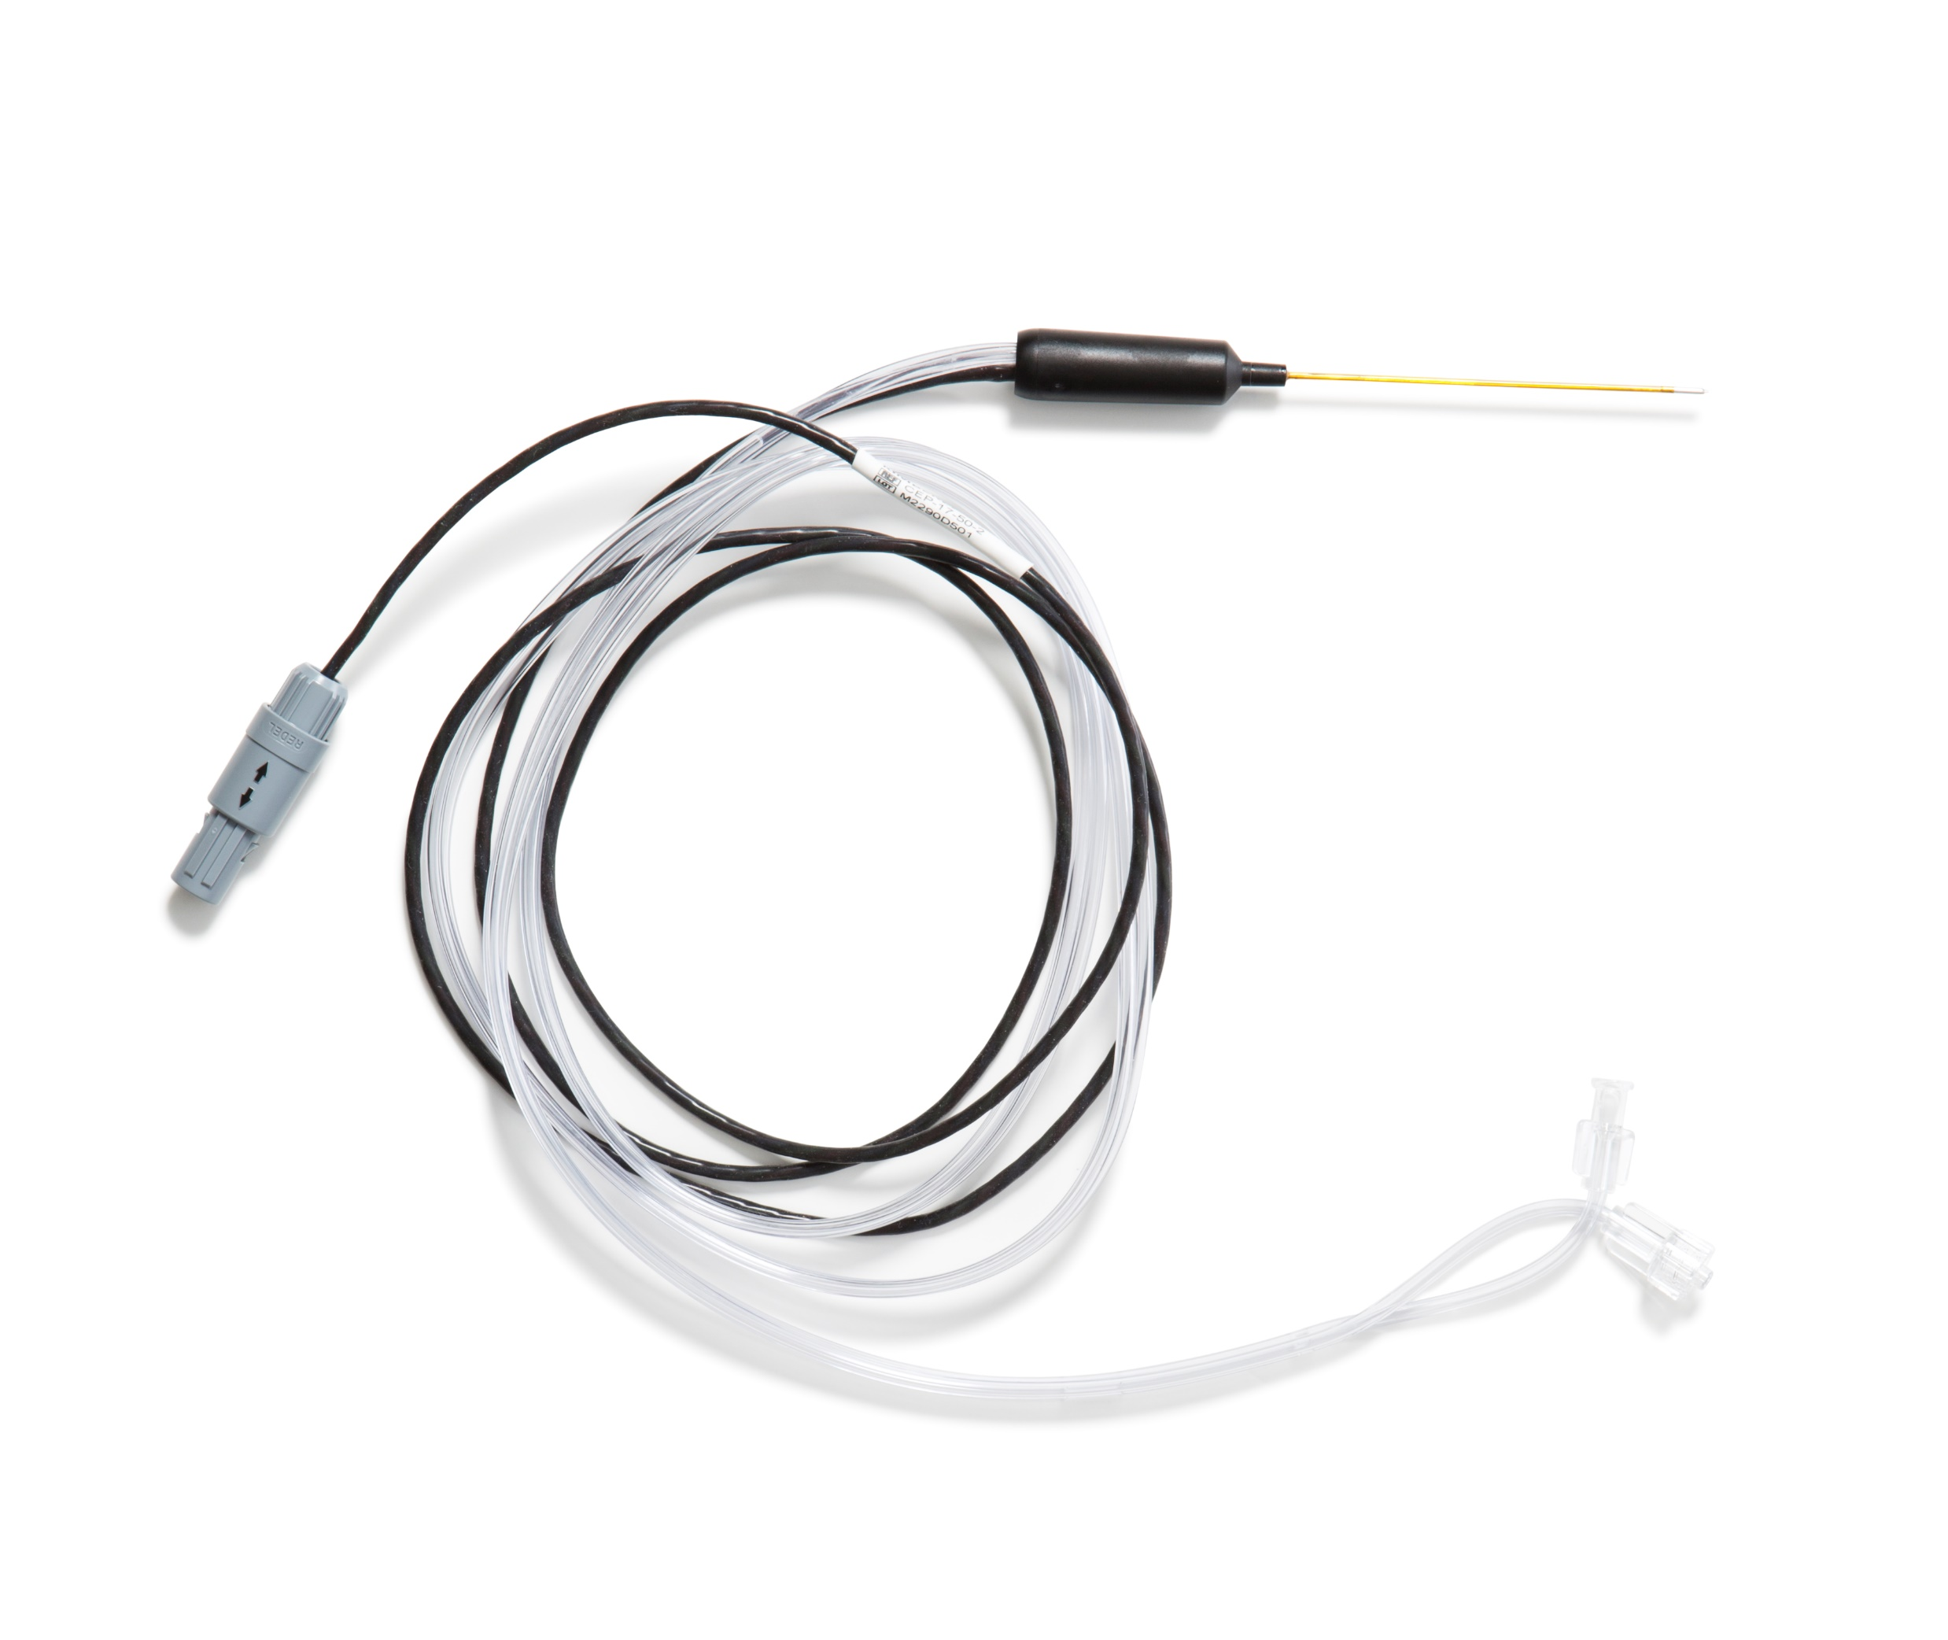
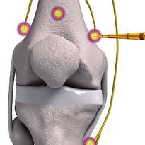
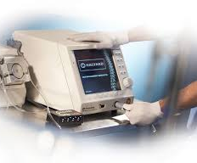
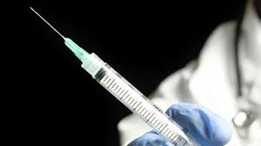
Technique
4 Needle Approach

Slide 21
Technique-Cooled RFA

Slide 22
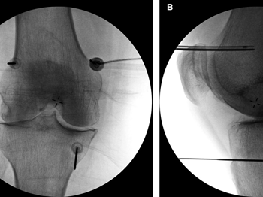
Technique
Once the introducer needle was placed, the 18G internally cooled, 4 mm active tip, RFA electrode (Coolief, Halyard Health, Alpharetta, GA, USA) was placed into the introducer needle, and positioning was verified with A-P and lateral fluoroscopic views.
After motor nerve activity was ruled out with testing at 2 Hertz at 1 mA, 1 mL of 2% lidocaine was injected through the introducer needles to anesthetize the region prior to thermal ablation.

Slide 23
Technique
Conscious sedation (midazolam 1–2 mg IV and/or fentanyl 25–100 mcg IV) and supplemental nasal cannula oxygen were administered.
Skin and soft tissues were anesthetized with 1 to 2 mL of 1% lidocaine at each of the four anatomic sites for RFA.
50-150 mm 17G introducer needle was placed to lesion the superior lateral, superior medial, inferior medial and suprapatellar genicular nerves.

Slide 24

Technique
Each target was sequentially lesioned for two minutes and 30 seconds at a set temperature of 60°C, which imparts a tissue temperature of 77° to 80°C surrounding the electrode.

Slide 25
Anesthetic Genicular Nerve Blocks
IF ≥50% pain reduction
Cooled Radiofrequency Ablation
Followed Patients with clinically validated surveys for knee pain and performance
1-2 wks later

Slide 26


Data Collection
Standardized telephone surveys were conducted 1 year after C-RFA procedure.
Pre and post C-RFA analgesic requirement, Knee injury and Osteoarthritis Outcome Score (KOOS), Western Ontario and McMaster Universities Osteoarthritis Index (WOMAC), complications and Visual Analog Score (VAS) were collected.
KOOS and WOMAC questionnaires structured to evaluate overall pain and function. They are composed of subscales including pain, function in daily living, function in sports and recreation, and quality of life. VAS score is a single item pain scale.

Slide 27
Demographic Data
Gender
Age​
Mean (SD)​ | 70.7 (5.13)​
Median [Min, Max]​ | 70.0 [60.0, 80.0]​
BMI​
Mean (SD)​ | 34.5 (4.33)​
Median [Min, Max]​ | 35.0 [25.0, 40.7]​
n=6 (30%)
n=14 (70%)
Female
Male

Slide 28
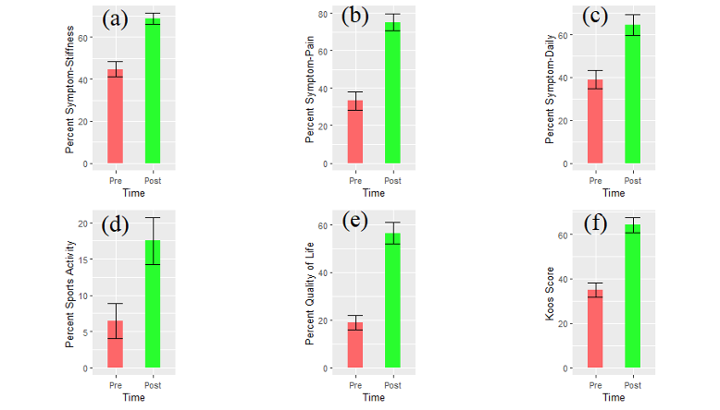
KOOS Score
**Median [Min, Max])**
Percent Symptom-Stiffness
Percent Symptom-Stiffness
Percent Symptom-Pain
Percent Symptom-Daily
Pre Post
Time
Pre Post
Time
Pre Post
Time
Pre: 43.0 [17.9, 82.1]
Post: 66.0 [54.0, 93.0]
p-value < 0.0001​
Pre: 28.6 [7.50, 69.4]​
Post: 78.5 [28.0, 100]​
p-value < 0.0001​
Pre: 36.2 [2.90, 76.5]
Post: 72.0 [12.0, 89.0]
p-value < 0.0001​

Slide 29
KOOS Score
**Median [Min, Max])**
Percent Sports Activity
Percent Quality of Life
Overall KOOS Score
Pre Post
Time
Pre Post
Time
Pre Post
Time
Pre: 0 [0, 40.0]
Post: 15.0 [0, 50.0]
p-value < 0.0004
Pre: 18.1 [0, 43.8]
Post: 63.0 [13.0, 88.0]
p-value < 0.0001​
Pre: 31.3 [7.70, 63.7]
Post: 67.1 [29.2, 81.1]
p-value < 0.0001​

Slide 30
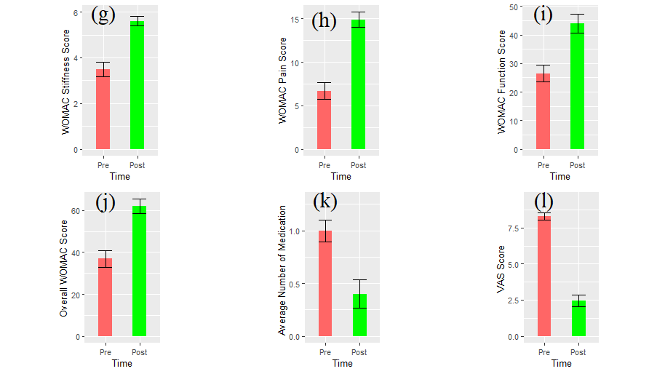
WOMAC Score
**Median [Min, Max])**
WOMAC Stiffness Score
WOMAC Pain Score
WOMAC Function Score
Overall WOMAC Score
Pre Post
Time
Pre Post
Time
Pre Post
Time
Pre Post
Time
Pre: 3.00 [1.00, 7.00]
Post: 5.00 [4.00, 7.00]
p-value < 0.0001​
Pre: 5.70 [1.50, 13.9]
Post: 15.7 [5.60, 20.0]
p-value < 0.0001​
Pre: 24.6 [2.00, 52.0]
Post: 48.9 [8.00, 60.3]
p-value< 0.0001​
Pre: 34.0 [5.10, 70.8]
Post: 62.3 [20.9, 85.4]
p-value < 0.0001​

Slide 31
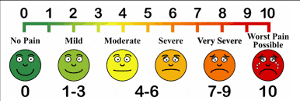
VAS Score
VAS Score
Pre: 8.00 [6.00, 10.0]
Post: 2.50 [0, 7.00]
p value < 0.0001
Pre Post
Time
**Median [Min, Max])**

Slide 32
Impact on Pain Medication Usage: Non-opioid Analgesic and opioid group.
Number of people
Number of people
Number of people
Pre-treatment
Post-treatment
Non-opioid analgesics (NSAID and Acetaminophen) Opioid (Hydrocodone, tramadol, Lortab, and Oxycontin)

Slide 33
Conclusion
TKA is the most performed total joint procedure in the United States
20% of patients after uncomplicated TKA develop chronic pain
Our single institution study demonstrates image-guided genicular nerve cooled radiofrequency ablation is a safe and efficacious novel alternative in treating chronic pain/stiffness in the setting of uncomplicated TKA
VAS score decrease from 8.0 to 2.5 (p<0.0001)
WOMAC score increase from 34.0 to 62.3 (p<0.0001)
KOOS score increase from 31.3 to 67.1(p<0.0001)
Decrease usage of opioid and non-opioid pain medication, with 12/18 (67%) patients discontinuing analgesic and opiates following ablation
No post procedural complications were encountered

Slide 34

For Questions: felix.m.Gonzalez@emory.edu

