Slide 1

Prediction of Heart Attack and Stroke in Nonhospitalized Adults Using a Fully Automated and Normalized Deep Learning Body Composition Analysis of Routine Abdominal CT
Kirti Magudia, MD PhD; Christopher P. Bridge, D Phil; Camden Bay, PhD; Florian J. Fintelmann, MD; Ana Babic, PhD; Katherine P Andriole, MD PhD; Brian Wolpin, MD MPH; Michael Rosenthal, MD PhD

Slide 2
Disclosures
Nothing to disclose

Slide 3
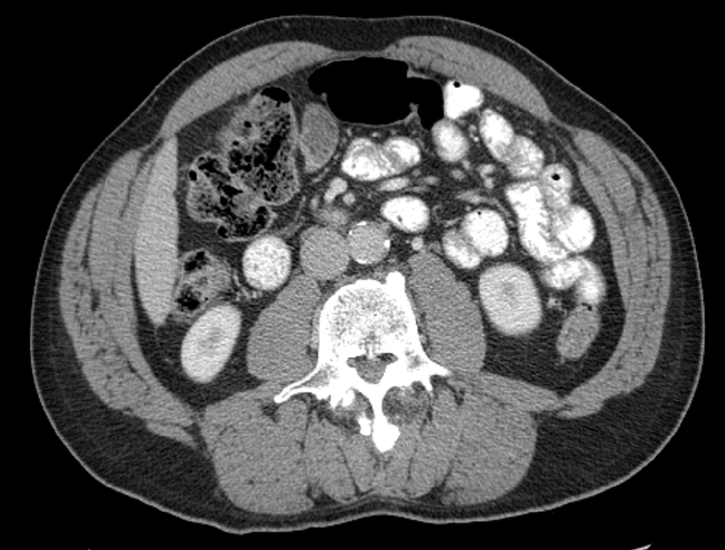
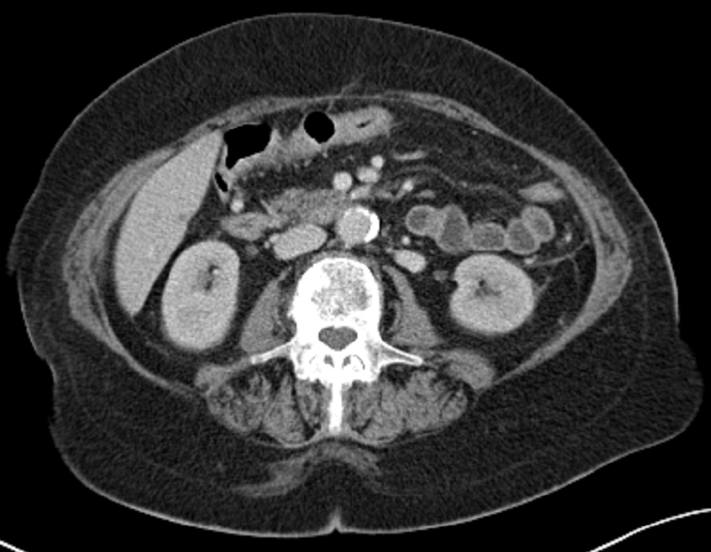
Body Composition: BMI
Body mass index (BMI) is associated with how long you live and your risk of heart attack and stroke
Two patients with identical BMI but different ratios of fat to muscle

Slide 4
Body Composition: Significance
Subcutaneous Fat
Skeletal
Muscle
Visceral
Fat
Cardiovascular disease
Cancer:
Risk and prognosis as well as side effects from chemotherapy

Slide 5
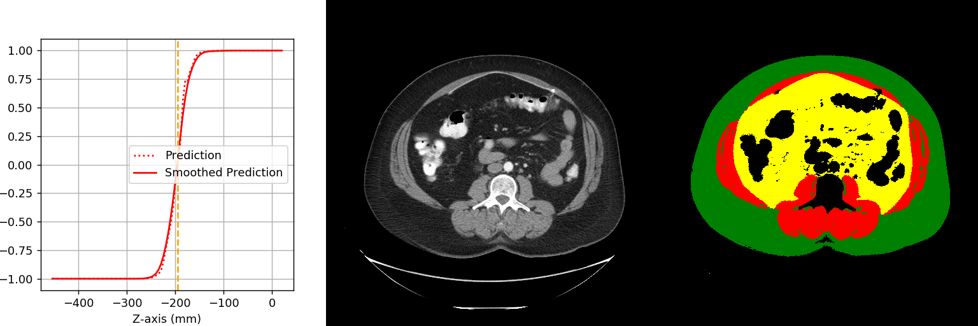
Body Composition: Prior Technique
Analysis of single CT slice at the level of the third lumbar vertebral body
Calculate areas
Subcutaneous fat
Visceral fat
Skeletal muscle
Can be done manually, but time intensive and costly, limiting application
Original CT image
Body composition segmentation

Slide 6
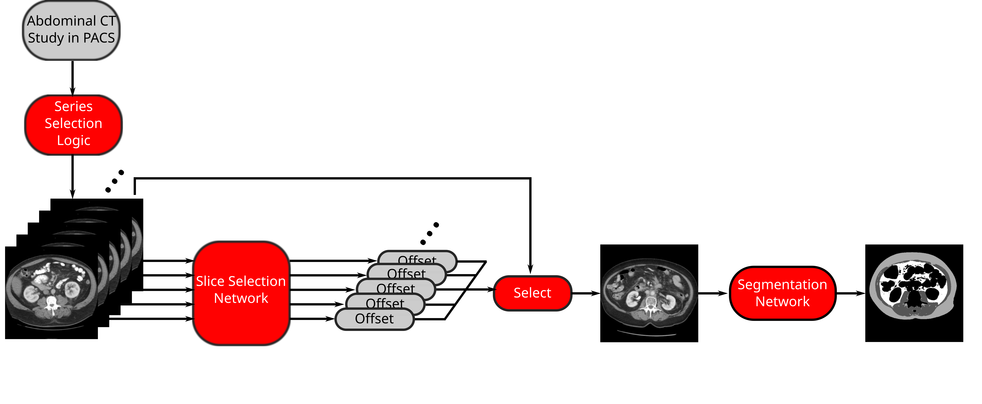
Fully Automated Body Composition Analysis Using Deep Learning
Magudia et al. Radiology (in press)

Slide 7
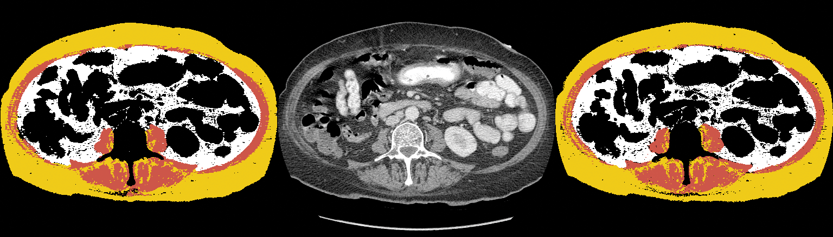

Validation of Automated Analysis
Model segmentation
Input CT slice
Radiologist segmentation
R=0.99 for all body compartments
Magudia et al. Radiology (in press)

Slide 8
Study Aims
Determine body composition areas for all outpatients undergoing abdominal CT exams at Partners in 2012 using automated method (final N=12,128)
Subjects with major cardiovascular disease or cancer were excluded
Normalize body composition data using race-, sex- and age- specific reference curves to determine z-scores
Determine association between body composition z-scores and subsequent heart attack and stroke

Slide 9
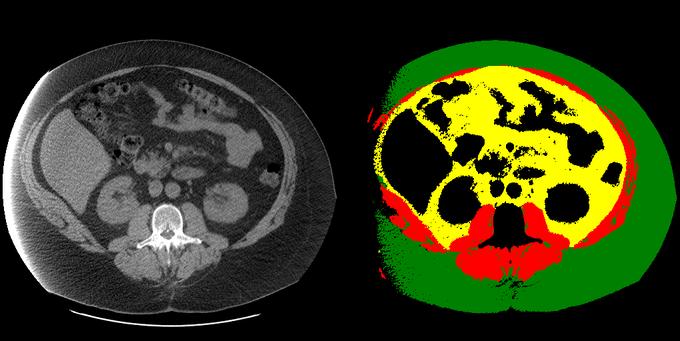
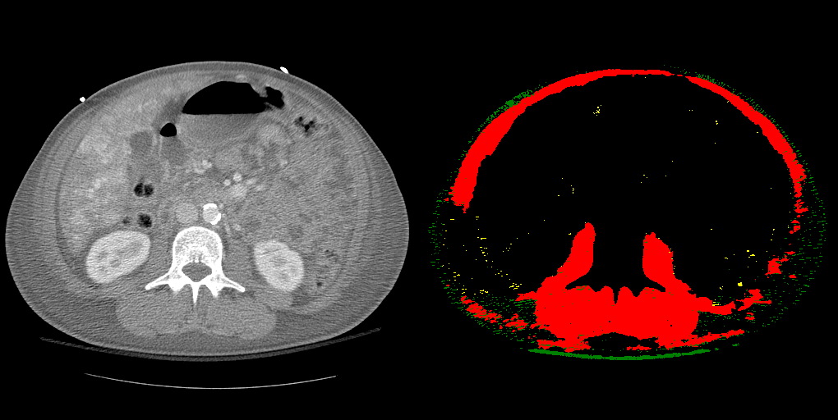
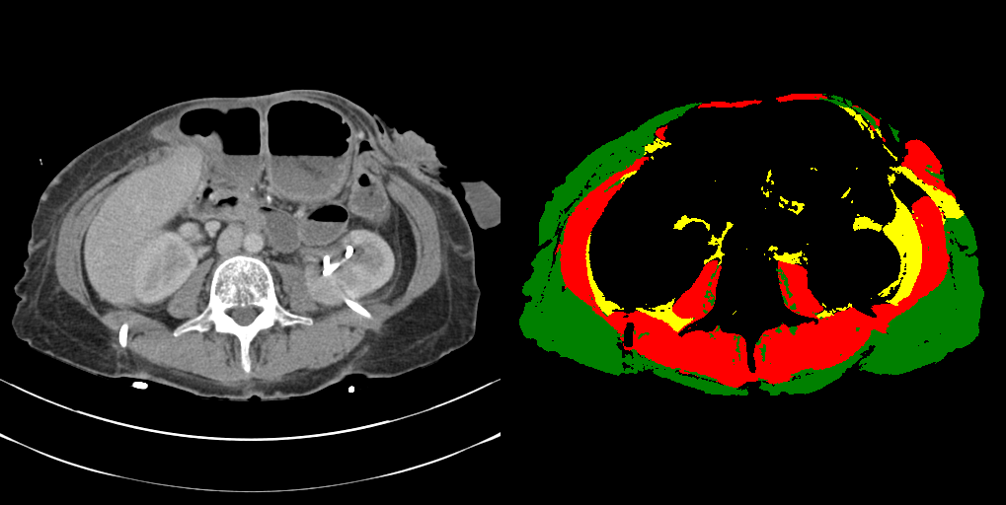
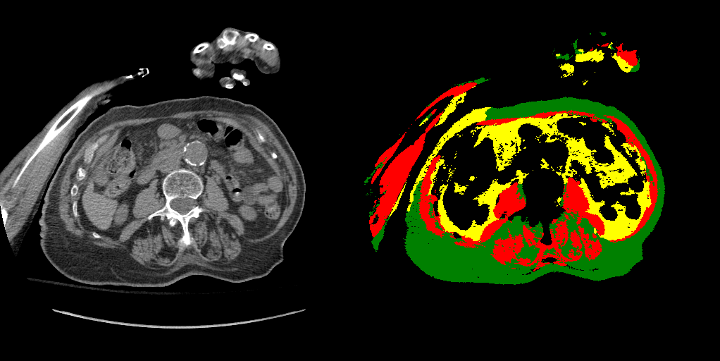
Body Composition Analysis: QA and Failure Analysis
Extremely low 2.5% failure rate
Notes:
2.0% of cases were manually reviewed
2.5% failure rate
segmentation deviates significantly from what manual segmentation would determine

Slide 10
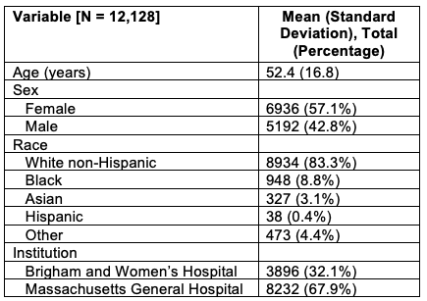
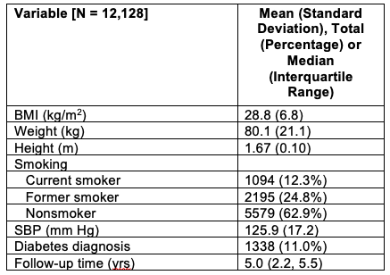
Patient Characteristics

Slide 11
Reference Curves
Specific to age, race and sex
Superior to inferior percentile lines:
97th (red)
95th (orange)
90th (yellow)
75th (green)
50th (black)
25th (purple)
10th (pink)
5th (cyan)
3rd (blue)
Magudia et al. Radiology (in press)

Slide 12
Statistical Analysis
Calculate z-scores for all patients in cohort
Divide patients into 4 quartiles for each body composition parameter
Analysis for occurrence of heart attack or stroke
Each body composition area alone
Multivariate with all body composition areas, weight, height and CV risk factors (smoking status, diabetes diagnosis and systolic BP)

Slide 13
Heart Attack and Visceral Fat Area
Quartile 4
Quartile 3
Quartile 2
Quartile 1
Univariate p<0.0001
Multivariate p=0.04
Notes:
Similar analysis with outperforming of weight

Slide 14
Stroke and Visceral Fat Area
Quartile 4
Quartile 3
Quartile 2
Quartile 1
Univariate p<0.0001
Multivariate p=0.04

Slide 15
Conclusions
Fully automated and normalized body composition analysis can be applied to large scale research projects with a low failure rate (2.5%)
Normalized visceral fat area are associated with subsequent heart attack and stroke

Slide 16
Acknowledgements
Lustgarten Foundation
Stand Up to Cancer Foundation
Hale Family Center for Pancreatic Cancer at Dana-Farber
MGH-BWH Center for Clinical Data Science
NIH/NCI U01 CA210171, NIBIB T32EB001631
Radiological Society of North America
Society of Abdominal Radiology

Slide 17
References
Berrington de Gonzalez A, Hartge P, Cerhan JR, et al. Body-Mass Index and Mortality among 1.46 Million White Adults. 2010;23(2).
Heymsfield SB, Peterson CM, Thomas DM, Heo M, Schuna JM. Why are there race/ethnic differences in adult body mass index-adiposity relationships? A quantitative critical review. Obes Rev. 2016;17(3):262–275.
Prentice AM, Jebb SA. Beyond body mass index. Obes Rev. Blackwell Science Ltd; 2001;2(3):141–147.
Shen W, Punyanitya M, Wang Z, et al. Total body skeletal muscle and adipose tissue volumes: estimation from a single abdominal cross-sectional image. J Appl Physiol. 2004;97:2333–2338.
Shen W, Punyanitya M, Wang Z, et al. Visceral adipose tissue: Relations between single-slice areas and total volume. Am J Clin Nutr. 2004;80(2):271–278.
Prado CM, Birdsell LA, Baracos VE. The emerging role of computerized tomography in assessing cancer cachexia. Curr Opin Support Palliat Care. 2009;3(4):269–275.
Prado CM, Lieffers JR, McCargar LJ, et al. Prevalence and clinical implications of sarcopenic obesity in patients with solid tumours of the respiratory and gastrointestinal tracts: a population-based study. Lancet Oncol. 2008;9(7):629–635.
Abate N, Garg A, Peshock RM, Stray-Gundersen J, Grundy SM. Relationships of generalized and regional adiposity to insulin sensitivity in men. J Clin Invest. 1995;96(1):88–98.
Goodpaster BH, Thaete FL, Simoneau J-A, Kelley DE. Subcutaneous Abdominal Fat and Thigh Muscle Composition Predict Insulin Sensitivity Independently of Visceral Fat. Diabetes. 1997;46(1579–1585).
Matsushita Y, Nakagawa T, Yamamoto S, et al. Adiponectin and visceral fat associate with cardiovascular risk factors. Obesity. 2014;22(1):287–291.
Neeland IJ, Gupta S, Ayers CR, et al. Relation of Regional Fat Distribution to Left Ventricular Structure and Function. Circ Cardiovasc Imaging. 2013;6(5):800–807.
Abbasi SA, Hundley WG, Bluemke DA, et al. Visceral adiposity and left ventricular remodeling: The Multi-Ethnic Study of Atherosclerosis. Nutr Metab Cardiovasc Dis. 2015;25:667–676.
Martin L, Birdsell L, MacDonald N, et al. Cancer cachexia in the age of obesity: Skeletal muscle depletion is a powerful prognostic factor, independent of body mass index. J Clin Oncol. 2013;31(12):1539–1547.
Prado CMM, Baracos VE, Mccargar LJ, et al. Sarcopenia as a Determinant of Chemotherapy Toxicity and Time to Tumor Progression in Metastatic Breast Cancer Patients Receiving Capecitabine Treatment. Clin cancer Res. 2009;15(8):2920–2926.
Hopkins JJ, Sawyer MB. A review of body composition and pharmacokinetics in oncology. Expert Rev Clin Pharmacol. Taylor & Francis; 2017;10(9):947–956.
Prado CMM, Baracos VE, McCargar LJ, et al. Body composition as an independent determinant of 5-fluorouracil-based chemotherapy toxicity. Clin Cancer Res. American Association for Cancer Research; 2007;13(11):3264–3268.
Kyrgiou M, Kalliala I, Markozannes G, et al. Adiposity and cancer at major anatomical sites: umbrella review of the literature. Br Med J. 2017;356356.
Bridge CP, Rosenthal M, Wright B, et al. Fully-Automated Analysis of Body Composition from CT in Cancer Patients Using Convolutional Neural Networks. MICCAI Clip workshop. 2018;

Slide 18
Thank you for your attention
kirti.magudia@ucsf.edu

