Slide 1
Correlation Between Imaging and Environmental Factors in a Population of Cooks Using Biomass Fuels in Rural India
A.S. Kizhakke Puliyakote et al.
Prepared for the press release for the Radiological Society of North America (RSNA)

Slide 2
Biomass prevalence
Over 3 Billion people cook with biomass fuels (wood and animal byproducts), many indoors with poor ventilation
Worldwide, exposure to biomass smoke from cooking is associated with millions of premature deaths due to lung disease annually
In the developing world, women are at higher risk of exposure as the primary cooks in rural environments
In spite of these associations, the lung changes occurring due to biomass smoke are not well known.

Slide 3
Our Approach
Combine real-time assessment of the cooking environment with lung function measurements
Use traditional lung function tests such as spirometry, and add more sensitive measures from computed tomographic (CT) imaging
CT imaging is more sensitive to regional changes in lung structure and function, before it manifests in noticeable or progressing symptoms
Apply our tests, along with an environmental home assessment, to volunteers in India who cook with biomass and compare to a smaller group in the same geographical neighborhood, who cook with cleaner fuels like liquified petroleum gas (LPG).

Slide 4
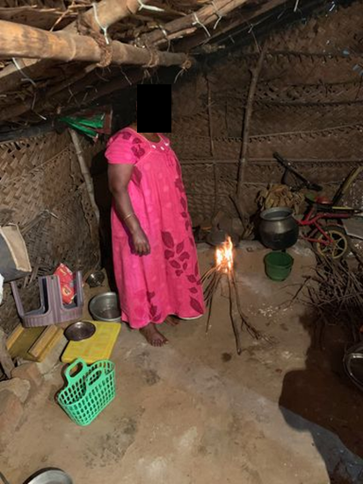
Our Field Site in India
Villages of Budalur and Vallam
(show in map inset)
Associated with the city of Thanjavur, in the state of Tamil Nadu.
(Chennai is the capital of Tamil Nadu shown as a smaller red square in the northern part of the state)
Photo shows the home of one of our subjects cooking with biomass. The kitchen area overlaps with the living and sleeping quarters all displayed here.

Slide 5
Environmental Assessment
We measured concentrations of
Particle matter <2.5μm (PM_{2.5})
(daily and weekly)
Black carbon
Endotoxin
Total deposited matter in rugs
(near the cooking stove)
A. Real-time (PATS+) and gravimetric (UPAS) PM2.5 devices B. Representative BM kitchen – collocated devices placed within cooks’ approximate breathing zone, yellow arrows C. Passive electrostatic dust collector, (EDC) used for Endotoxin measurement D. Field EDC deployment, yellow arrow

Slide 6
Lung Function Assessment
Pulmonary function testing (Spirometry)
– before and after bronchodilator use
CT imaging
- At full inspiration (total lung capacity, TLC)
- At full expiration (residual volume, RV)
In-vitro cell studies using particulate matter collected from homes

Slide 7
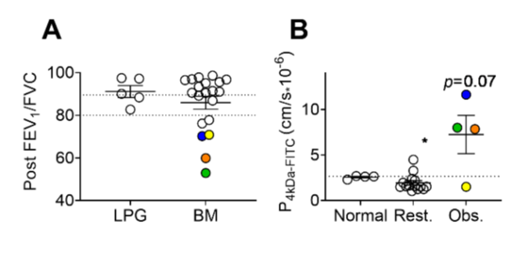
Results
Cooks using biomass (BM) had greater variability in lung function
Particles collected from BM homes (particularly from those identified as obstructive) resulted in greater changes to cell permeability (from in-vitro cell studies)
A. Post-bronchodilator LPG and BM PFTs – values >90 and <80 indicate respiratory restriction and obstruction, respectively, colored dots indicate BM cooks with obstruction. B. In-vitro cell permeability after exposure to particles from each home. Dotted line=control, *p≤0.05

Slide 8
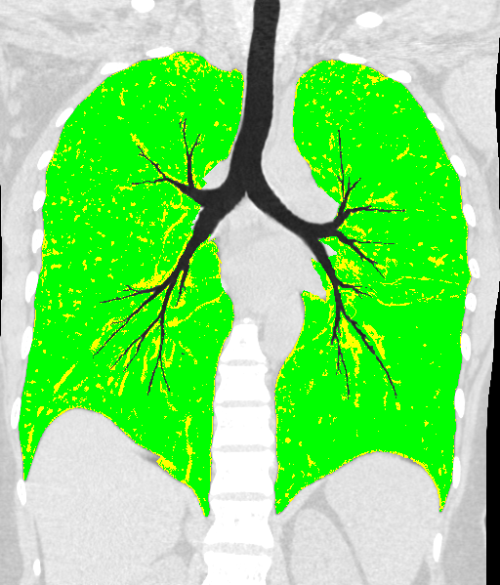
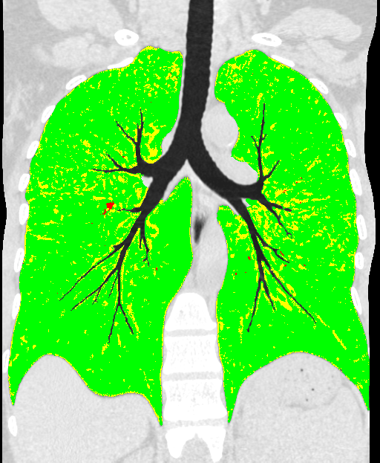
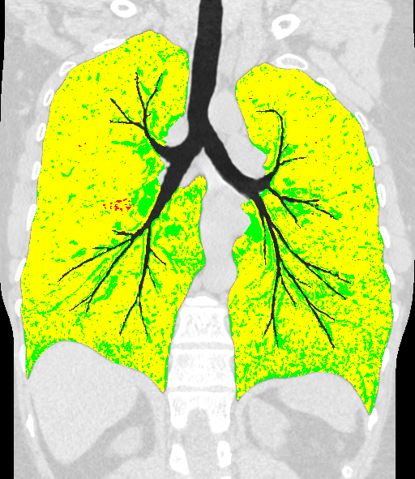
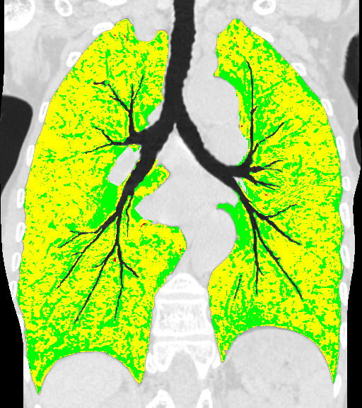
Imaging Regional Lung Fuction
LPG
14
20
Lung volume change between inspiration and expiration was reduced in BM cooks
Through image matching between full inspiration and full expiration, we assess regional lung function.
Air-Trapping (lung regions that do not efficiently exchange air with the environment) was significantly increased in BM cooks, but also very variable.
Biomass
10
22
Labeled Maps showing extent of abnormalities assessed via image-registration (Disease Probability Measures, DPM, VIDA Diagnostics). Lower Row: two representative BM-cooks. Upper Row: LPG cooks. Regions in yellow, and green represent air-trapping, and normal respectively. Note: Air-trapping is highly prevalent among BM-cooks.

Slide 9
Imaging
Airways are warped so as to appear in a single plane with associated lung features (Hyperion View - VIDA Diagnostics, Coralville, Iowa).
Hyperion view (top row) and 3D airway tree reconstruction (bottom) of inspiratory/expiratory images from one BM subject (A,B) and one LPG subject (C,D).
Inspiratory-Expiratory volume difference is 25% (BM) and 65% (LPG).

Slide 10
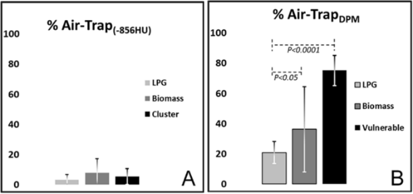
Air-Trapping
Traditional measures of air-trapping rely on a counting lung below a fixed density measurement and may be influenced by the presence of inflammation which increases local lung density.
The image-registration based approach used here is less influenced by density shifts
Air-Trapping correlated to concentrations of PM_{2.5}, endotoxins, and metals (Chromium, Radium, Sulphur, Rubidium)
Air-Trapping estimated using the density threshold method (A) and image registration-based method, the disease probability map (B). Due to increased lung density from diffuse inflammation, the threshold-based assessment severely underestimates the extent of lung air trapping.

Slide 11
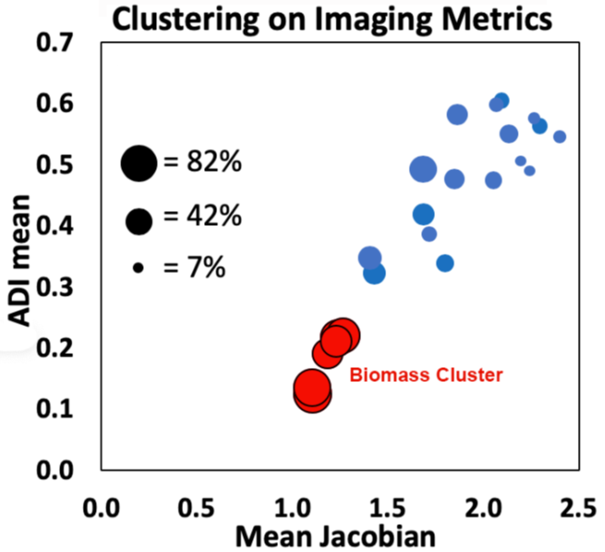
Imaging
We identified a cluster of “vulnerable” subjects, with greatest changes in imaging metrics
~30% of biomass cooks were in this group
Concentrations of black carbon and endotoxins, and metals (Sulphur, Uranium, Strontium and Biobium) were associated with the ‘vulnerable’ subjects
Cluster analysis using DPM assessed measures of regional lung mechanics, showing potentially vulnerable subjects in red. Bubble size corresponds to the %Air-Trapping. Each subject in the cluster had >50% lung air-trapped.
ADI: Anisotropic Deformation Index

Slide 12
Preliminary Conclusions from Pilot Study
Cooking with solid biomass and poor ventilation exposes cooks to high concentrations of pollutants
Exposure to biomass smoke results in air trapping, but not emphysema, unlike tobacco exposure
Traditional approaches may be blunted by presence of inflammation, but registration-based measurements are less affected
CT imaging-based measurements provide identification of a vulnerable group of biomass-cooks.
With the identification of vulnerable biomass-cooks, appropriate interventions can be designed with a better understanding of the underlying mechanisms

Slide 13
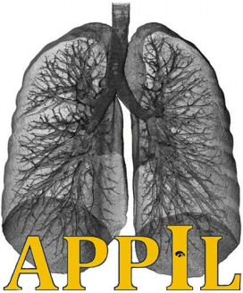

Members of the Research Team
The University of Iowa
(Iowa City, IA, USA)
A.S. Kizhakke Puliyakote, PhD
(currently at UC San Diego)
Emma Stapleton, PhD
Monalisa Biswas
Rui Huang
Kung-Sik Chan, PhD
Alejandro P. Comellas, MD
Eric A. Hoffman, PhD
Periyar Maniammai Institute of Science and Technology (Thanjavur, TN, India)
Dr. Kumaran Shanmugam
Dr. Kumar Durairaj
Dr. Kesavan Karuppusamy
Dr. Geetha Kumar
Dr. Sirajunissa
Funded by: University of Iowa Environmental and Health Science Research Center (EHSRC, National Institute of Environmental Health Sciences, NIH 5P30 ES005605), by the Bowers Emphysema Research Fund, the Origins of Cystic Fibrosis Airway Disease NIH PPG HL091842-11, and additional NIH funding (NIH R01HL112986, NIH R01HL126838 and NIH R01HL130883)

