Slide 1


RSNA 2020 – Press Release
Effect of sleeve gastrectomy on marrow adipose tissue in adolescents with obesity
M A Bredella, V Singhal; N Hazhir Karzar; A Animashaun; A Bose; M Misra
Massachusetts General Hospital & Harvard Medical School, Boston, MA, USA

Slide 2
Disclosures: none

Slide 3
Summary of our Study:
Sleeve gastrectomy is the most commonly performed weight loss surgery in children and adults
Childhood is the critical time to build-up bone mass
Sleeve gastrectomy during childhood leads to bone loss
Sleeve gastrectomy also causes fat accumulation within bones of the lumbar spine which weakens bone
  despite significant loss of body fat

Slide 4
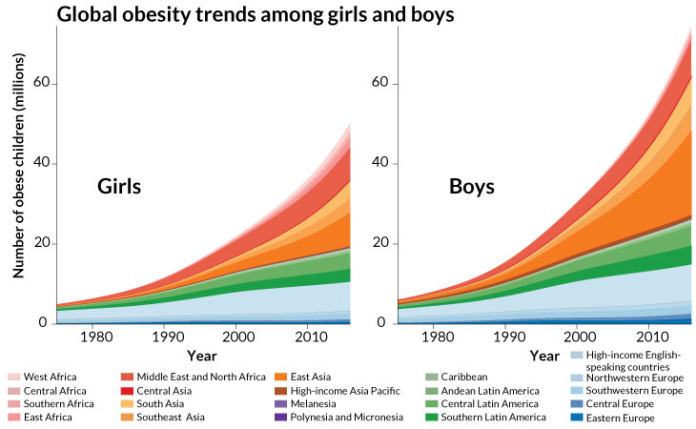
Childhood obesity is a major global public heath threat
Childhood obesity has increased more than tenfold over last 4 decades
Childhood obesity will lead to early development of type 2 diabetes, fatty liver, heart disease, high blood pressure
Direct costs of childhood obesity > $14 billion
Caprio S et al Nature Metabolism 2020

Slide 5
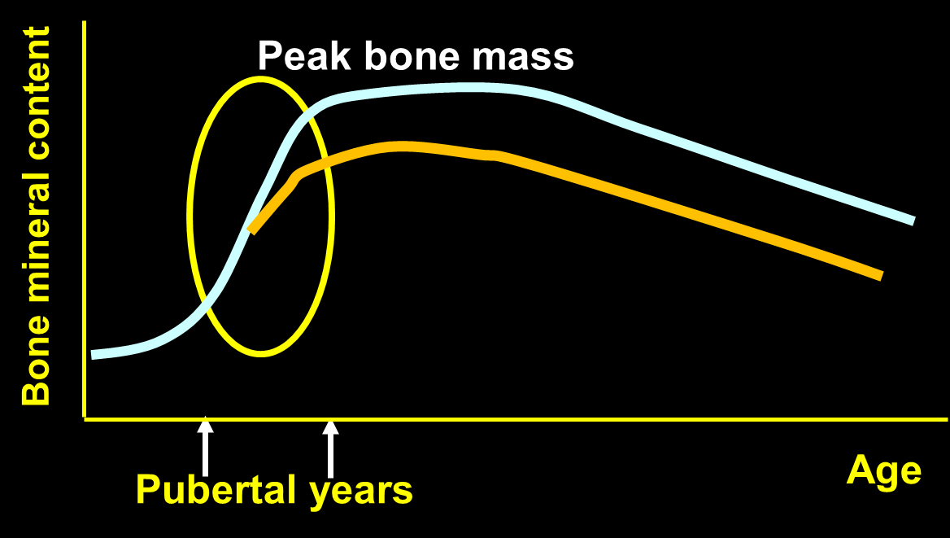
Adolescence is the critical time to build bone mass
We reach our peak bone mass at about age 25 years and then continuously lose bone
Any process that prevents bone accrual during these critical pubertal years might have damaging effects later in life
  because peak bone mass is never reached

Slide 6
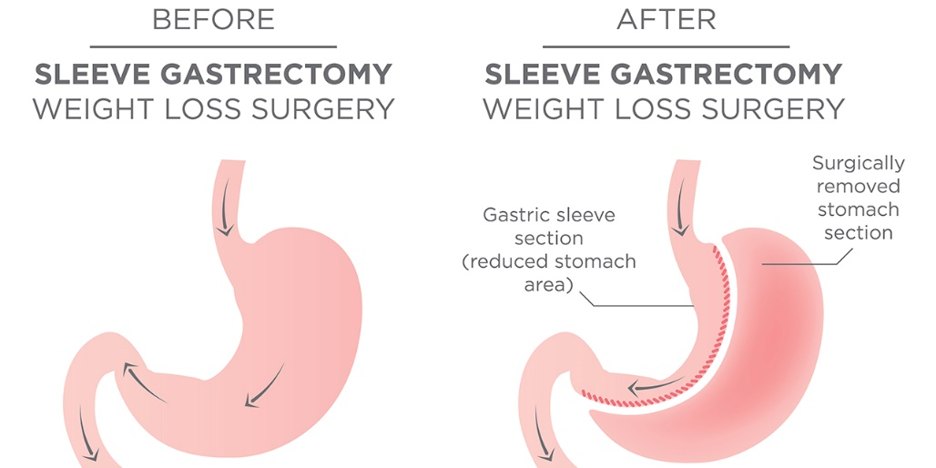
Weight loss surgery is highly effective in treating obesity and comorbidities …
Sleeve gastrectomy (SG) is the most commonly performed weight loss surgery in adults and children
SG is effective in causing weight loss and treating co-morbidities, such as diabetes, sleep apnea, heart disease or high blood pressure
https://www.beebehealthcare.org/

Slide 7
… but leads to bone loss in adults
Weigh loss surgery in adults has deleterious effects on bone in adults:
  low bone mineral density
  higher risk of fractures
Reasons for bone loss include:
  disruption of hormones and nutrients that are important for bone health
  decreased weight bearing because of weight loss leads to bone loss

Slide 8
We studied 56 children with severe obesity before and one year after weight loss surgery
We also studied a group of children with obesity who did not undergo surgery over one year
We wanted to determine the effects of sleeve gastrectomy on bone density and fat inside bones (marrow adipose tissue) in children with obesity

Slide 9
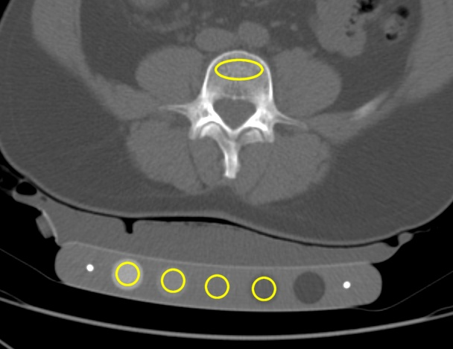
We studied children using a specialized CT to assess bone density
Quantitative computed tomography (QCT) measures volumetric bone mineral density (vBMD)
  less susceptible to extreme changes in body weight

Slide 10
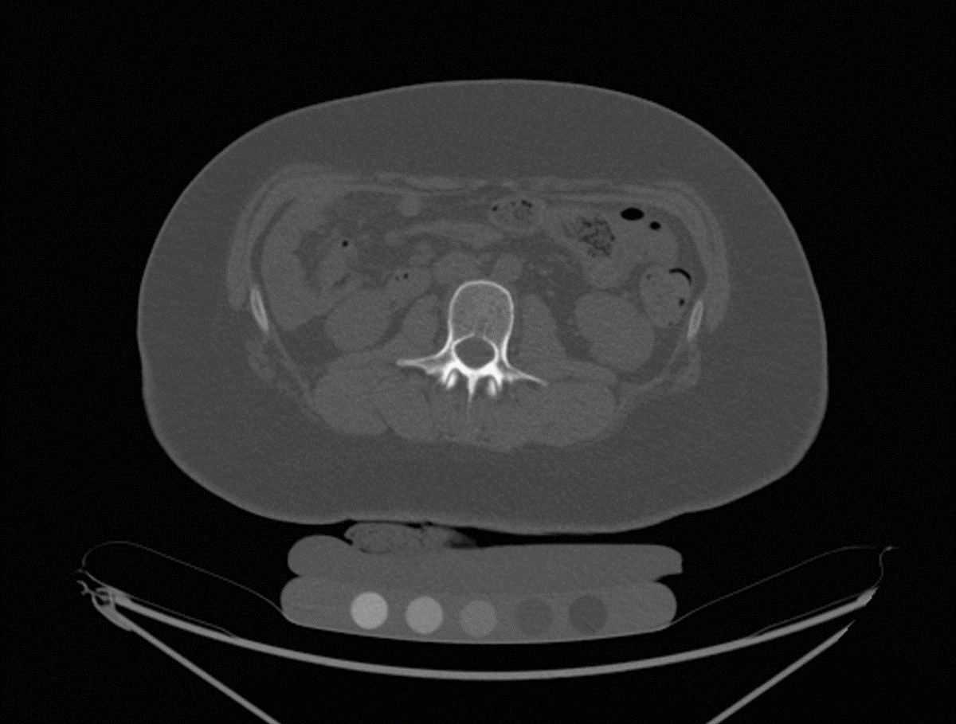
Children lost bone mineral density one year after sleeve gastrectomy
QCT of L2 in a 17-year-old female prior to and 12 months after sleeve gastrectomy showing decrease in vBMD from 183 to 146 mg/cm3
Pre-surgery: vBMD 183 mg/cm³
Post-surgery: vBMD 146 mg/cm³

Slide 11
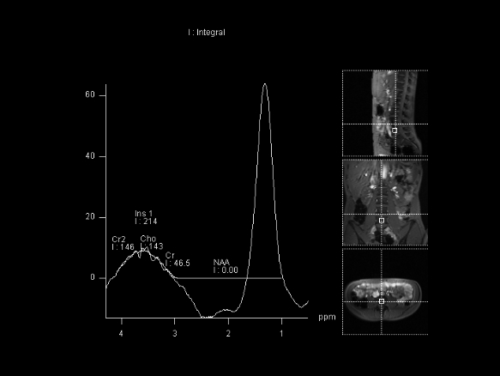
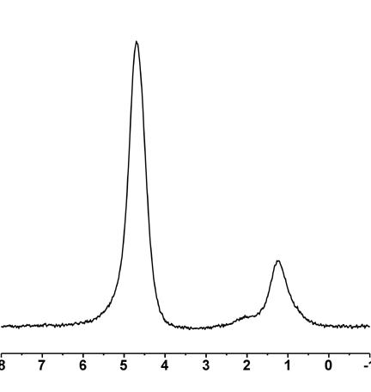
We used a special type of MRI to assess the amount of fat within bone
Proton MR spectroscopy (1H-MRS) can quantify the amount of fat within bones
Fat peak (lipids) corresponds to fat within bone (expressed in lipid to water ratio – LWR)
Too much fat within bones makes them weak
Water
Lipids

Slide 12
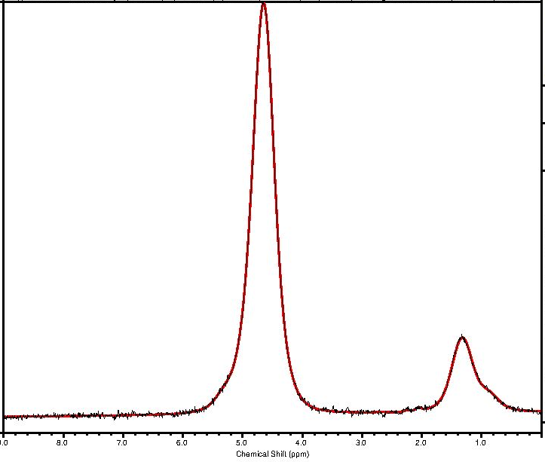
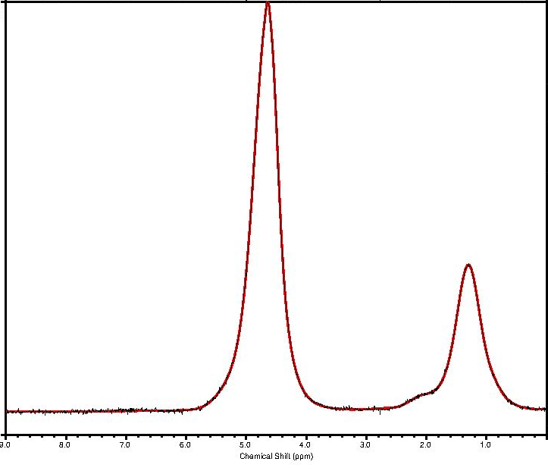
1H-MRS of the 1st lumbar vertebral body in an 18-year-old female prior to and 12 months after sleeve gastrectomy showing increase in marrow fat from 0.2 to 0.41 (lipid to water ratio)
Fat within bones increased one year after sleeve gastrectomy
Water
Water
Lipids
Lipids
Pre-surgery: marrow fat 0.20 LWR
Post-surgery: marrow fat 0.41 LWR

Slide 13
Conclusion: We found that sleeve gastrectomy in children is bad for bones
Sleeve gastrectomy in children with severe obesity:
  led to a reduction in volumetric bone mineral density of the lumbar spine
  led to an increase in fat within bones of the lumbar spine
It will be important to find new ways to treat bone loss in children undergoing weightloss surgery

Slide 14

Funded by NIH R01 DK103946, NIH K23DK110419-01, P30-DK040561, K24DK109940, K24 HD071843, L30 DK118710, NIH P30-DK057521

Slide 15
Thank you for your attention
Questions?
mbredella@mgh.harvard.edu

