Slide 1
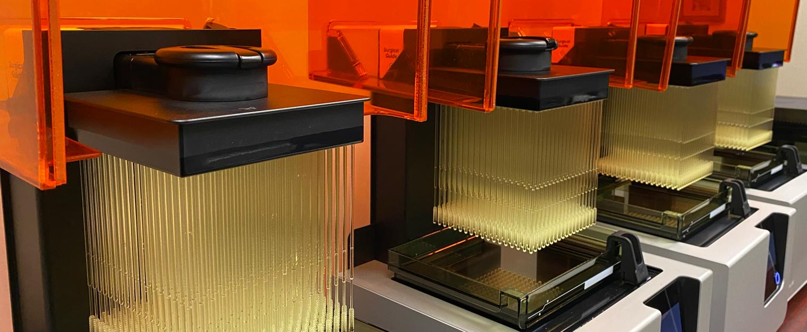
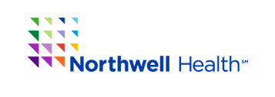


Unexpected Uses of 3D Printing During COVID-19: The Creation and Clinical Validation of a 3D Printed Nasopharyngeal Swab for Critical Need Testing
Todd Goldstein PhD, Jonathan Ford PhD, Sean Trahan MS, Todd Hazelton MD, and Summer Decker PhD
Northwell Health Systems and USF Health Morsani College of Medicine, Tampa General Hospital

Slide 2
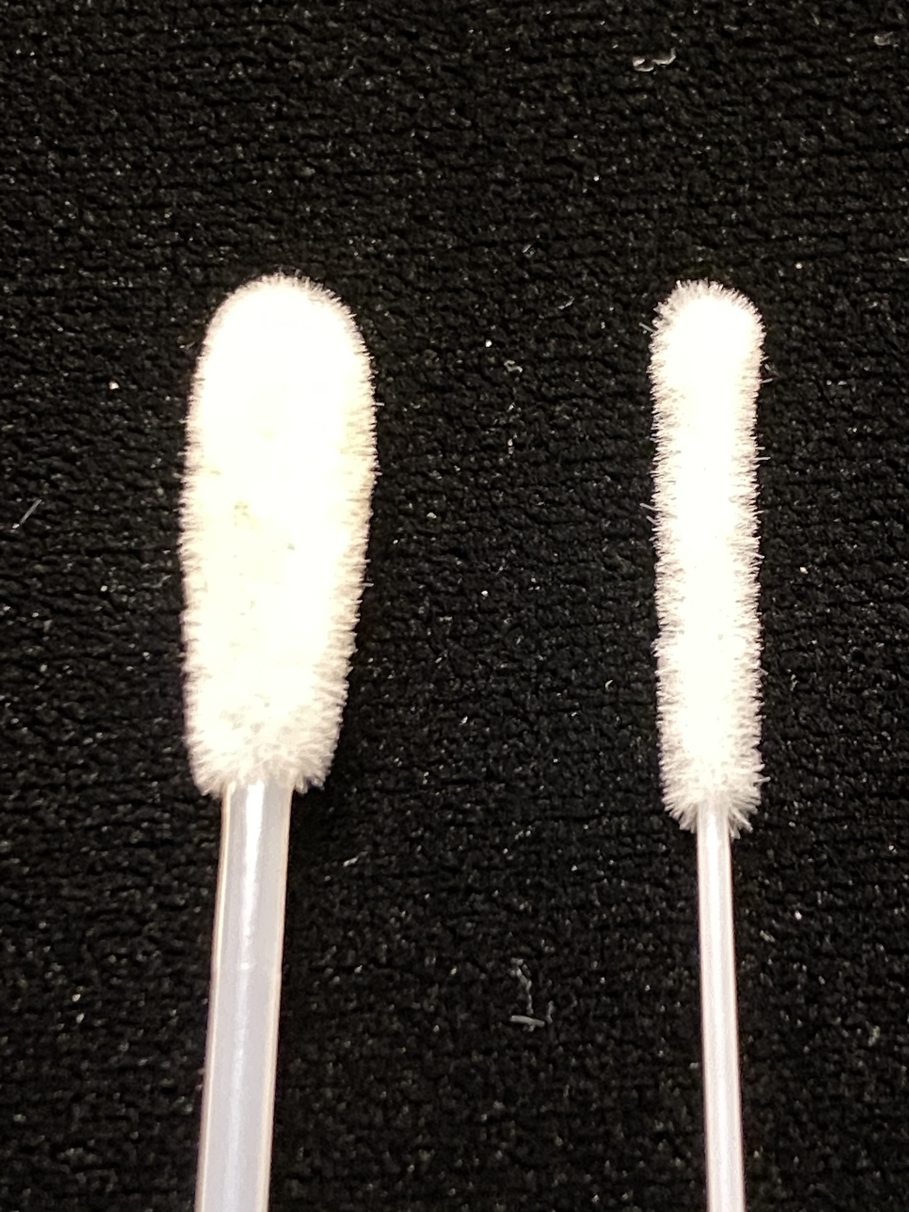
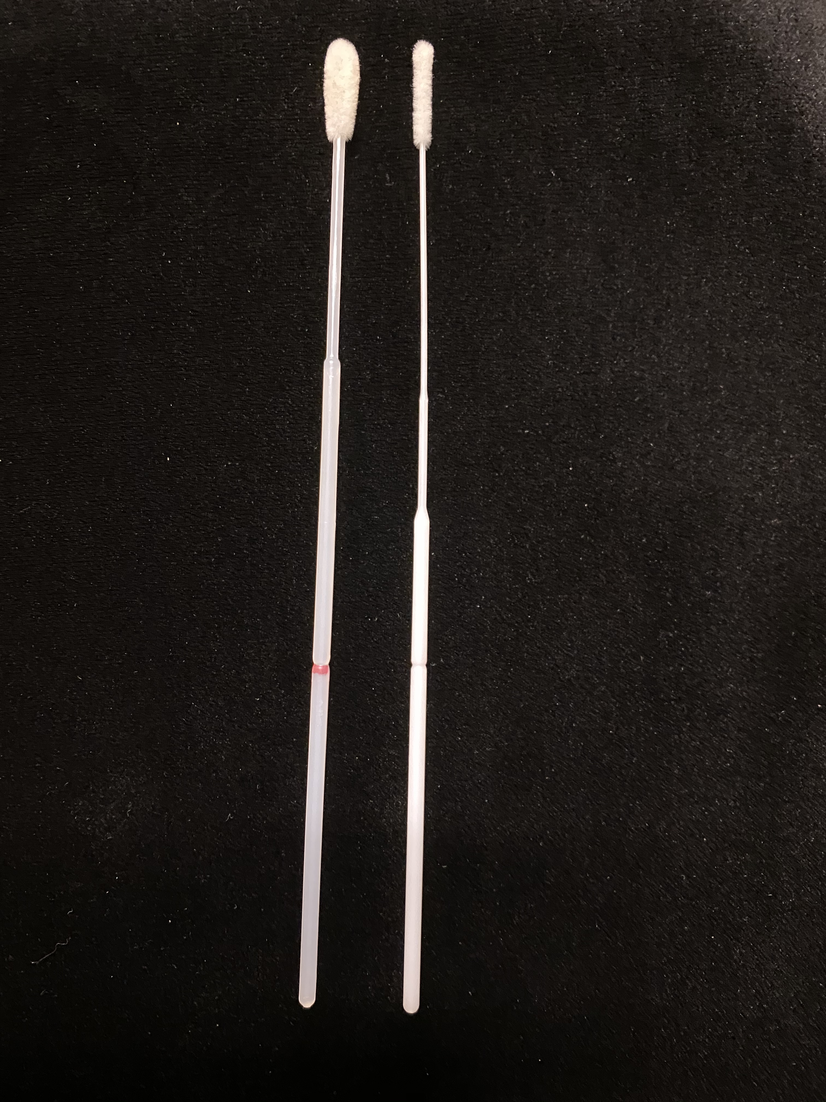
COVID-19 Testing Kit & Crisis
Kit consists of three key parts
Test Tube
Viral Transport Media
Nasopharyngeal Swab
Synthetic flocked swabs standard as organic (cotton) swabs interfere with viral testing
Global supply chain has been disrupted directly impacting the ability to test in the US
(Main producers are Italy and China)

Slide 3
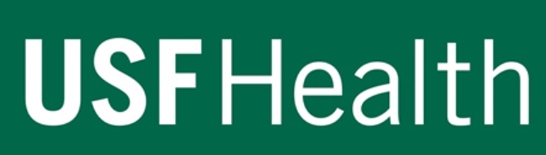
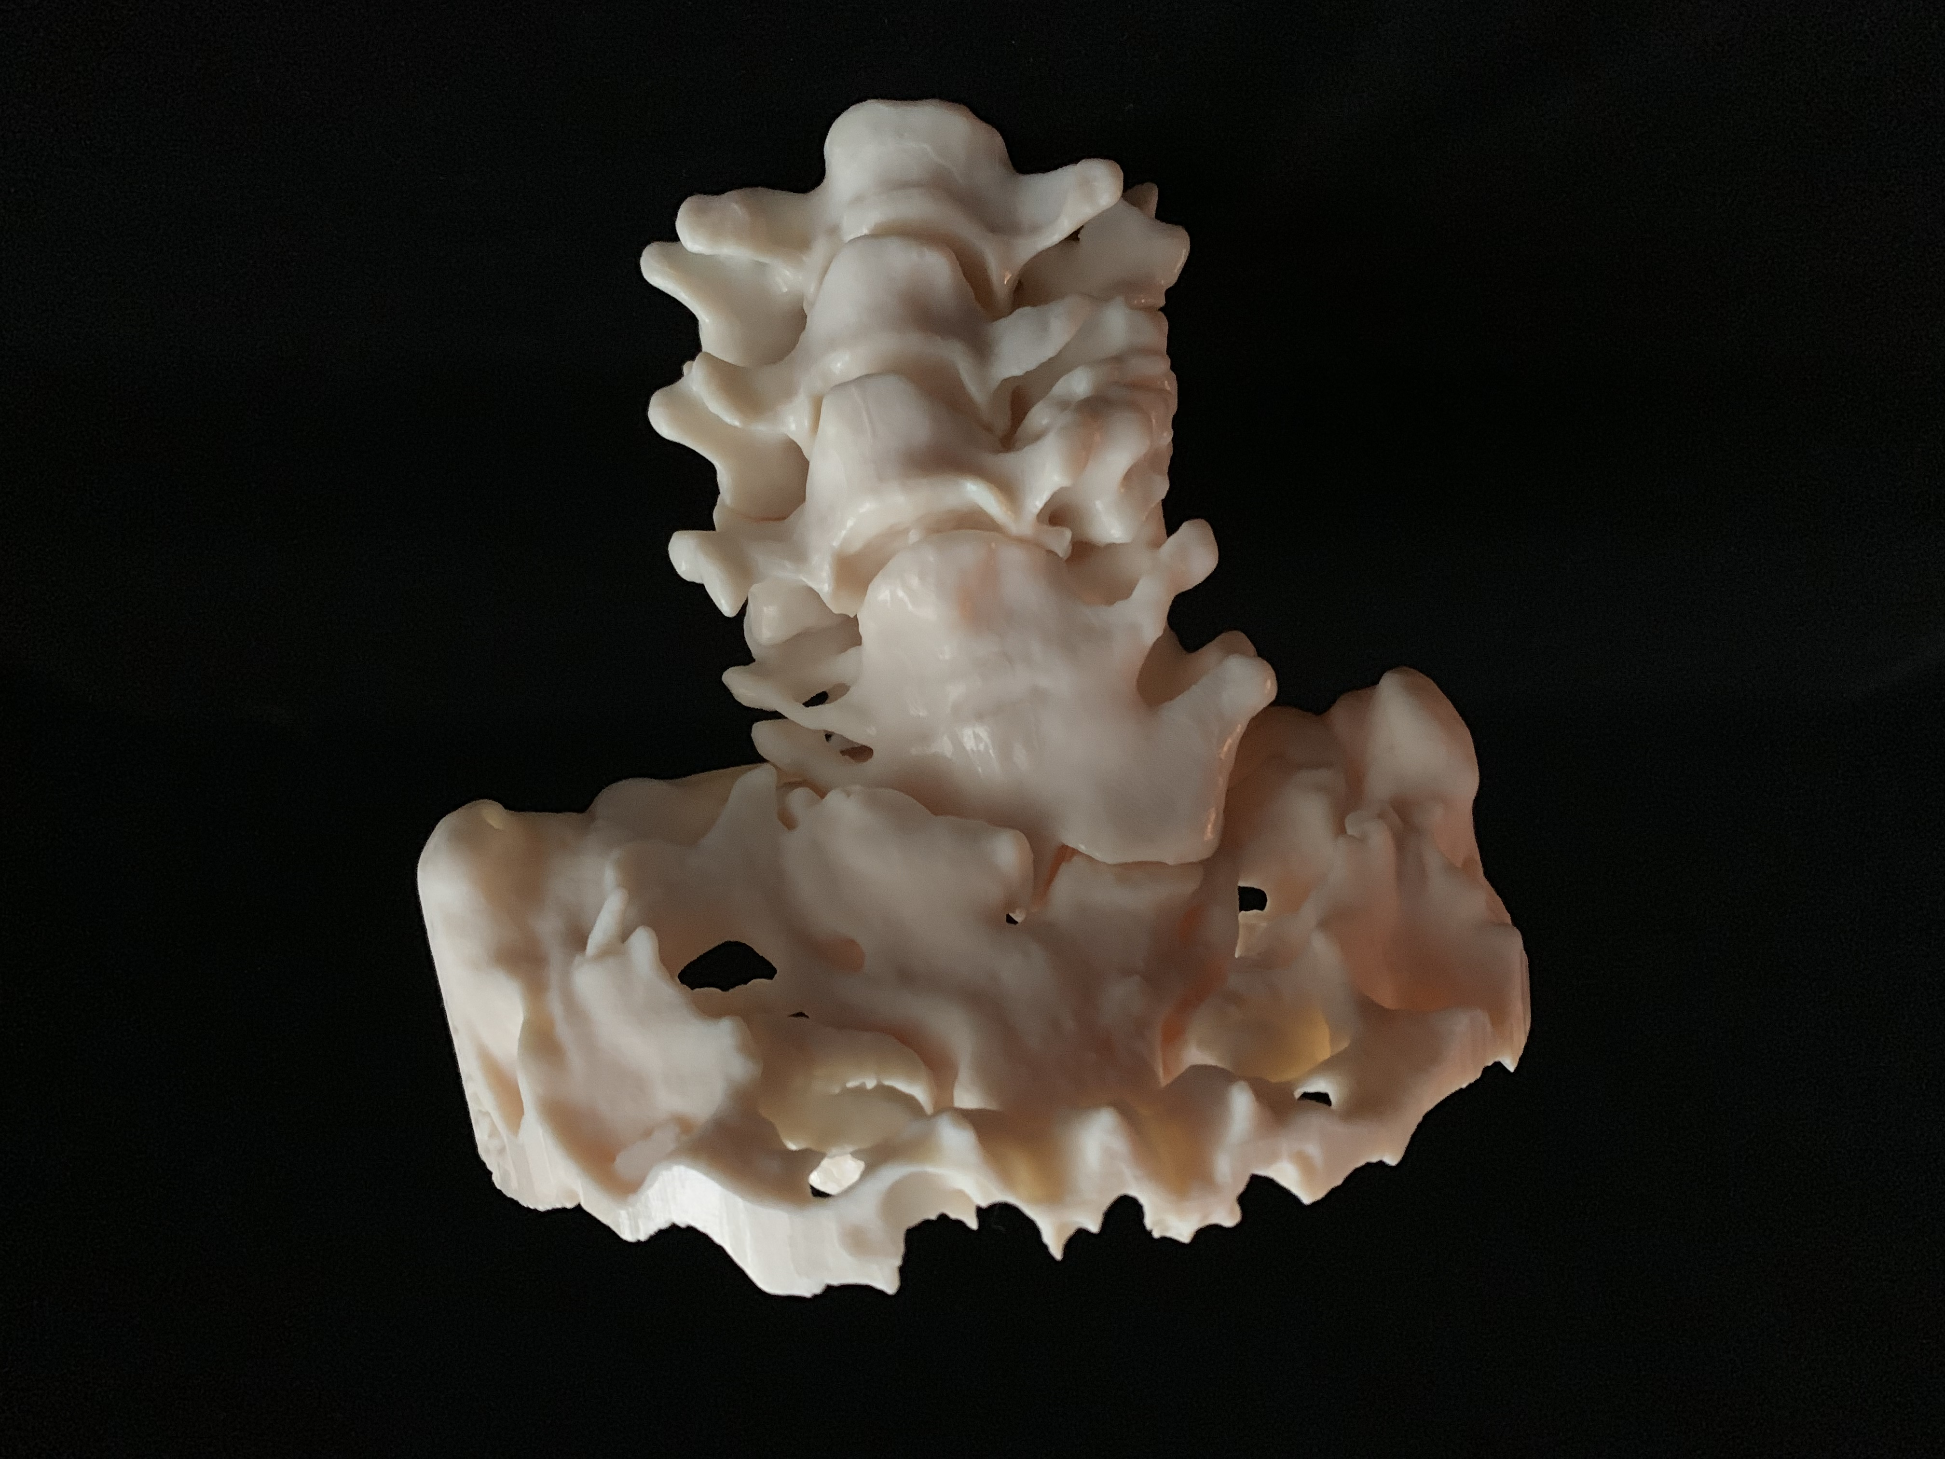
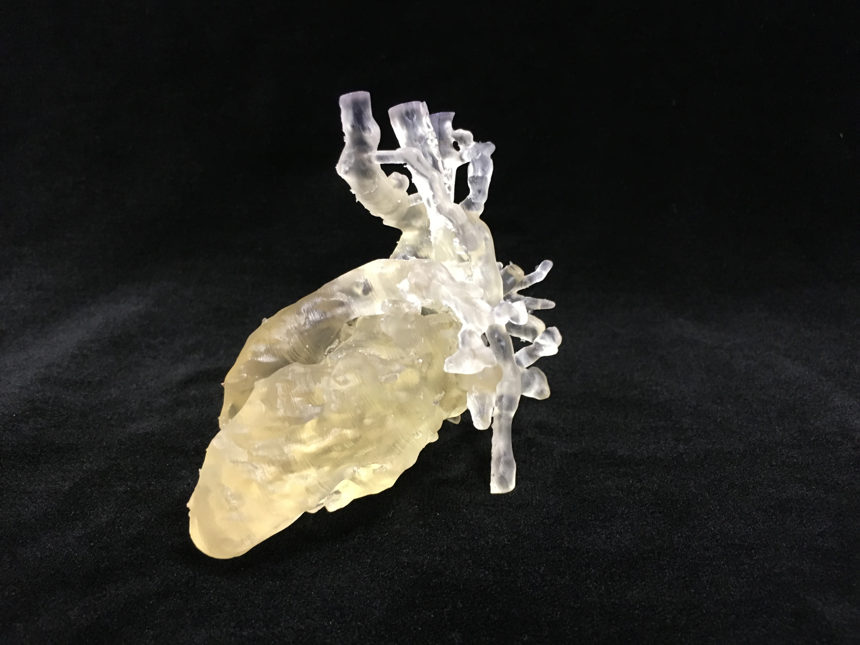
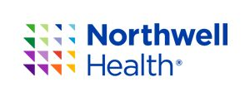
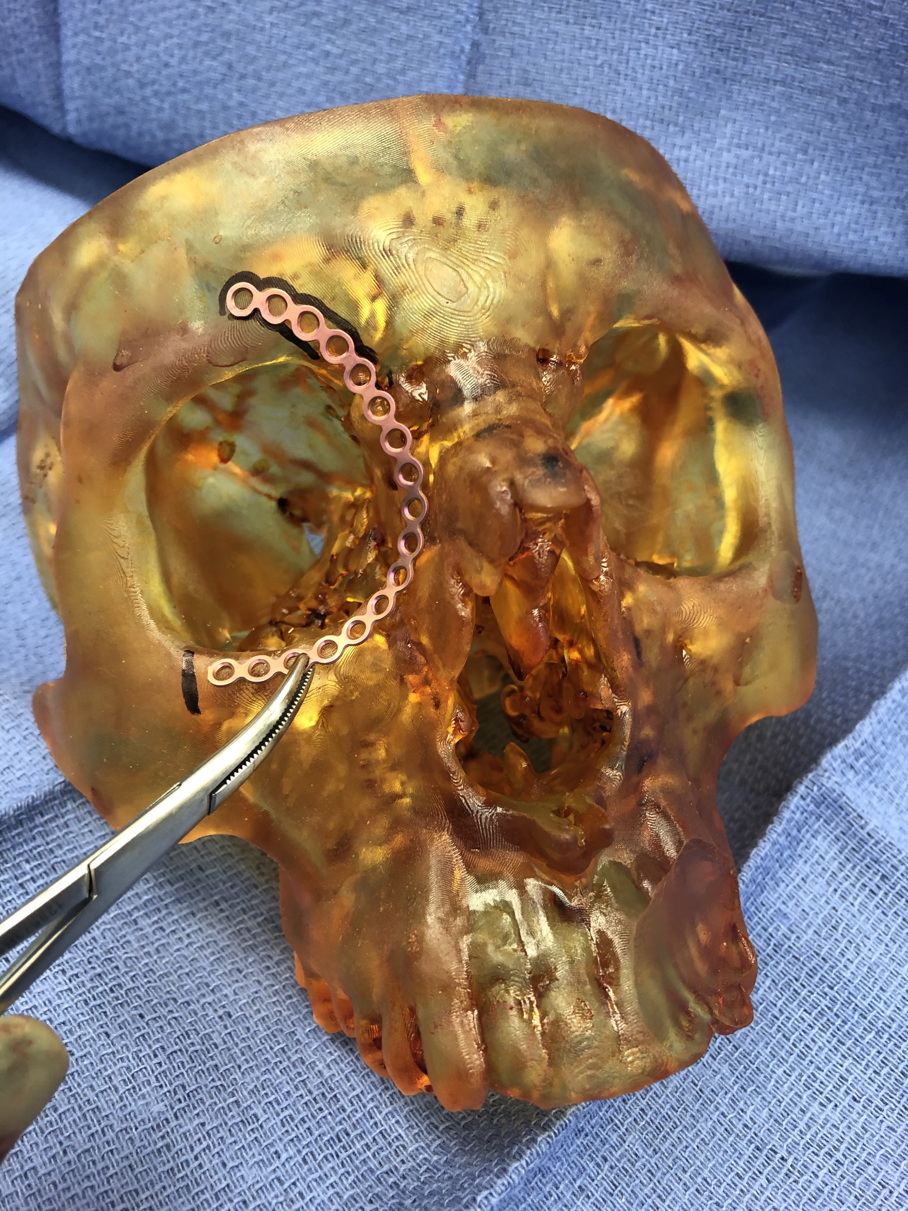
3D Printed Swabs
USF Radiology Division of 3D Clinical Applications
Point-of-Care 3D Printing lab at Tampa General Hospital
Northwell Health’s Division of 3D Design and Innovation- New York City

Slide 4
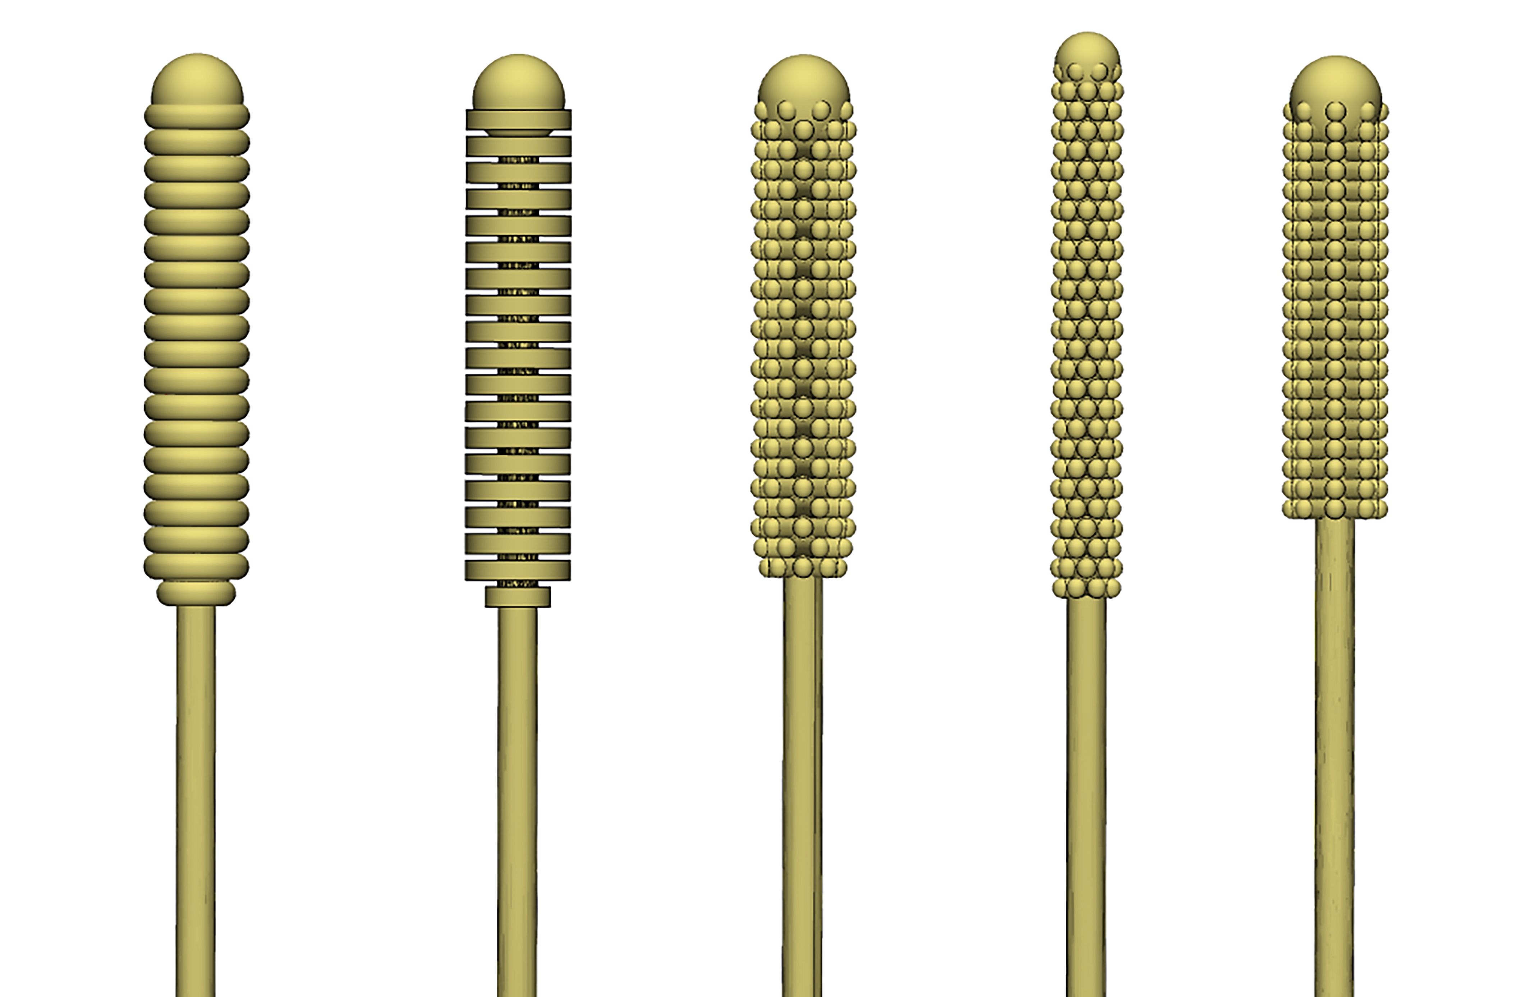
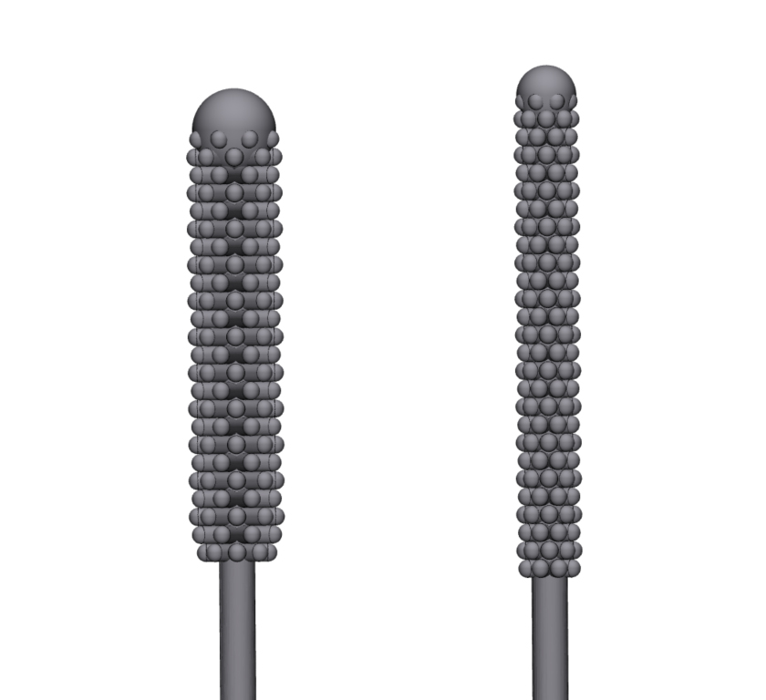
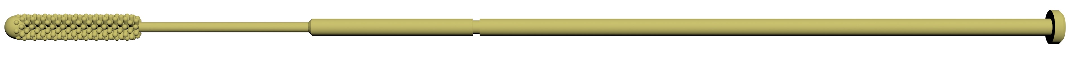
Design
Design was a collaborative process
We designed several tip and stem iterations
Received feedback from clinicians
Tested on volunteers for ergonomic comfort
Finalized design before bench lab testing

Slide 5
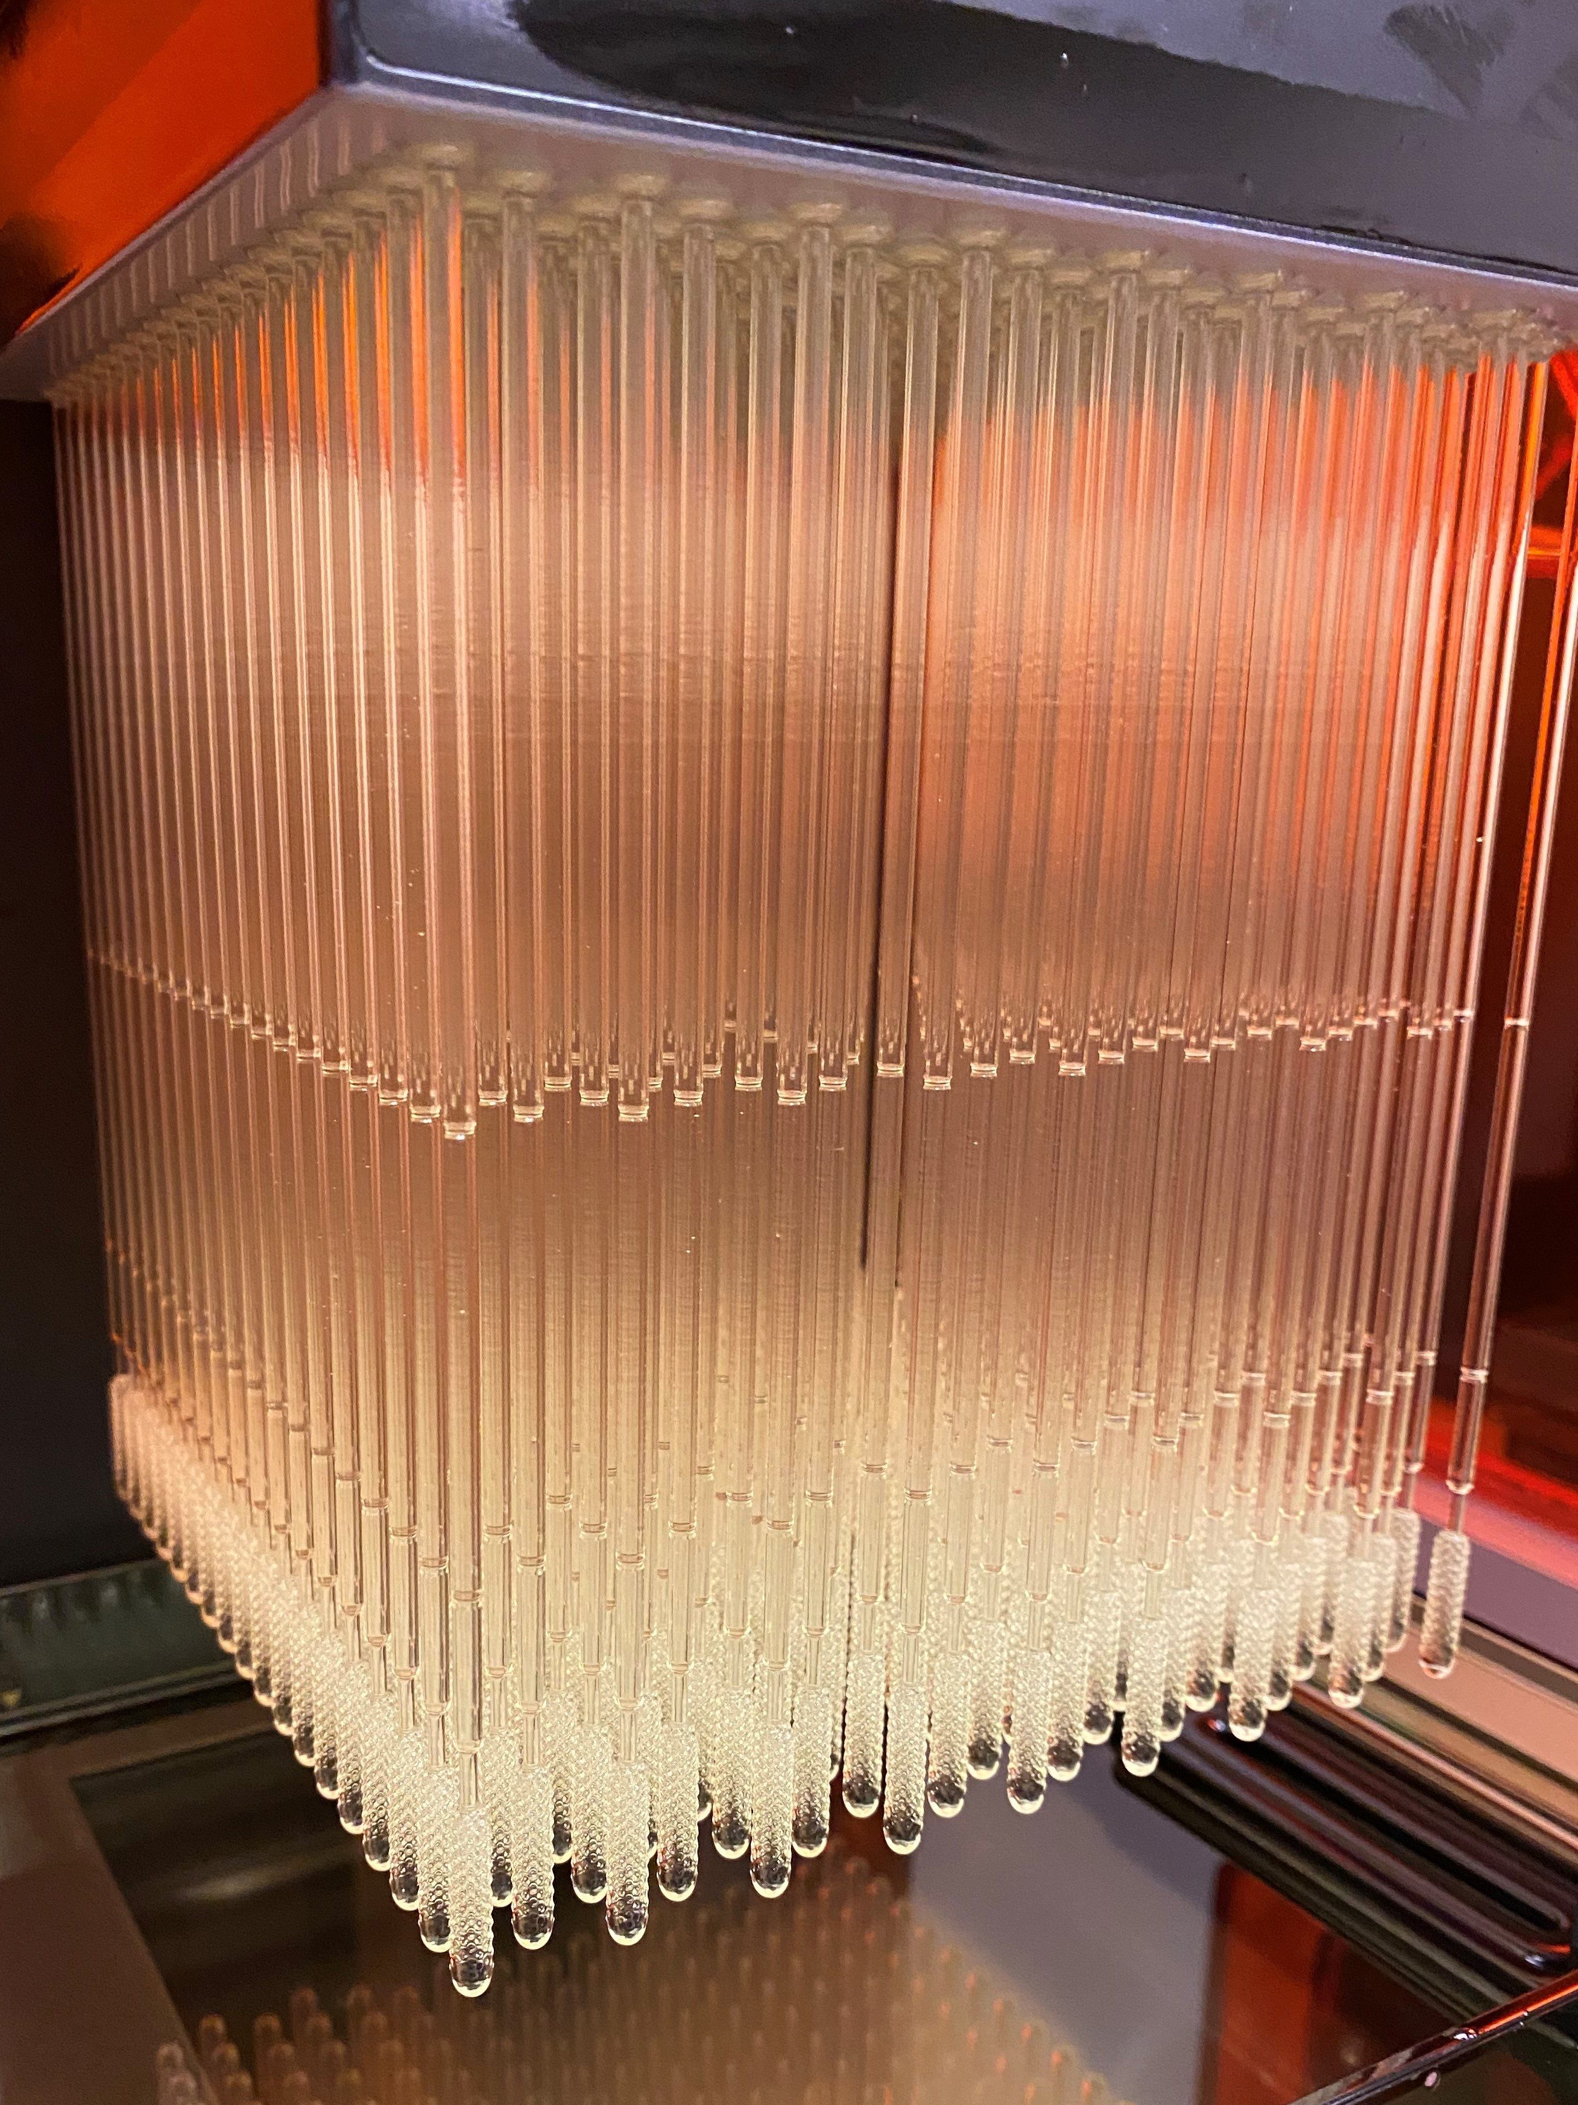

Printer and Material Selection
3D Printer Type and Material
Formlabs Form 2 and Form 3B
Surgical Guide Resin - Already cleared by FDA for clinical and dental use
Sterilizable via autoclave
Existing widespread use in Clinical and Dental 3D Printing so already in many hospitals and clinics

Slide 6
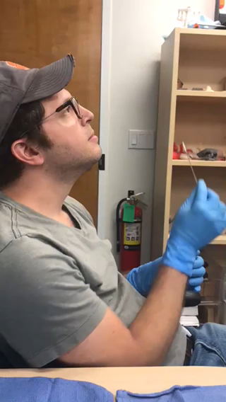
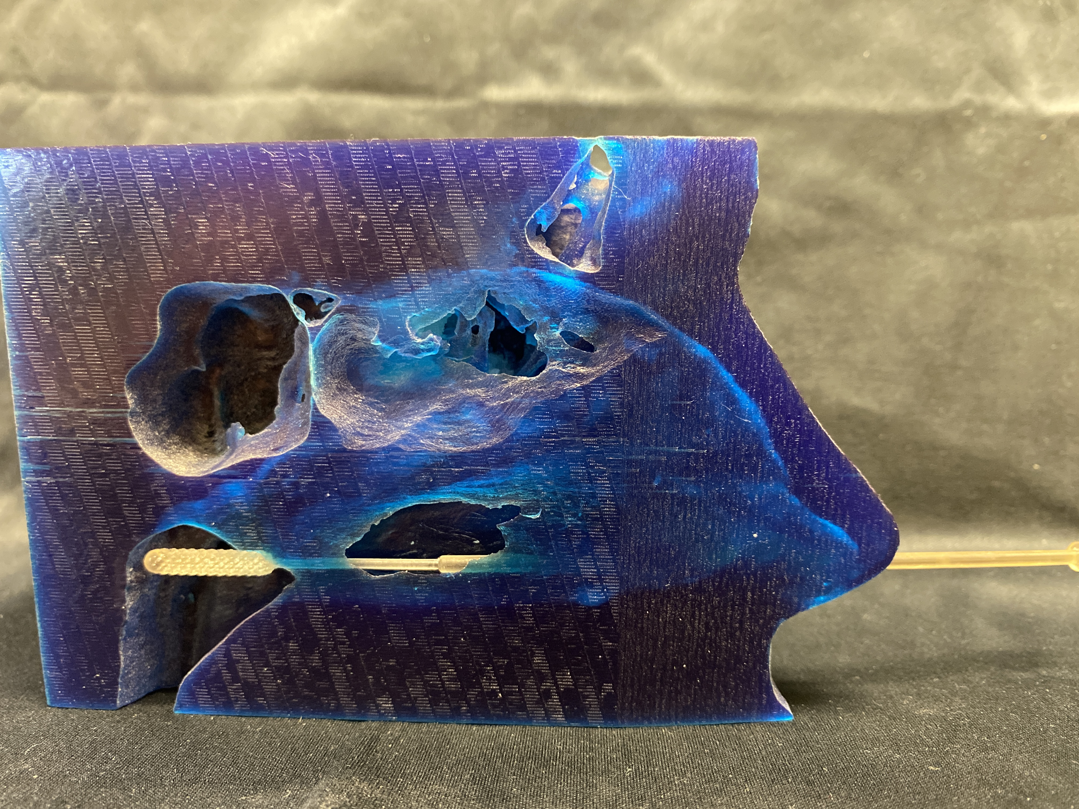
Volunteer Testing
Tested comfort and ergonomics on volunteers
Notes:
Jonathan swabbing his head

Slide 7
Bench Lab Testing: Can it detect viral loads?
1 ml of synthetic sputum (from Sophie Darch, Mol Med) was spiked or not with 10⁶ PFU of RSV.
Swabs were dipped into the sputum, rotated for 5 sec, then the tips were cut off into BD UTM (1 ml).
Tips were incubated in UTM for 15 min, 22ºC
140 μl UTM from each tube was subjected to RNA isolation with Qiagen viral RNA mini kit, elution in 50 μl.
10 ul of RNA was used to make cDNA (iScript, BioRad) in a 20 μl final volume.
qRT-PCR was performed with 2 sets of RSV primers for the N gene and the SH-G intergenic region. 2 μl of cDNA per well, triplicate wells. 20 μl qRT-PCR using SensiFAST SYBRgreen kit (Bioline).
Shown are cycle thresholds (C(t)), where RSV RNA was detected. Lower is better.
Conclusion: 3DP Swab statistically just as good or better than current synthetic swab
C(t)
C(t)
Notes:
Dr. Michael Teng

Slide 8
Will it interfere with viral testing assay?
2 ml of BD UTM was spiked or not with 10⁶ PFU of RSV and aliquoted to 2 1.8 ml cryotubes.
One sterile swab tip was cut off into one tube.
Cryotubes were incubated at 4ºC, 24, 48 and 72 hrs.
140 μl UTM from each tube was subjected to RNA isolation with Qiagen viral RNA mini kit, elution in 50 μl.
10 ul of RNA was used to make cDNA (iScript, BioRad) in a 20 μl final volume.
qRT-PCR was performed with 2 sets of RSV primers for the N gene and the SH-G intergenic region. 2 μl of cDNA per well, triplicate wells. 20 μl qRT-PCR using SensiFAST SYBRgreen kit (Bioline).
Shown are cycle thresholds (C(t)), where RSV RNA was detected.
Conclusion: 3DP Swabs do not leech chemicals that interfere with viral assay

Slide 9

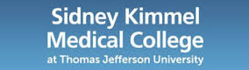
USF Health/Tampa General Hospital
Northwell Health
Thomas Jefferson University
Direct head-to-head comparison on same patient in alternative nostrils
Synthetic swab in one nostril
3DP swab in alternate nostril
Results of 291 patients
156 Females, 135 Males
Significance
3 different assay machines
 |  | 3DP | 3DP | 3DP | Total
 |  | + | - | inc
FLNP | + | 74 | 2 | 3 | 79
FLNP | - | 4 | 203 | 1 | 208
FLNP | inc | 0 | 2 | 2 | 4
Total |  | 78 | 207 | 6 | 291
Conclusion: Cycle threshold was statistically the same so the 3DP swab as good as the synthetic standard, in some cases better.
Hospital review boards accepted 3DP swab as alternative swab.
Clinical Trial Testing: Comparison of C(t) for Viral Targets

Slide 10
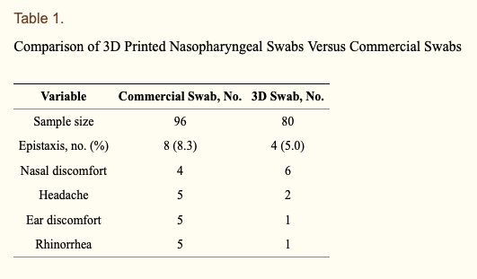
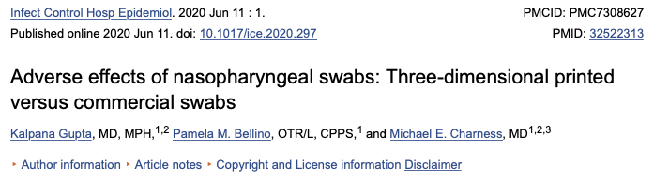
But does it hurt?
3DP swabs performed similarly to standard of care swabs with respect to patient comfort

Slide 11
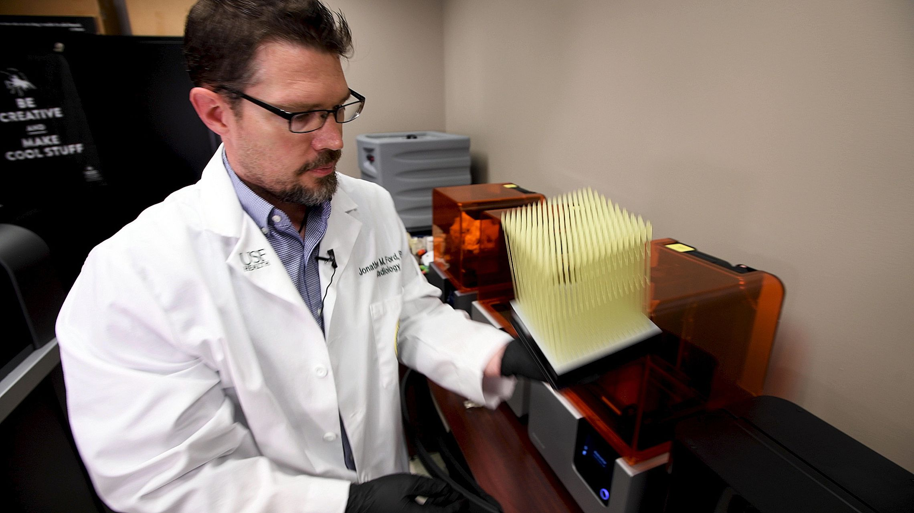
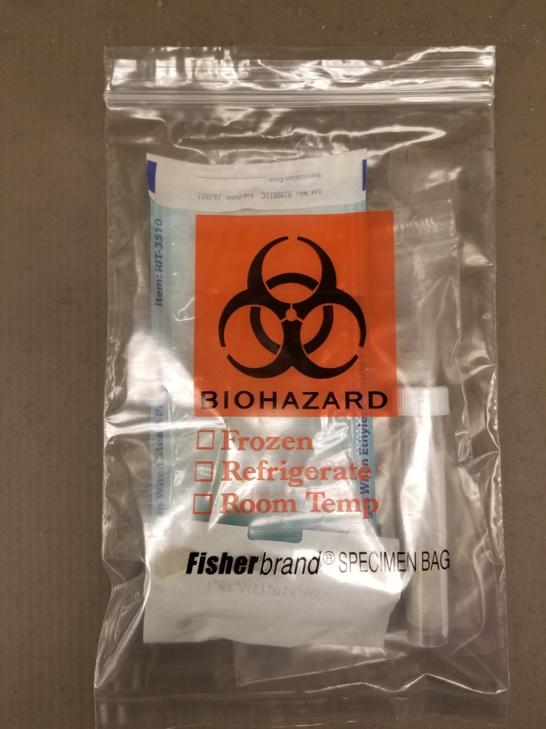
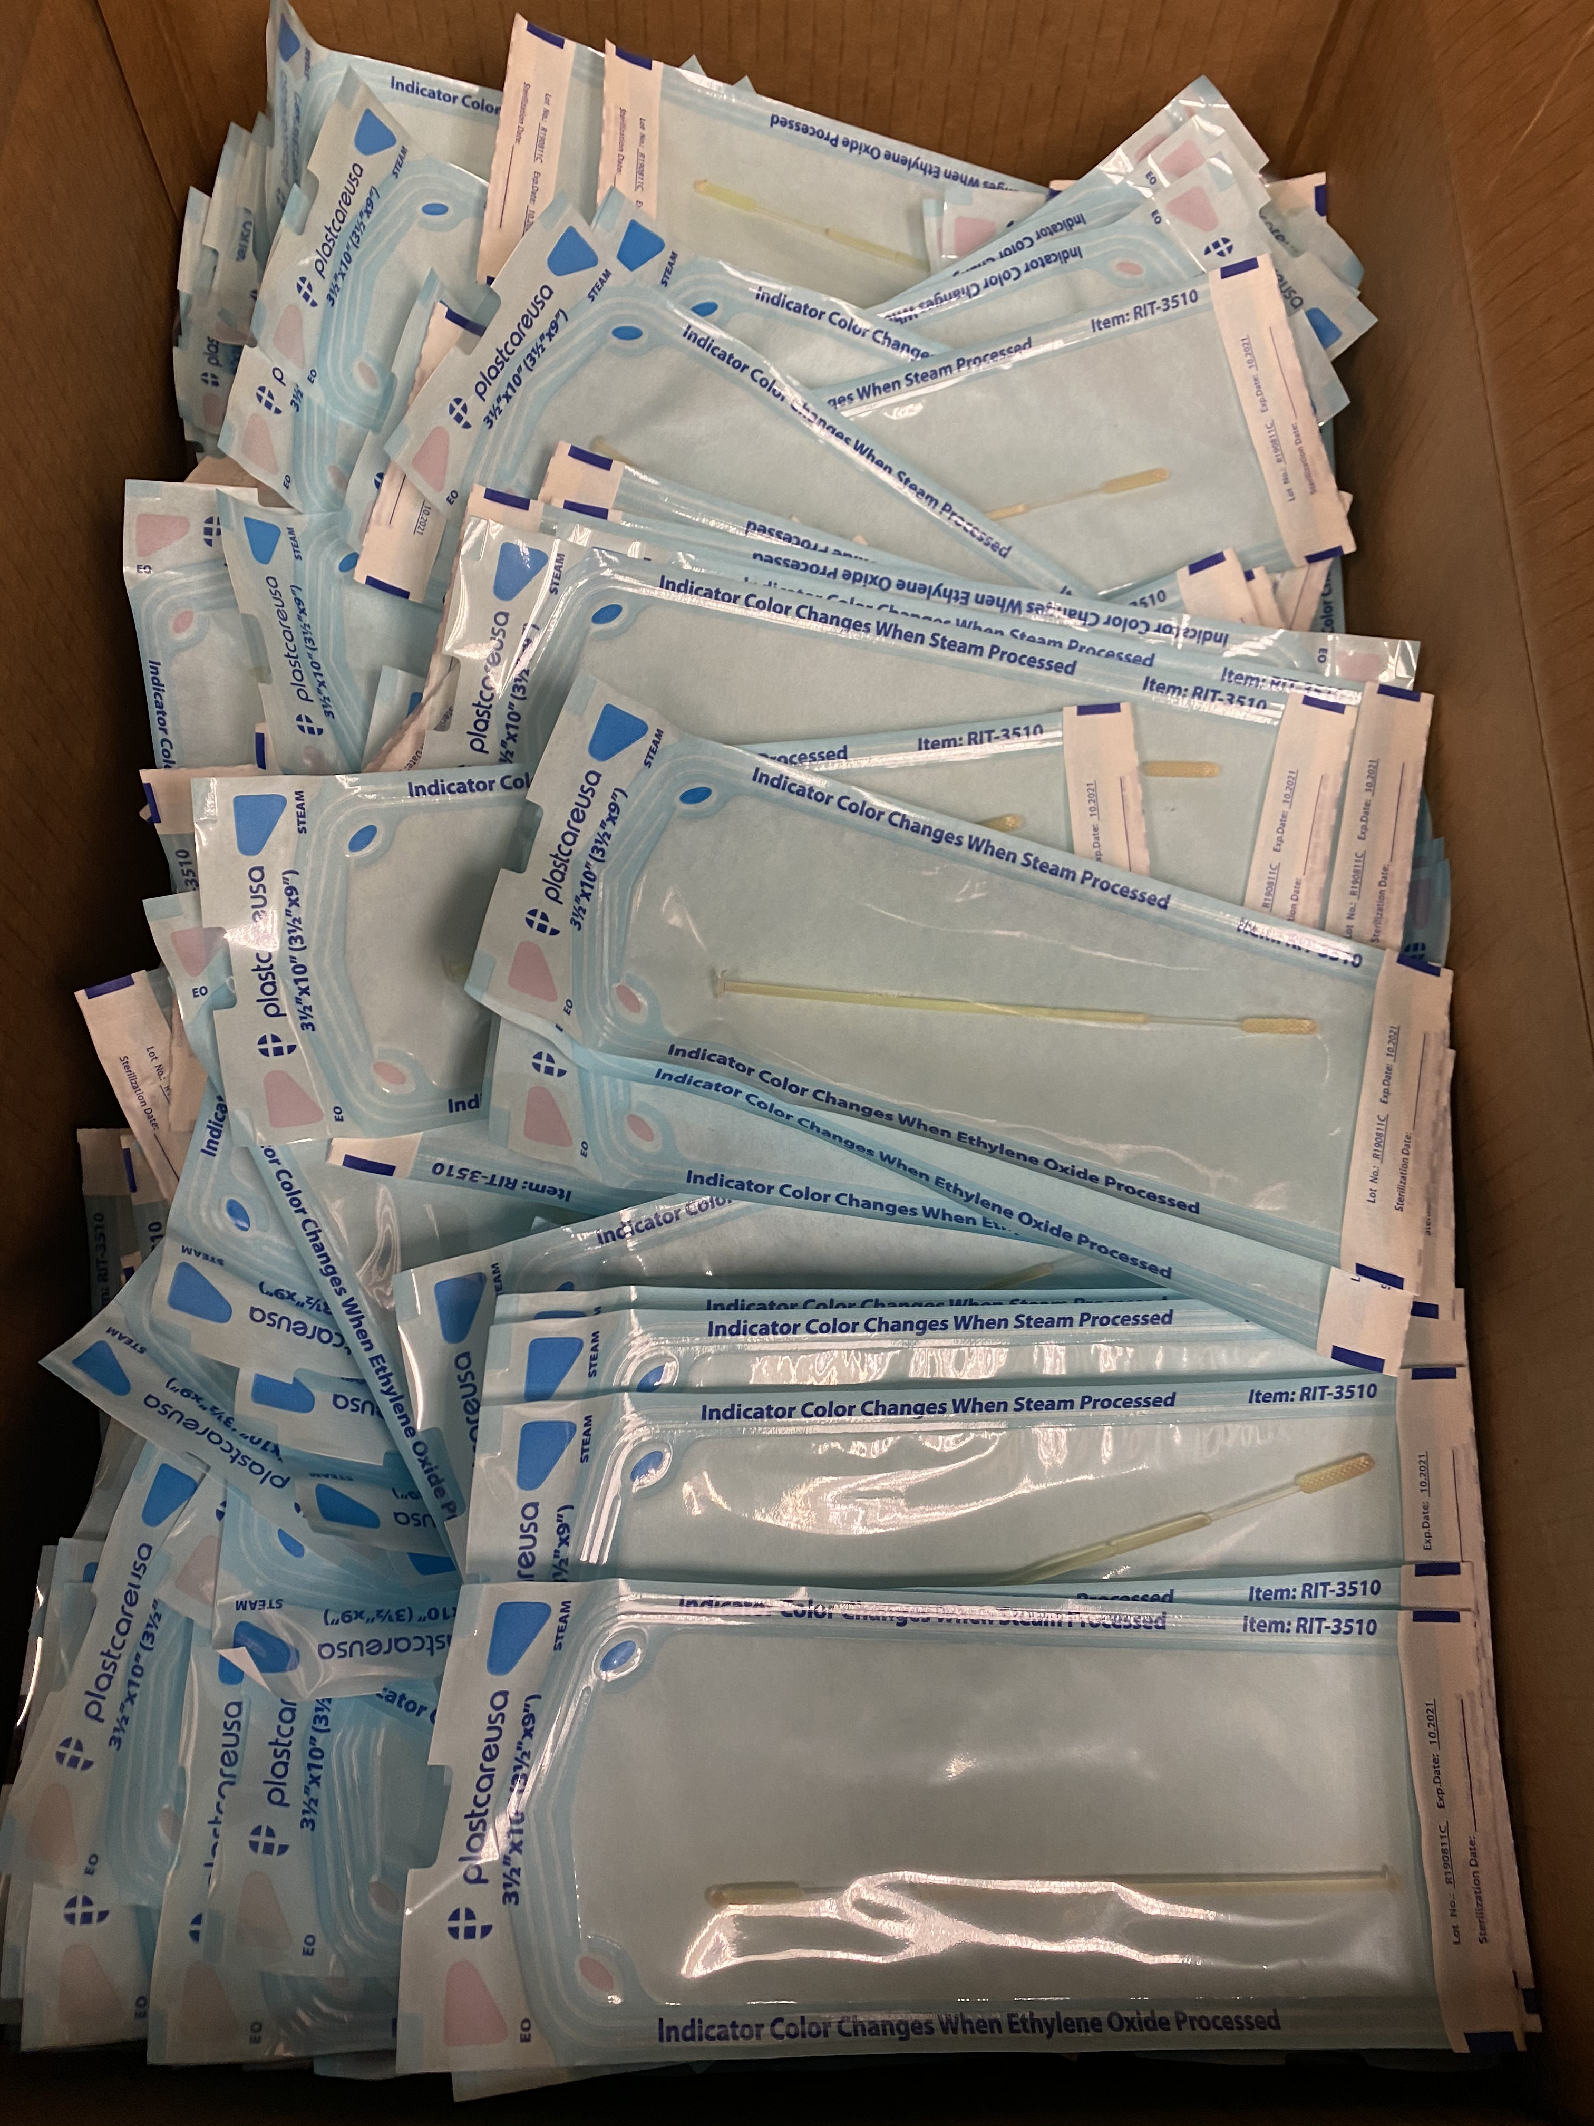
Completing the Kit
Swabs are delivered to USF Health Dept. of Infectious Disease labs for sterilization
Each swab is individually wrapped before autoclaving
Bundled with the other testing kit components
Distributed to affiliate hospitals

Slide 12
Global Impact
US VA system- 25% of the 170 hospitals are using the USF Health/Northwell Health swab
Majority are printing their own; some are being supplied by affiliates like USF MCOM
Doubled the 3D printing in VA facilities across the US
Numerous states using the USF Health/Northwell Health swab including New York, Massachusetts, Kansas, Oklahoma, and Ohio
Ohio has over 1 million alone
Over 60 hospitals and hospital systems including the Mayo Clinic, Brigham and Women’s, LSU Medical Center, etc.
Used in 30+ countries: Canada, Colombia, Brazil, Japan, Switzerland, Ethiopia, Malawi, Uruguay, Georgia, Portugal, Malaysia, Argentina, United Kingdom, etc.
In total, there are tens of millions USF Health/Northwell Health designed swabs in the world which have directly impacted the national response to COVID.

Slide 13
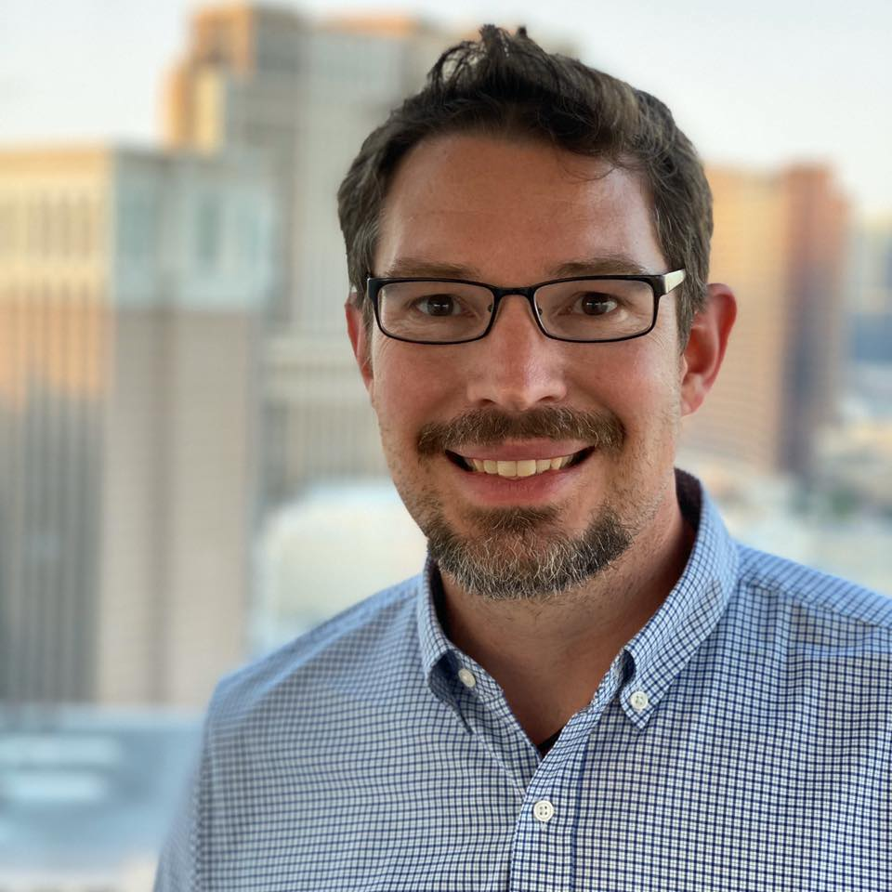
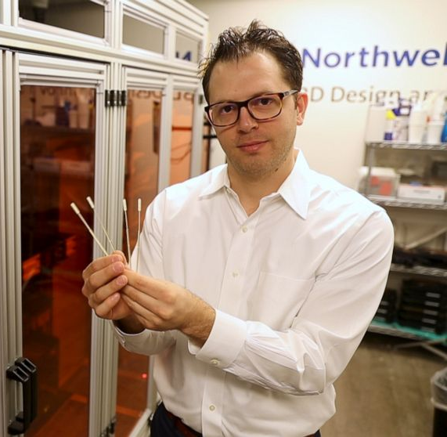
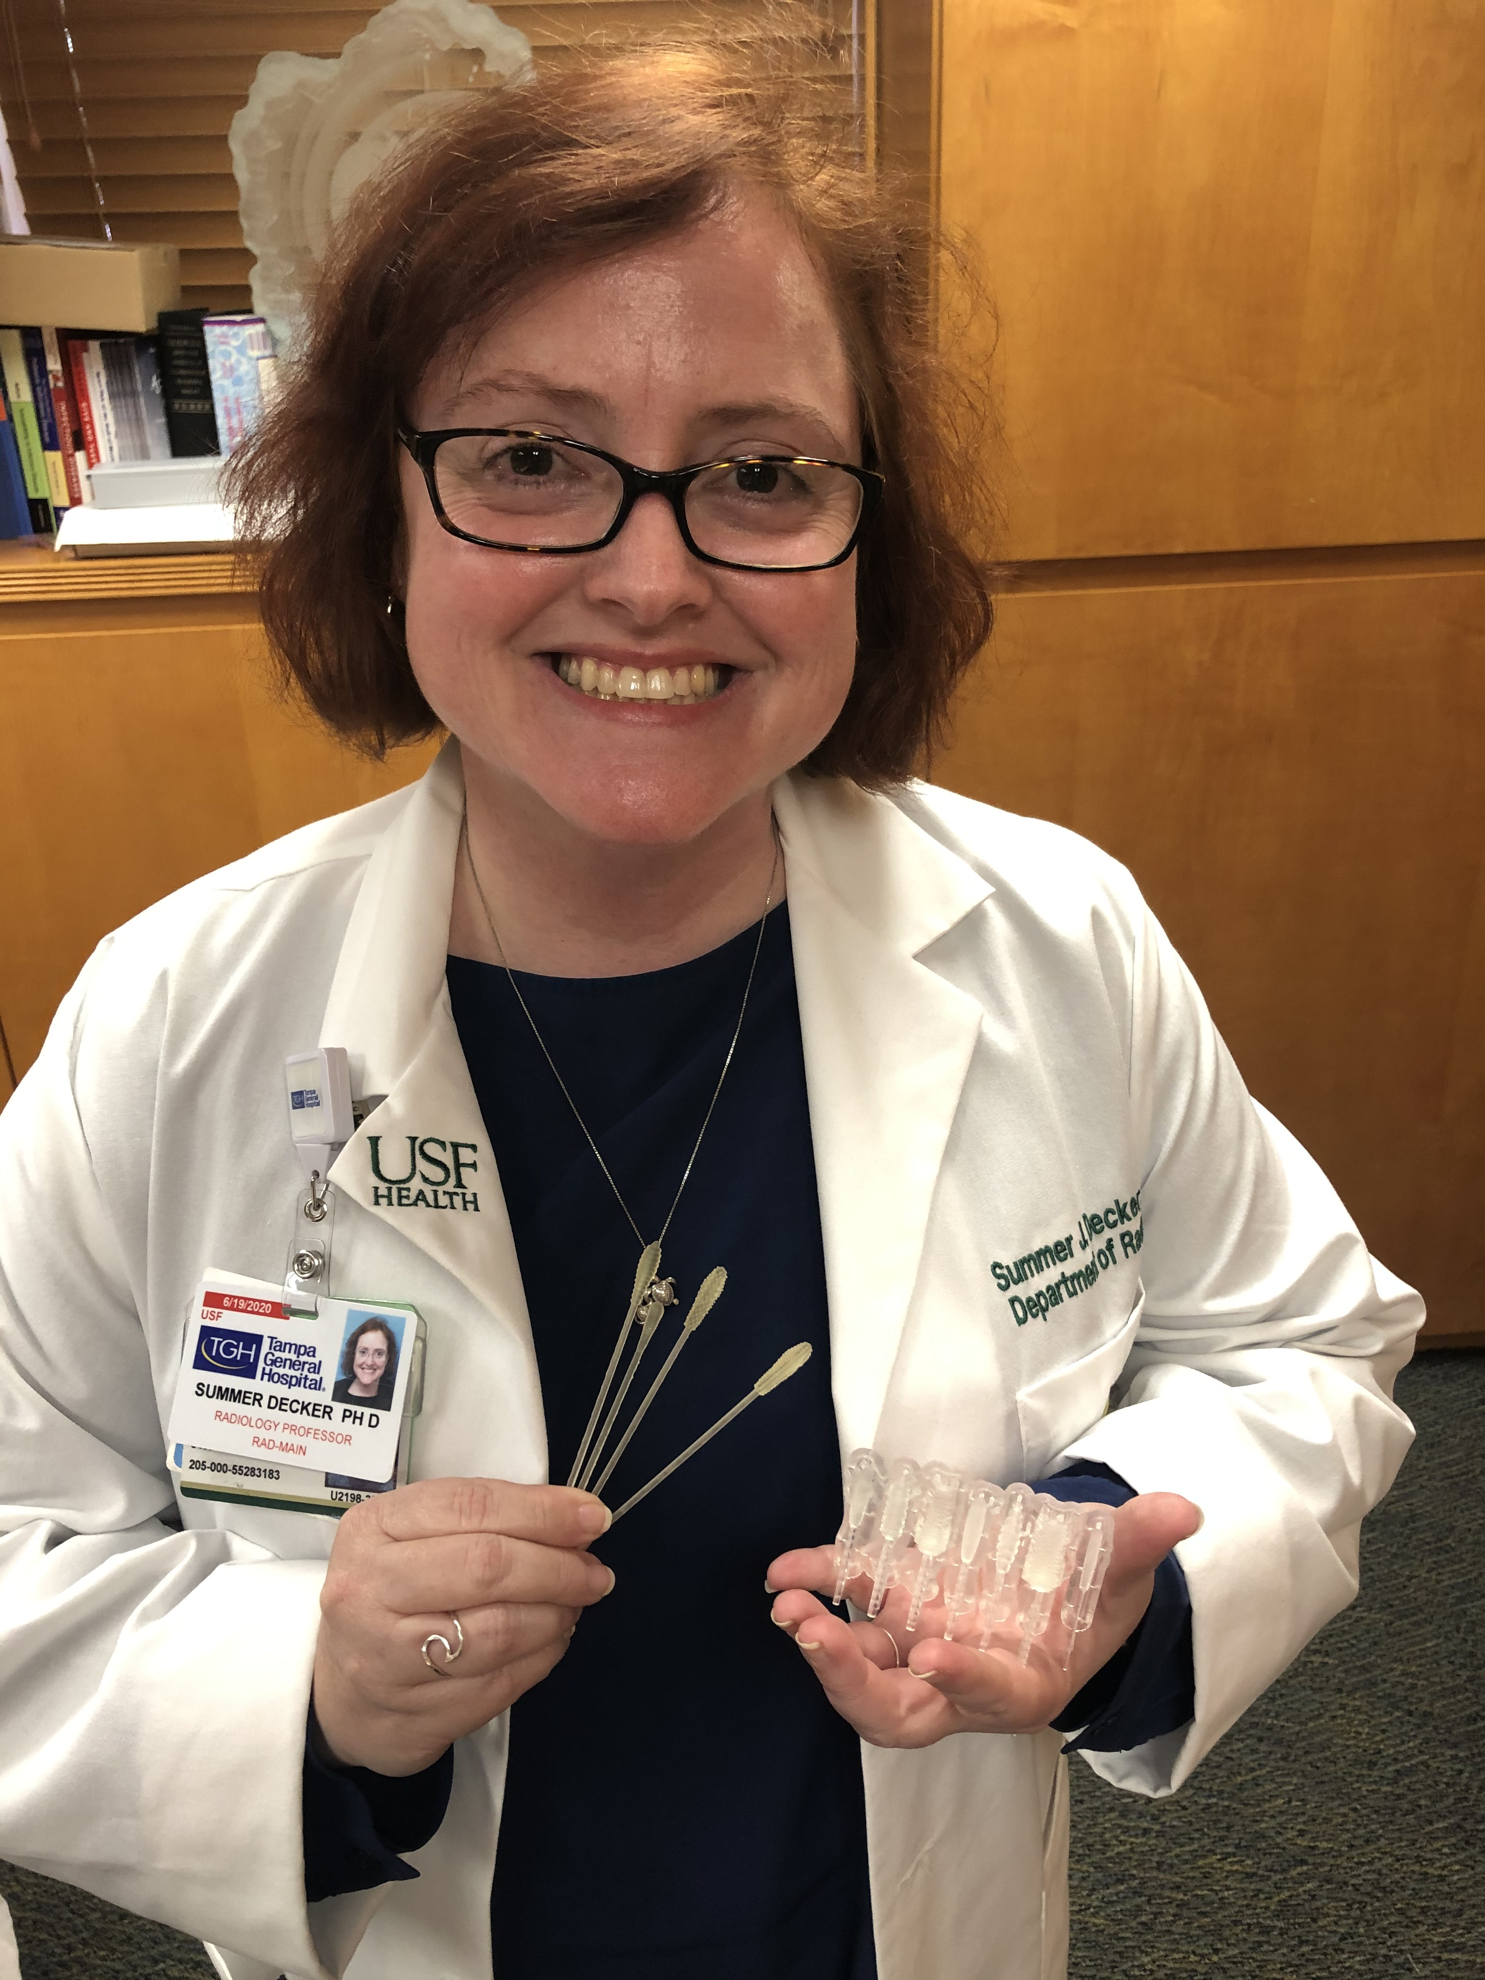
3D Printed NP Swab Team
Thomas Jefferson University
Dr. Robert Pugliese
Dr. Matthew Pettengill
Dr. Kristy Shine
Dr. Zi-Xuan Wang
Dr. Morgan Hutchinson
Dr. Barbara Goldsmith
Dr. Donna Gentile O’Donnell
Northwell Health
Dr. Todd Goldstein*
Dr. Greg Berry
Dr. Ona Bloom
Dr. James Crawford
Dr. Dwayne Breining
Mr. James Castagnaro
USF Health
Dr. Summer Decker*
Dr. Jonathan Ford*
Dr. Todd Hazelton
Dr. Michael Teng
Dr. Kami Kim
Dr. Jason Wilson
Dr. John Sinnott
Dr. Suzane Silbert
Dr. Charles Lockwood

Slide 14
Thank you
For more information on swabs please contact:
3dclinicalapplications@usf.edu

