Slide 1

Impact of Different Physical Activity Types on Longitudinal Knee Joint Health in Overweight and Obese Subjects: Data from the Osteoarthritis Initiative
S.Schirò^{1,2}, S.C. Foreman¹,M. Posadzy¹, G. B. Joseph¹, N. Sverzellati², R.B. Souza³, C.E. McCulloch⁴, M. C. Nevitt⁴, T.M. Link¹
¹Department of Radiology and Biomedical Imaging, University of California San Francisco, San Francisco, CA USA
² Section of Radiology, Department of Medicine and Surgery (DiMec), Università Degli Studi di Parma, IT
³Department of Physical Therapy & Rehabilitation Science, University of California, San Francisco, CA, USA
⁴Department of Epidemiology and Biostatistics, University of California, San Francisco, USA

Slide 2
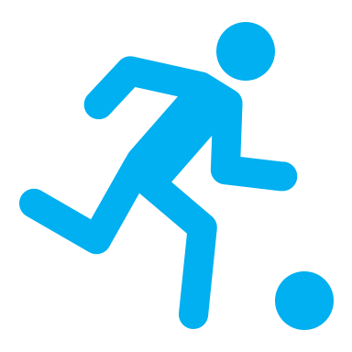
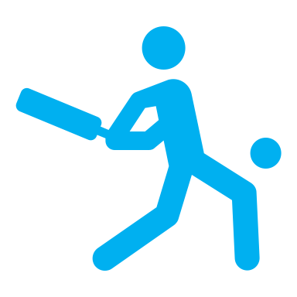



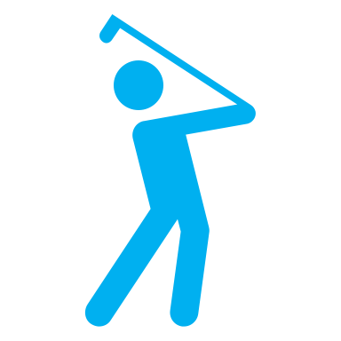







Background
Method and Materials
Results
Conclusion
Acknowledgment
Knee Osteoarthritis (OA) is worldwide the second most frequent cause of lower extremity disability, and it has a global incidence of 199 cases per 100.000¹, including over 14 million people with symptomatic knee OA in the US².
Overweight and obese individuals have a higher incidence of knee OA due to excessive knee joint load. An association between weight loss and less cartilage degeneration has been previously reported^{3,4}.
¹Nelson AE. Osteoarthritis Cartilage. 2018;26(3):319-25.
²Felson DT et Al. Arthritis Rheum. 1987;30(8):914-8.
³Gersing AS et Al. Radiology. 2017;284(2):508-20.
⁴Guimaraes JB at Al. Eur Radiol. 2018;28(3):953-62.
2

Slide 3
Background
Method and Materials
Results
Conclusion
Acknowledgment
The association between physical activity and knee OA, has not been systematically addressed in overweight and/or obese subjects and its association seems to be controversial 🤔
☞ On the one hand,
Physical activity has been found to be beneficial in the management knee homeostasis providing an optimized chondrocyte cycle of production and destruction¹.
☛ On the other hand,
Excessive fast-paced physical activity with high load-joint torsion has been found to have an increased incidence of knee injury independently of body weight².
¹Buckwalter JA, Am J Sports Med. 1997;25(6):873-81.
²Alkatan M, J Rheumatol. 2016;43(3):666-72.
3

Slide 4
Background
Method and Materials
Results
Conclusion
Acknowledgment
Joint injury can lead to a trauma-initiated joint degeneration, which has been found to be associated with 5% of new knee OA cases^{1, 2}.
Physical activity is recommended to lose weight and to have a healthy life style.
The effect of different types of physical activity on morphologic degeneration of the knee has never been assessed with MR Imaging.
MRI is the most sensitive modality which can depict early structural alteration of cartilage and knee internal structures³.
¹Buckwalter J et Al. Orthop Sports Phys Ther. 2003;33(10):578-88.
²Tanamas S et Al. Arthritis Rheum. 2009;61(4):459-67.
³Gersing AS et Al. Radiology. 2017;284(2):508-20
4

Slide 5
To assess the impact of different types of physical activity types on longitudinal knee joint structural changes over 48 months in overweight and obese subjects.
Purpose

Slide 6


Background
Method and Materials
Results
Conclusion
Acknowledgment
Participants were selected from the Osteoarthritis Initiative (OAI, https://oai.epi-ucsf.org), a multicenter cohort study of individuals with or without risk factors for knee osteoarthritis (OA) as well as individuals with mild to moderate OA, supported by the U.S. National Institutes of Health (NIH).
Inclusion criteria:
BMI ≥ 25 kg/m² at baseline
Radiographic right knee Lawrence- Kellgrenn (K/L) score ≤ 3
Reported Top 3 physical activities
WORMS readings available in our database
Exclusion criteria:
No physical activity reported
Rheumatoid arthritis
No MRI scans available at baseline or 48-months
6
Notes:
Follow up questionaire

Slide 7

Background
Method and Materials
Results
Conclusion
Acknowledgment
Flow chart illustrating Subject Selection
7
Notes:
double check MRI

Slide 8

Background
Method and Materials
Results
Conclusion
Acknowledgment
Assessment of Physical Activity THE QUESTIONNAIRE¹
Participants retrospectively provided information about the physical activity that they performed at least 20 minutes within a given day for at least 10 times in their life.
Participants gave information about the regularity of each activity performed (i.e. number of years, numbers of months per year).
Participants reported the 3 activities they performed most frequently (Top 3 Activities).
For each of the Top 3 Activities, they were asked how many years they participated in that physical activity.
¹ Lisa Chasan-Tab.Am J Epidemiol 2002;155:282–9.
https://nda.nih.gov/oai/
8

Slide 9
Background
Method and Materials
Results
Conclusion
Acknowledgment
Top 3 Activities Selected
Bicycling (outdoor or individual stationary cycling)
Elliptical trainer
Jogging or running (outdoor or indoor treadmill or track)
Swimming
Sport types using a racquet (including: tennis single or double, badminton, squash, and racquet ball)
Sports types including a ball (basketball, baseball, volleyball, football, soccer and handball)
9

Slide 10
Background
Method and Materials
Results
Conclusion
Acknowledgment
IMAGING
3T MR Knee imaging
3 Tesla MRI (Siemens Magnetom Trio, Siemens Healthcare, Erlangen, DE)
The following sequences were analyzed using the Whole Organ Resonance Imaging Score (WORMS):
3D dual echo steady-state (DESS) gradient-echo with water excitation (WE) sequences obtained in the sagittal plane
2D proton density-weighted sequences in the coronal plane
2D intermediate-weighted fat suppressed (FS) sequences obtained in the sagittal plane.
8

Slide 11
Background
Method and Materials
Results
Conclusion
Acknowledgment
WORMS SCORING SYSTEM
All the baseline and 48-months Right Knee MR images were scored according the WORMS scoring system
The following features were graded:
Articular cartilage
Bone marrow edema pattern
Subarticular cysts
Patella, Trochlea, Medial femur, Lateral femur, Medial tibia and Lateral tibia
Medial and Lateral Meniscus
Anterior Horn, Body and Posterior horn
Ligament abnormalities
ACL,PCL,MCL,LCL, PT, POP
Effusion
Loose bodies
Popliteal cysts
9

Slide 12

Background
Method and Materials
Results
Conclusion
Acknowledgment
For each feature, a sum score was calculated by adding the lesion scores of all subregions of the knee
and
An overall WORMS score was obtained by adding these sum scores.
10

Slide 13
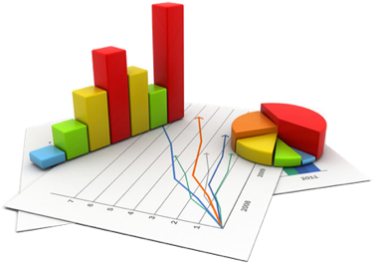
Background
Method and Materials
Results
Conclusion
Acknowledgment
Statistics
Linear regression models were used to assess the associations between participation in different physical activity types and changes in WORMS.
Bonferroni-correction was performed to correct for multiple comparisons.
13

Slide 14
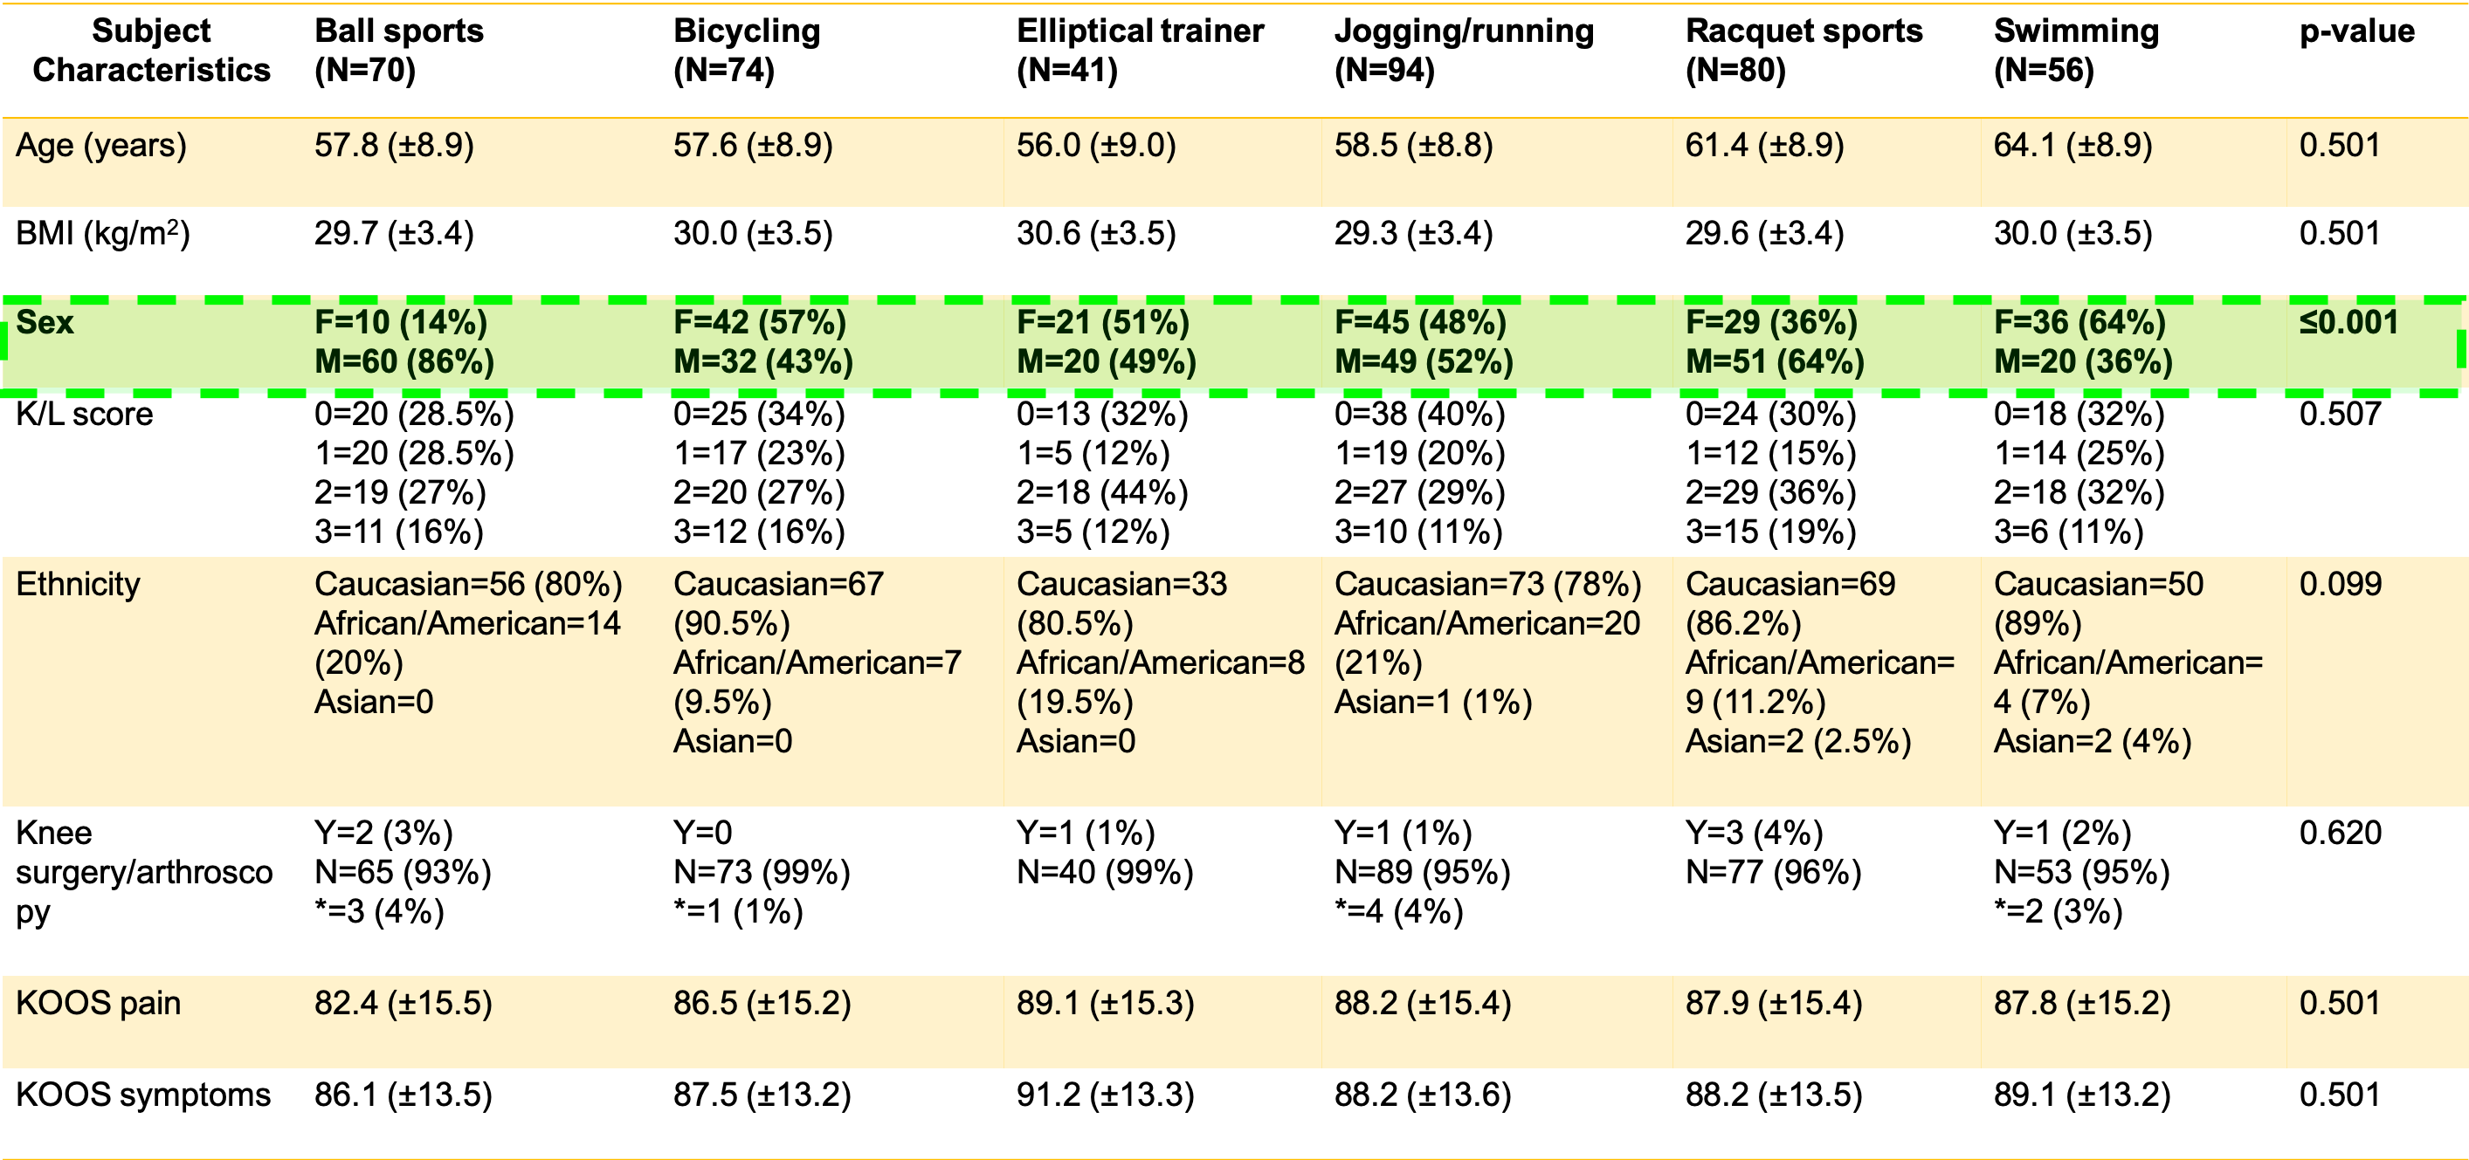
Background
Method and Materials
Results
Conclusion
Acknowledgment
Subjects Characteristics
*missing data
14

Slide 15
Background
Method and Materials
Results
Conclusion
Acknowledgment
Worms Parameters | Racquet Sports N=80 Elliptical trainer N=41 |  | P-value
 | Adjusted means changes in WORMS over 48 months [95% CI] |  | Elliptical trainer vs Racquet sports Bonferroni
Overall Worms score | 6.36 [5.16,7.56] | 1.37 [-0.29,3.05] | ≤0.001*
Cartilage
Global Sum | 2.96 [2.34,3.58] | 0.76 [-0.10,1.62] | 0.001*
Medial femur | 0.65 [0.43,0.87] | 0.13 [-0.17,0.43] | 0.098
Medial tibia | 0.59 [0.37,0.81] | -0.14 [-0.45,0.16] | 0.003*
Meniscus
Global sum | 1.22 [0.81,1.63] | 0.20 [-0.36,0.76] | 0.068
Medial meniscus body | 0.23 [0.08,0.38] | 0.09 [-0.12,0.30] | 1.00
Medial meniscus posterior | 0.33 [0.18,0.47] | 0.05 [-0.14,0.24] | 0.386
15
Notes:
Alan

Slide 16
Background
Method and Materials
Results
Conclusion
Acknowledgment
Worms Parameters | Racquet Sports N=80 Jogging/running N=94 |  | P-value
 | Adjusted means changes in WORMS over 48 months [95% CI] |  | Jogging/running vs Racquet sports Bonferroni
Overall Worms score | 6.36 [5.16,7.56] | 3.48 [2.37,4.58] | 0.009*
Cartilage
Global Sum | 2.96 [2.34,3.58] | 1.69 [1.12,2.26] | 0.050*
Medial femur | 0.65 [0.43,0.87] | 0.39 [0.19,0.59] | 1.00
Medial tibia | 0.59 [0.37,0.81] | 0.31 [0.11,0.51] | 1.00
Meniscus
Global sum | 1.22 [0.81,1.63] | 0.55 [0.17,0.92] | 0.261
Medial meniscus body | 0.23 [0.08,0.38] | 0.09 [-0.04,0.24] | 1.00
Medial meniscus posterior | 0.33 [0.18,0.47] | 0.10 [-0.02,0.23] | 0.339
16

Slide 17
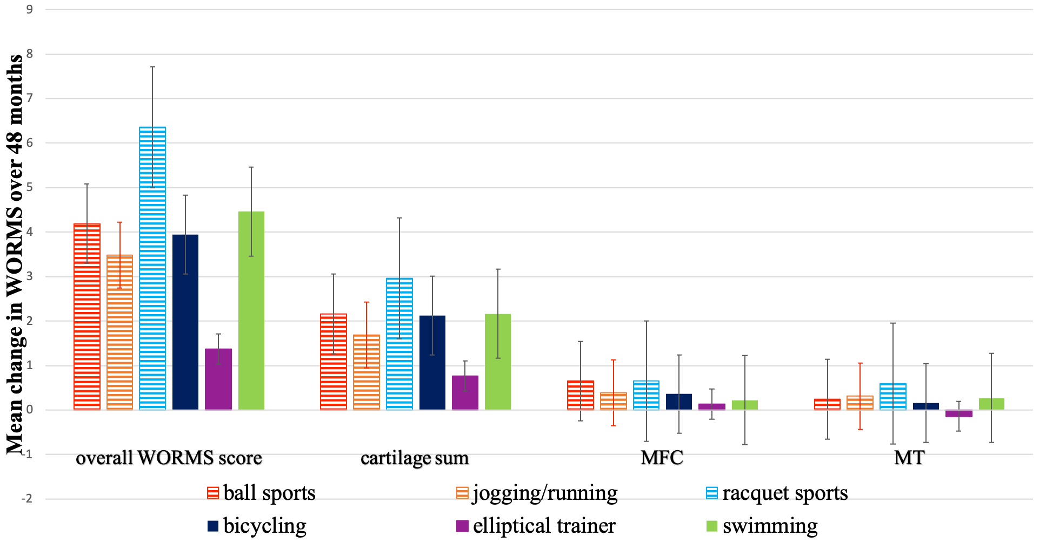
Background
Method and Materials
Results
Conclusion
Acknowledgment
Graphic Summary of mean changes in WORMS for each physical activity group
17

Slide 18
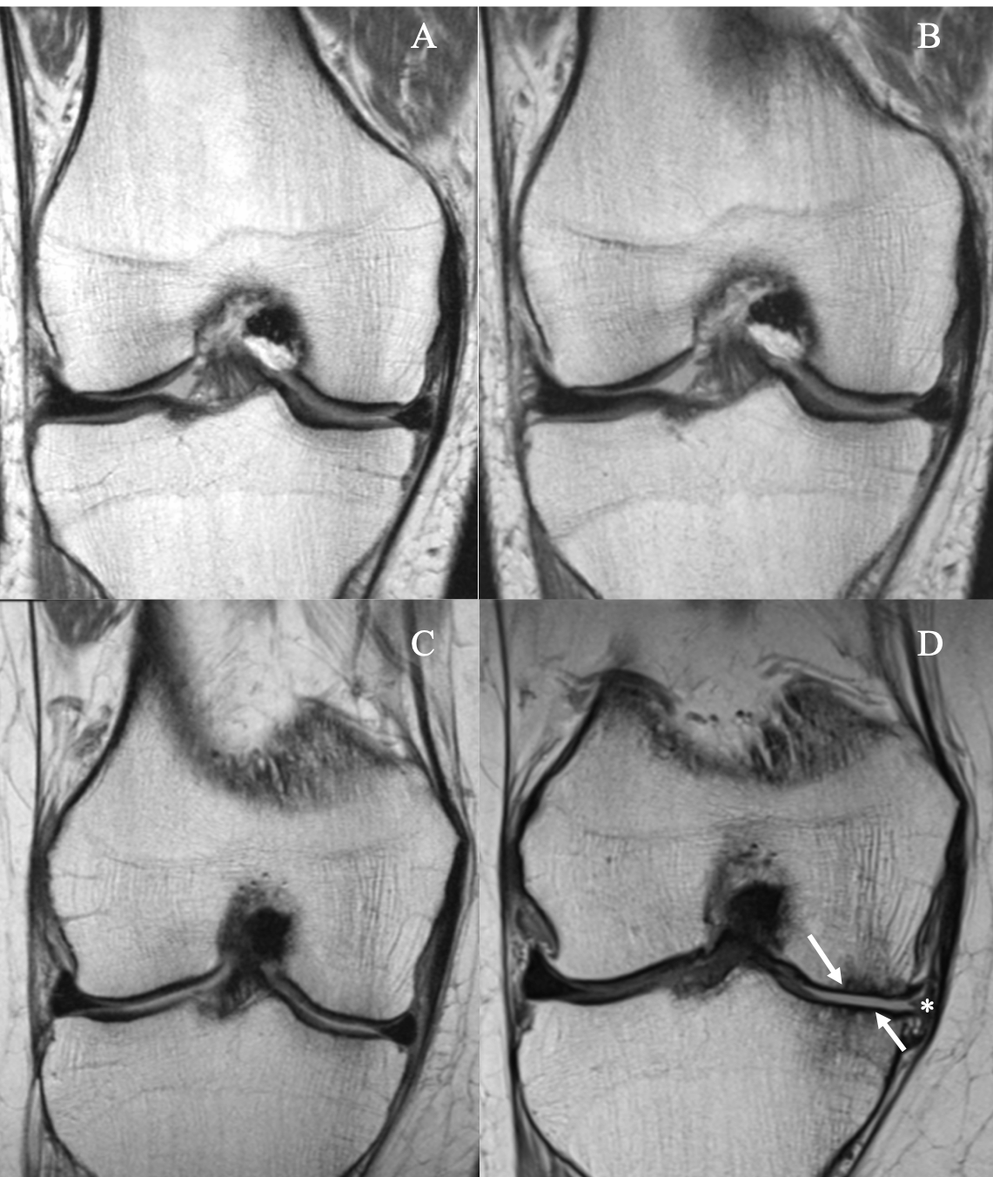
Background
Method and Materials
Results
Conclusion
Acknowledgment
Obese 76-year-old man performing elliptical trainer
Baseline
After
48-months
No cartilage defects
No cartilage defects
18

Slide 19
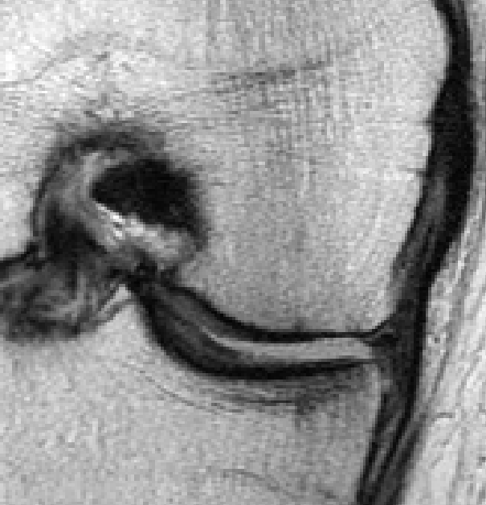
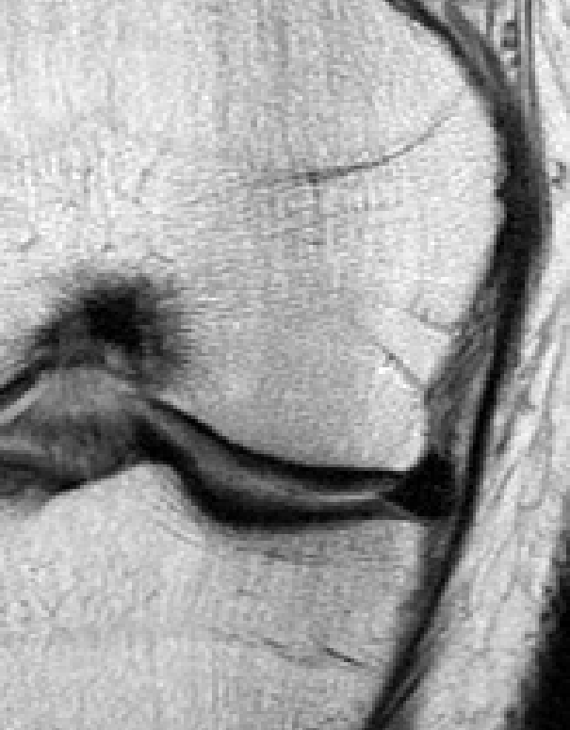
Background
Method and Materials
Results
Conclusion
Acknowledgment
Obese 59-year-old woman performing a racquet sports
Baseline
After
48-months
*
Full thickness cartilage defects in medial femur condyle and tibia (arrows) and extrusion of the meniscus body (asterisk).
No cartilage defects
19

Slide 20
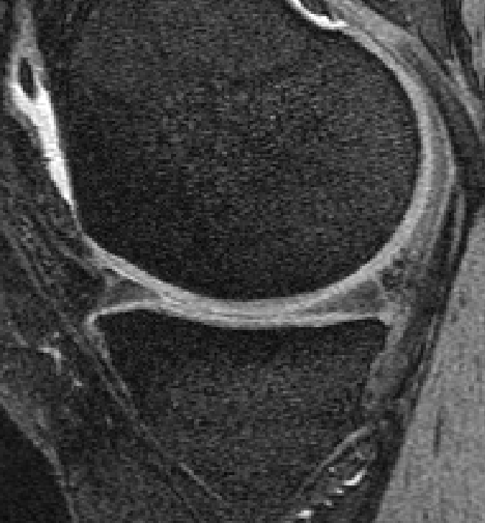
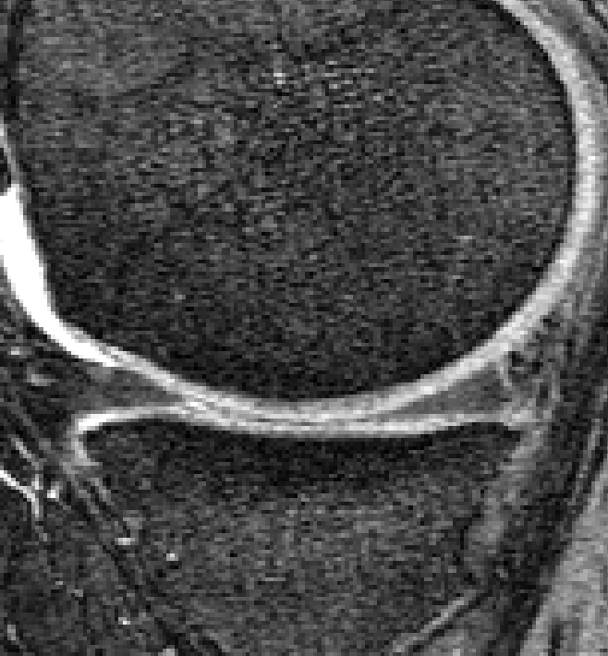
Background
Method and Materials
Results
Conclusion
Acknowledgment
Overweight 47-year-old woman in the elliptical trainer group
Baseline
48-months
No cartilage defects
No cartilage defects
20

Slide 21
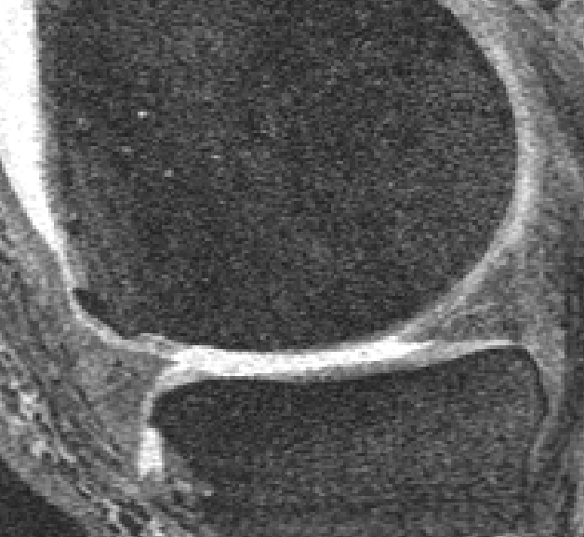
Background
Method and Materials
Results
Conclusion
Acknowledgment
Overweight 64-year-old man in the racquet sports group
Baseline
48-months
No cartilage defects
Full thickness cartilage defects medial femur and tibia (arrowhead).
21

Slide 22
Background
Method and Materials
Results
Conclusion
Acknowledgment
☞ Progression of knee joint degeneration was consistently higher in obese and overweight subjects engaging in racquet sports.
☞ Subjects using the elliptical trainer showed the smallest changes in structural degeneration over 48 months.
22

Slide 23
Background
Method and Materials
Results
Conclusion
Acknowledgment
Overweight and obese subjects could benefit from low impact physical activities, especially exercising with elliptical trainer in order to slow progression of knee joint degeneration and cartilage defects.
23

Slide 24

Background
Method and Materials
Results
Conclusion
Acknowledgment
silvischiro@gmail.com

