Slide 1
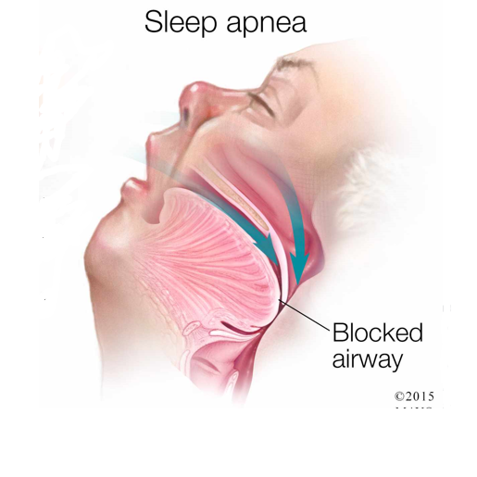
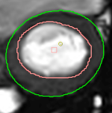
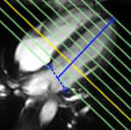


Subclinical Changes in Cardiac Functional Parameters as Determined by MRI in Patients with Sleep Apnea and Snoring: Findings from UK Biobank
Department of Radiology
Munich University Hospital
Prof. Dr. J. Ricke
Curta A; Hetterich H; Schinner R; Sommer W, Aung N, Sanghvi MM, Neubauer S, Piechnik SK; Petersen S

Slide 2
UK Biobank
Population based study
500,000 recruited individuals from 2006-2010
Age 40-69 years
Subgroup of 100,000 participants with comprehensive imaging protocol
  Magnetic resonance imaging of the head, heart and abdomen
  Ultrasound of the vessels supplying the brain
  Bone density measurements
So far manual evaluation of ca. 5,000 heart examinations

Slide 3
Obstructive sleep apnea (OSA)
Prevalence 10-17% in males and 3-9% in females aged 30-70
Narrow upper airways and nighttime loss of muscle tone
  Breathing cessation
  Abrupt awakening
  Increased risk for cardiovascular disease
Association with high arterial and pulmonary blood pressure
Higher risk for heart failure, left atrial dilation, arrhythmia and stroke
Up to date limited studies using magnetic resonance imaging
Peppard PE et al. Am J Epidemiol. Jul 2013;1006-1014.
Mansukhani MP et al. Current hypertension reports. Sep 2014;16(9):476.
Bliwise DL et al. Chest. Mar 1991;99(3):600-608.
Gottlieb DJ et al. Circulation Jul 2010 Jul;122(4):352-60
Palomaki H et al Neurology. Jul 1992;42(7 Suppl 6):75-81

Slide 4
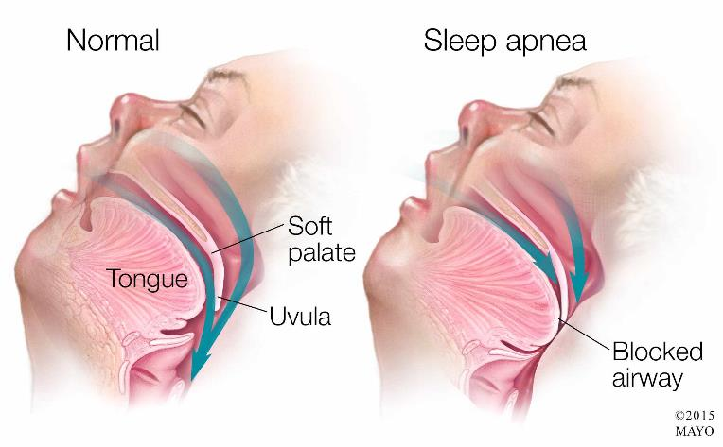
Obstructive sleep apnea
https://newsnetwork.mayoclinic.org/

Slide 5
Obstructive sleep apnea – Symptoms
Loud snoring
Breathing cessation during sleep with abrupt awakening
  In advanced cases shortness of breath on awakening
Dry mouth or sore throat on awakening
Morning headaches
Lack of concentration and excessive daytime sleepiness

Slide 6
Purpose of our study
Exploration of cardiac function with magnetic resonance imaging in individuals with sleep apnea and self-reported snoring without known cardiac disease
Hypothesis:
  There is a stepwise deterioration of cardiac function in sleep apnea and snoring compared to the control population.

Slide 7
Material and methods – demographics
Threefold acquisition of patient data:
  NHS “Hospital Episode Statistics Analysis”
  Electronic questionnaire
  Interview
Measurements of blood pressure, heart rate, height and weight at the interview and prior to imaging.

Slide 8
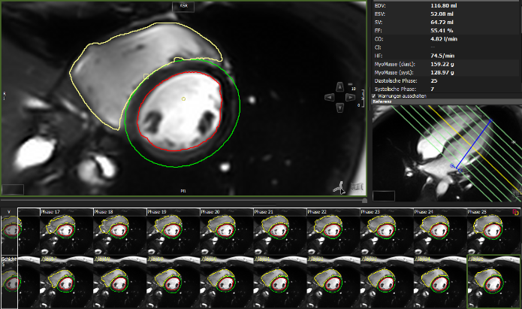
Material and methods - HEart IMAGING
Contours are drawn in multiple slices of the heart during a whole heartbeat to determine cardiac parameters (volume, function, mass)

Slide 9
Results - Demographics
Fewer individuals than expected had known sleep apnea
(1.1% males / 0.2% females)
Significantly more men had sleep apnea and reported snoring compared to women.
Individuals with snoring and sleep apnea were overweight, had higher blood pressure and reported more daytime sleepiness.
There was no significant age difference between the groups.

Slide 10
Results – Heart parameters Females
Gender specific difference in heart parameters:
Females with…
  Sleep Apnea:
    Decreased volumes of the left and right heart chamber during diastole, possibly due to increased stiffness of the heart muscle
    Heart muscle mass was not significantly increased, possibly due to the small number of individuals
  Snoring:
    Increase in heart muscle mass as a possible early indicator for hypertrophy.

Slide 11
Results – Heart parameters MALES
We found a gender specific difference in heart parameters:
Males with…
  Sleep Apnea:
    Increase in the function of the right heart chamber, possibly as an early sign of hypertrophy
    No significant increase in the function of the left heart chamber, possibly due to the low number of individuals.
  Snoring:
    Increase in the function of the left and right heart chamber, possibly as an early sign of hypertrophy

Slide 12
Conclusion
Sleep apnea is grossly underdiagnosed
  We assume there is a great number of individuals with sleep apnea in the snoring group.
  More extensive information/prevention programs needed
Different effect on the heart in the early stages based on gender
  Women: Alterations in the heart muscle and increase in mass
  Men: Increase in heart function
As this is a population based study, these observations have to be validated in dedicated prospective studies.

Slide 13

Thank you

