Slide 1
Cryoablation as a Primary Treatment of Low Risk Breast Cancers : An Update and Imaging Findings of the Ice 3 Trial
Kenneth R. Tomkovich, MD
RSNA 2018
Chicago Illinois USA

Slide 2
Historical Perspective
Radical Mastectomy first performed late 1800’s
Modified Radical Mastectomy 1960’s
Lumpectomy and axillary dissection 1980’s
  Umberto Veronesi NEJM 2002; 347:1227-32
  Bernard Fisher NEJM 2002; 347: 1233-41
  20 year survival same mastectomy, lumpectomy, lumpectomy with radiation
Is it time for the next step in the treatment of breast cancers?

Slide 3
Historical Perspective
Technologic improvements in cancer detection over the last 10-20 years
  Digital mammography
  Breast tomosynthesis
  High resolution ultrasound
  Breast MRI
AJCC 8th Breast Cancer Staging System
  2018 tumor biology differences recognized
https://cancerstaging.org/references-tools/deskreferences/Pages/Breast-Cancer-Staging.aspx (accessed October 28, 2018)

Slide 4
Ablation Therapy as a Primary Treatment for Cancer
Interventional Radiologists developed many of these techniques for the treatment of
Liver
Kidney
Lung
Bone
Thyroid
What is missing???....

Slide 5
Ablation Therapy as a Primary Treatment for Cancer
Breast

Slide 6
The Case For Cryoablation
Why is cryoablation best for breast cancer?
  Widely available
  Easily monitor ice ball with ultrasound
  No damage to chest or pectoral muscle (burning)
  Can be used close to skin (saline injection)
  Performed under local anesthesia
  Patient comfort: awake and supine
  Ice ball provides anesthesia
  Potential immune benefit?
    Roubidoux MA, Yang W, Stafford RJ. Image-guided ablation in breast cancer treatment. Techniques in Vascular and Interventional Radiology. 2014;17:49-54.

Slide 7
The Case For Cryoablation
How does cryoablation work?
  Uses Argon gas or liquid Nitrogen to cool the probe
  Cell death due to ice formation
  Alters tissue osmosis
  Cell membrane damage
  Cell lysis and death
  Body resorbs dead tissue over time

Slide 8
Ice 3 Trial
Purpose
First of its kind large scale multi-center trial to assess cryoablation as a primary treatment for breast cancer
No surgical resection
Results to date
Important imaging findings

Slide 9
Ice 3 Trial
Method and Materials
HIPAA compliant, IRB approved multi-center trial
150-200 patients with low risk invasive carcinoma of the breast
Females age 60 and older with Stage 1 breast cancer
Unifocal primary disease 15mm or smaller
Lobular carcinoma and extensive DCIS are excluded
Strict pathologic criteria following ultrasound biopsy
  ER+, PR+/-, HER 2 -, Nottingham grade 2 or less
Ultrasound guided cryoablation of visible tumor with IceSense 3 system (IceCure Medical, Ltd.)

Slide 10
Ice 3 Trial: Method and Materials
Goal of 10mm margin of visible ice around tumor or a 35-40mm diameter of ice at the end of the freeze
Hormone therapy, chemotherapy, radiation therapy as per NCCN guidelines
Patients followed by mammography at 6 months, 12 months and then annually
Patients may have additional imaging with ultrasound or MRI but this is not a requirement

Slide 11
Ice 3 Trial: Technique
Experienced operators (extensive training and or experience in ultrasound guided biopsy or ultrasound guided ablation)
Sterilize breast
Locate lesion with ultrasound guidance (must have residual visible tumor post biopsy)
Local anesthetic (10 ml 1% lidocaine)

Slide 12
Ice 3 Trial: Technique
5mm skin incision
Place probe through center of lesion using ultrasound guidance
Freeze, thaw, freeze cycle (typically 9 minutes, 8 minutes, 9 minutes)
Remove probe
Apply dressing

Slide 13
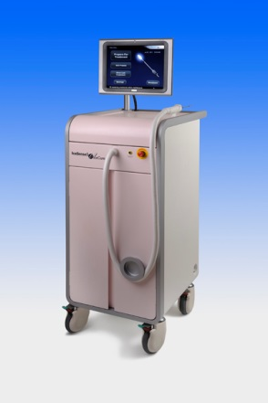
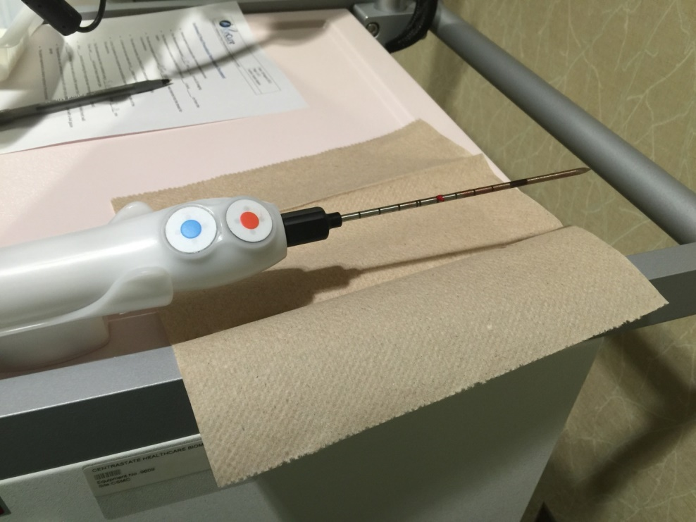
Ice 3 Trial: Technique

Slide 14
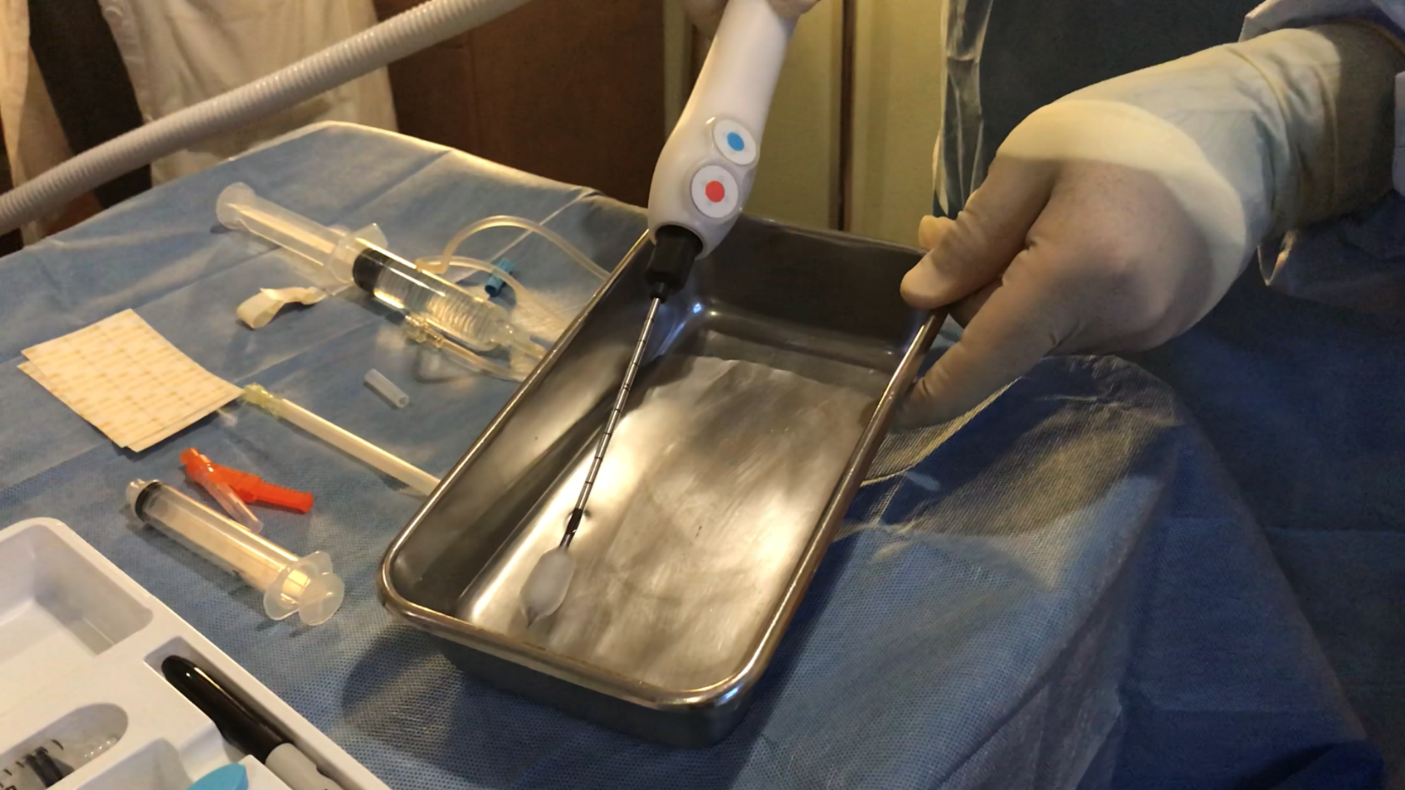

Slide 15
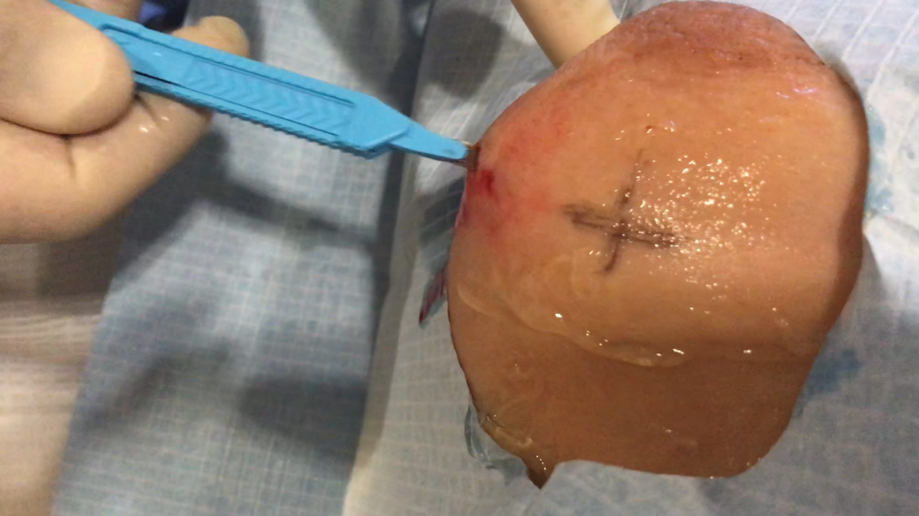

Slide 16
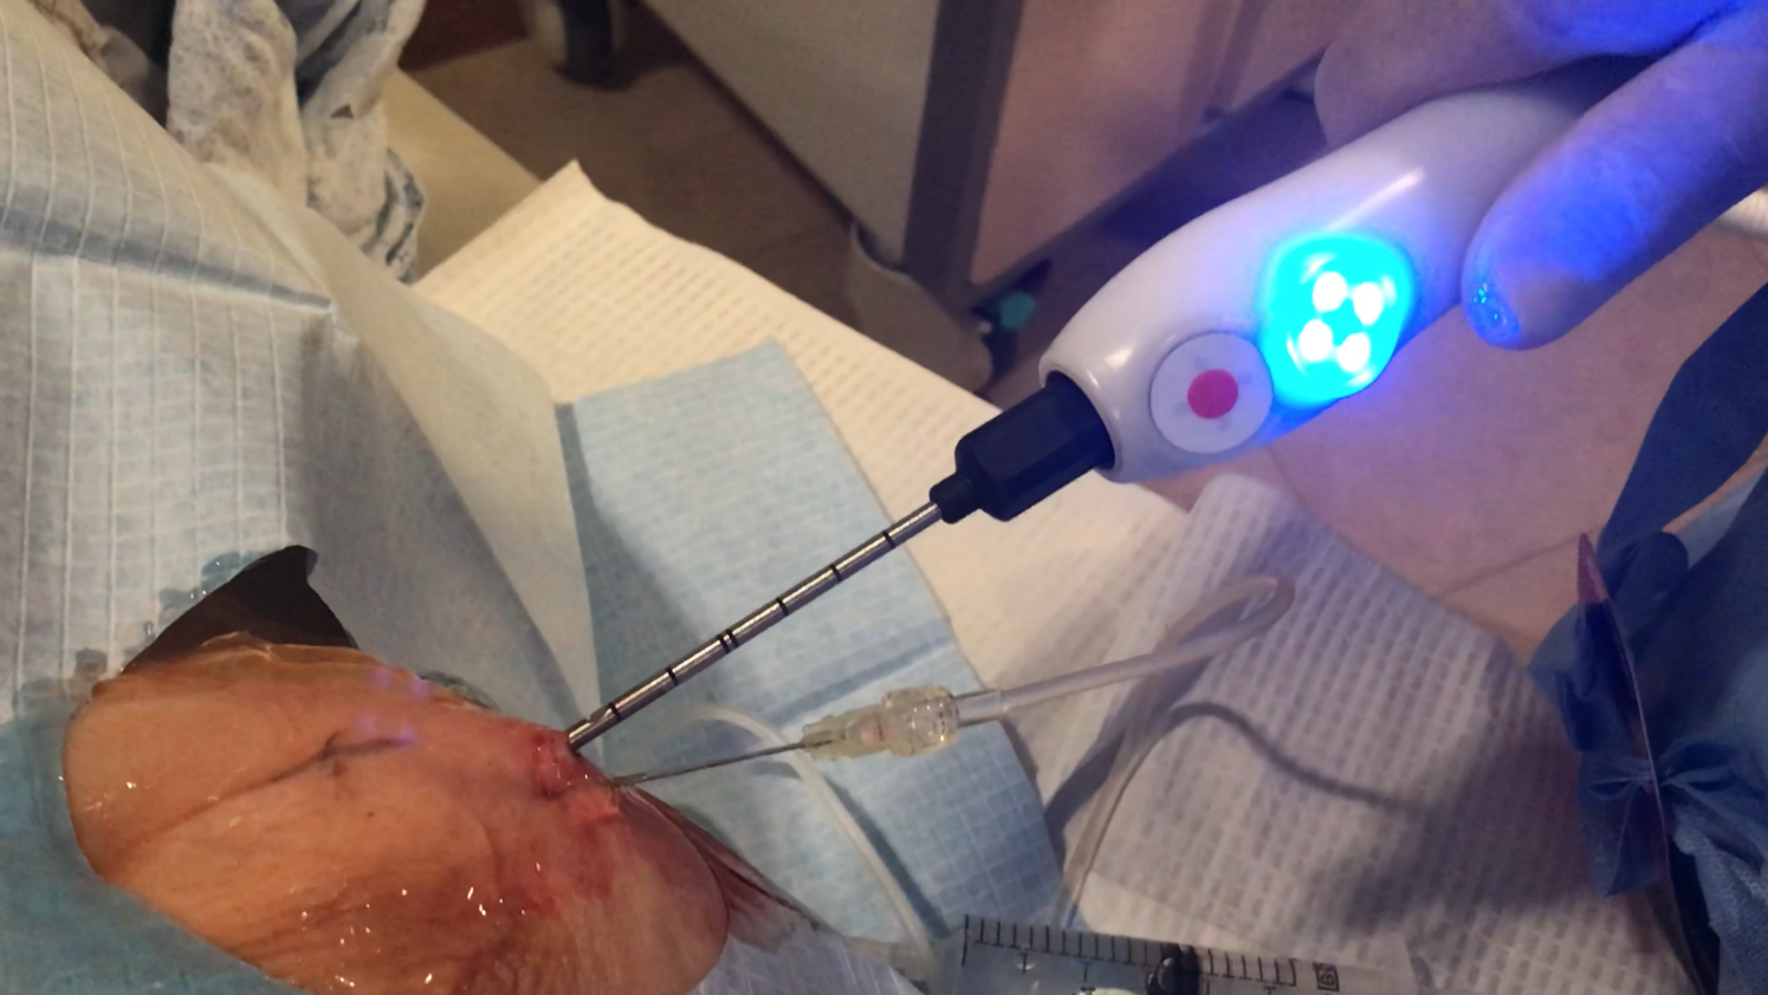

Slide 17
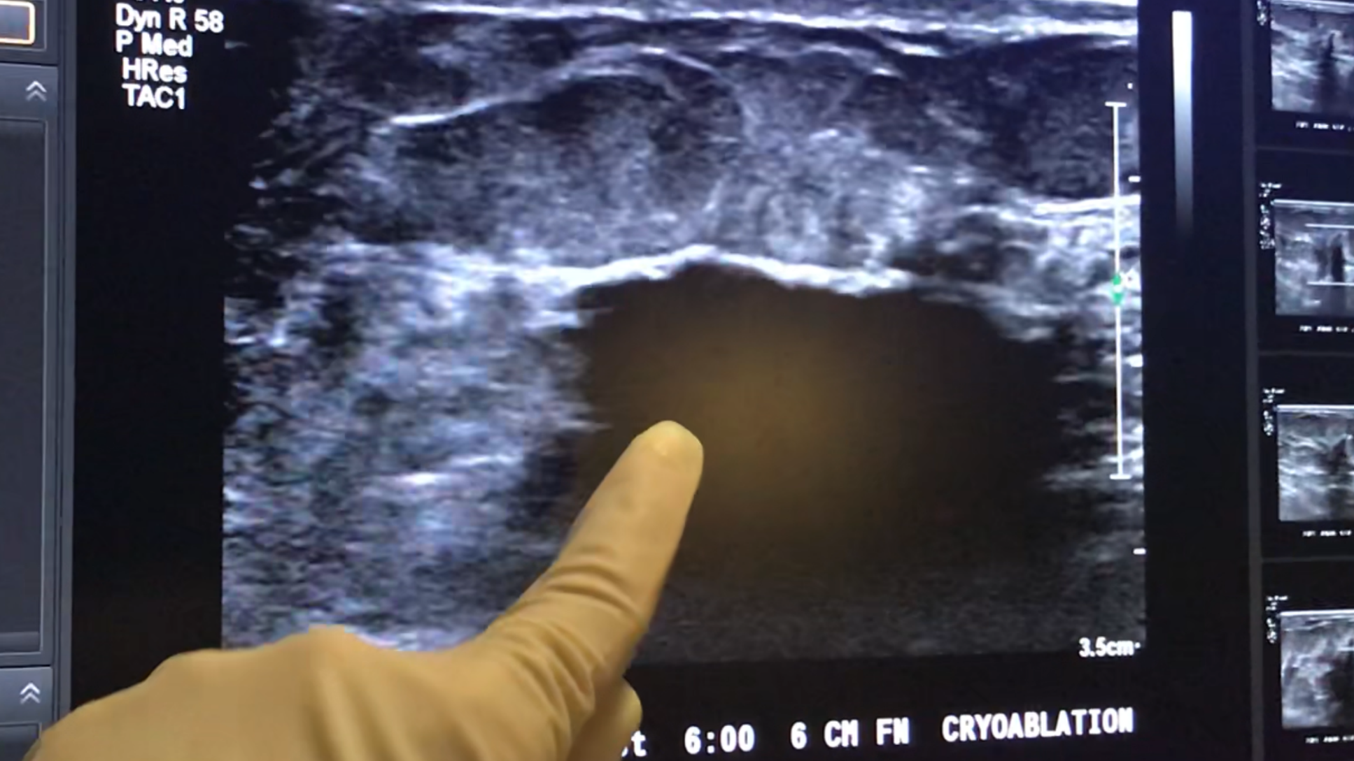

Slide 18
Ice 3 Trial
Imaging Findings

Slide 19
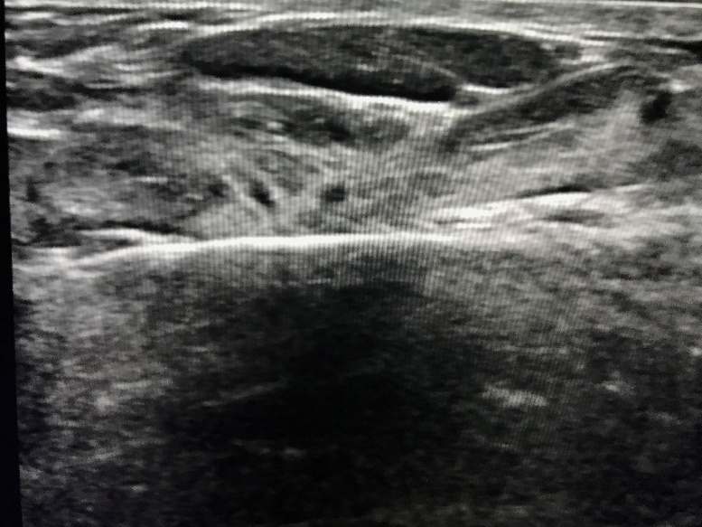
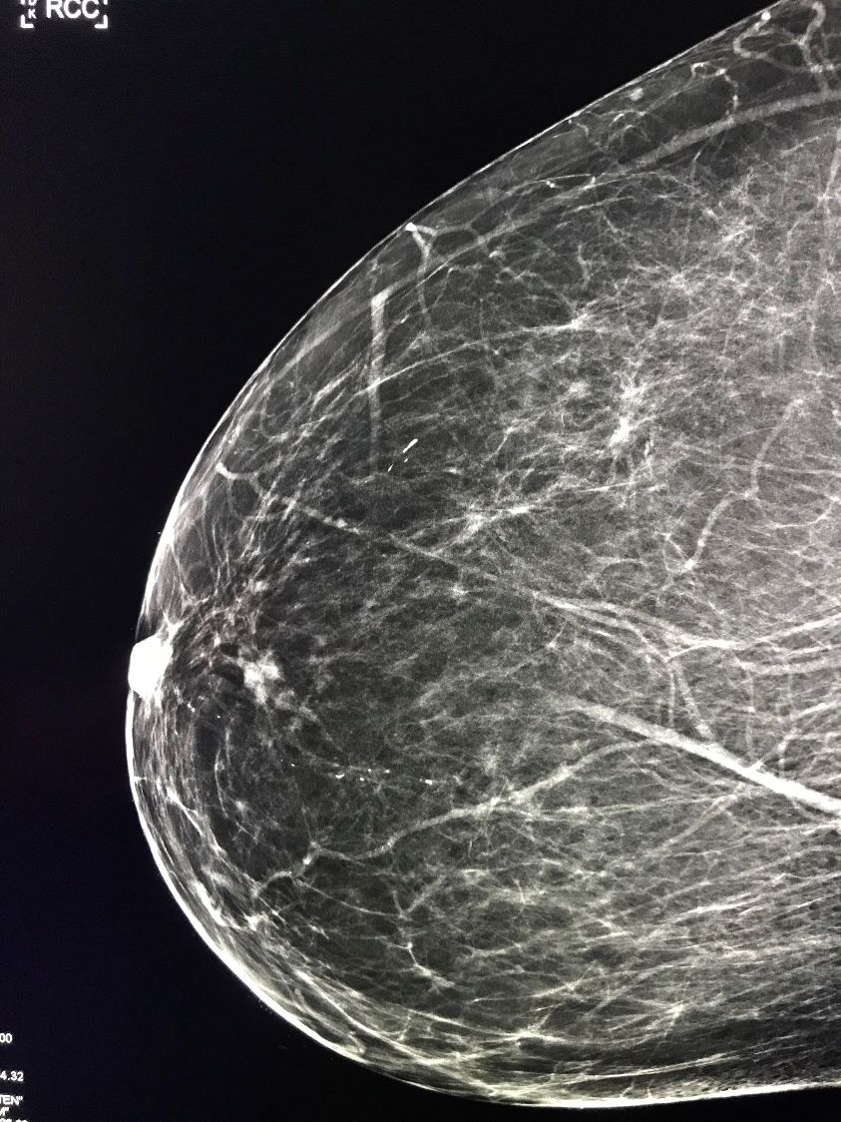
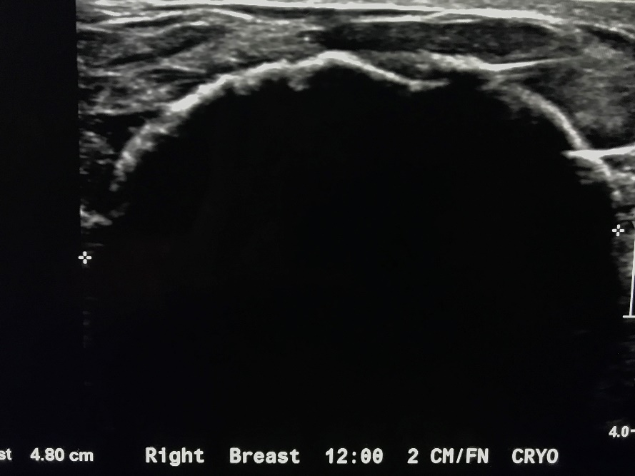
Case 1 invasive carcinoma

Slide 20
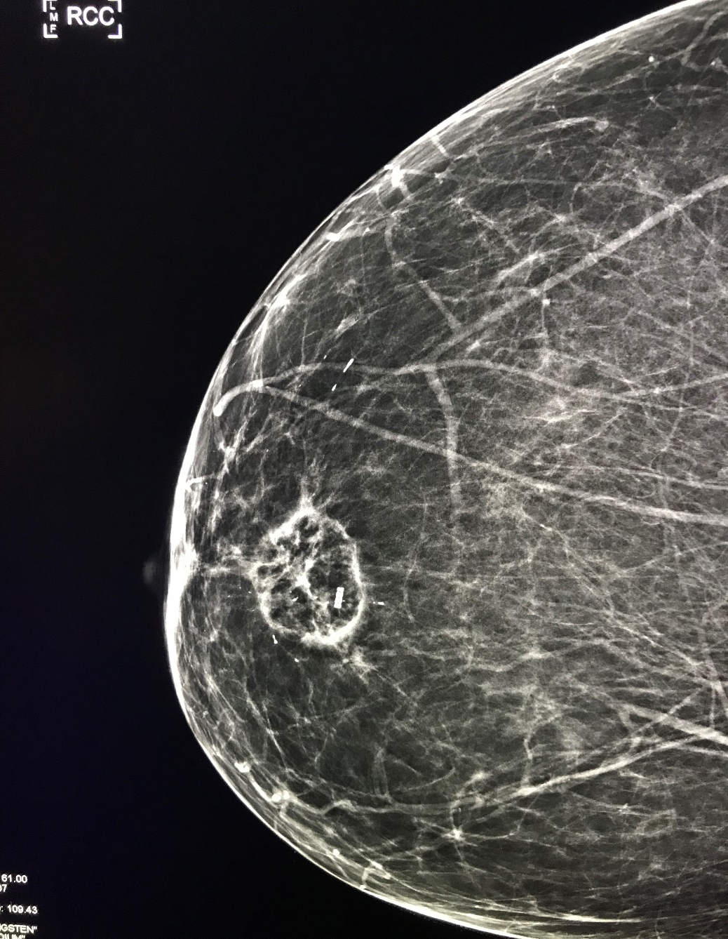

Case 1 Pre-ablation
Follow up at 6 months

Slide 21
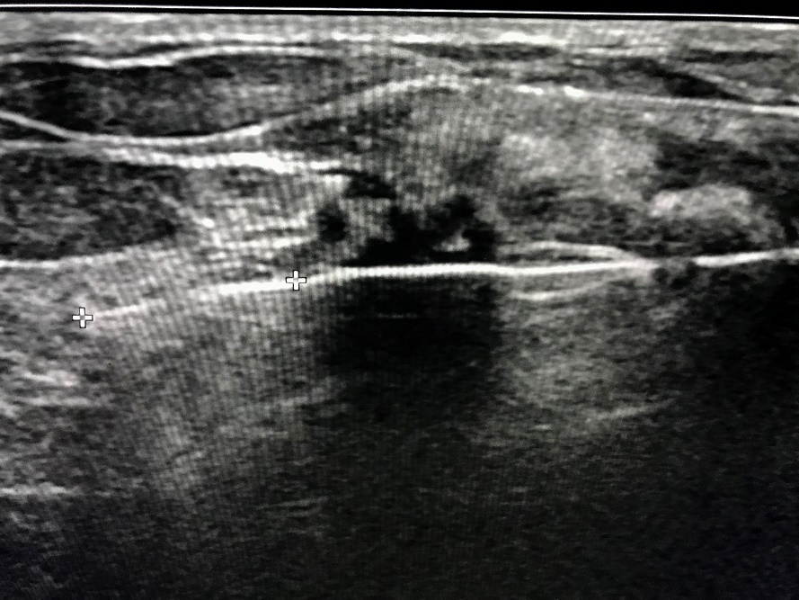
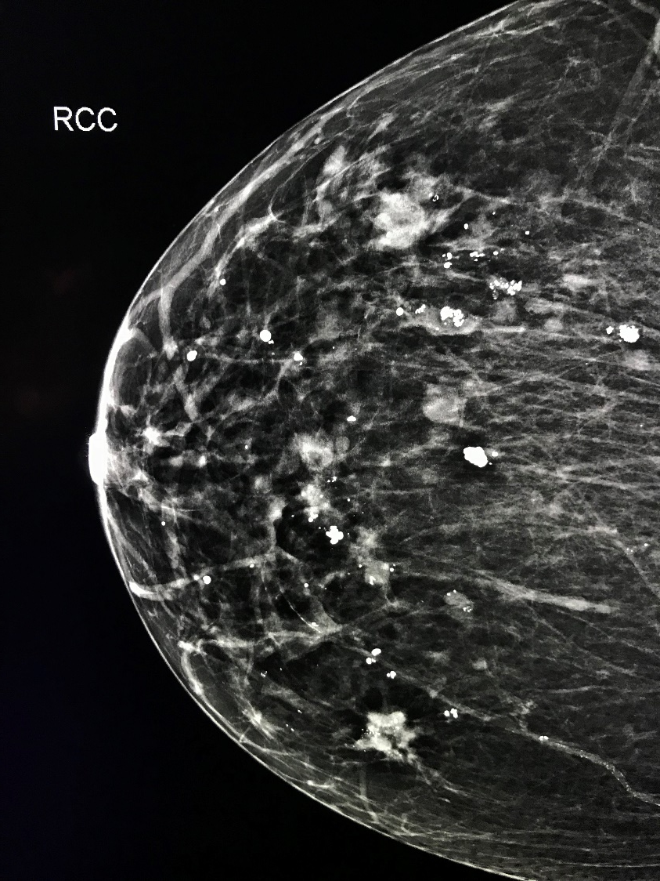
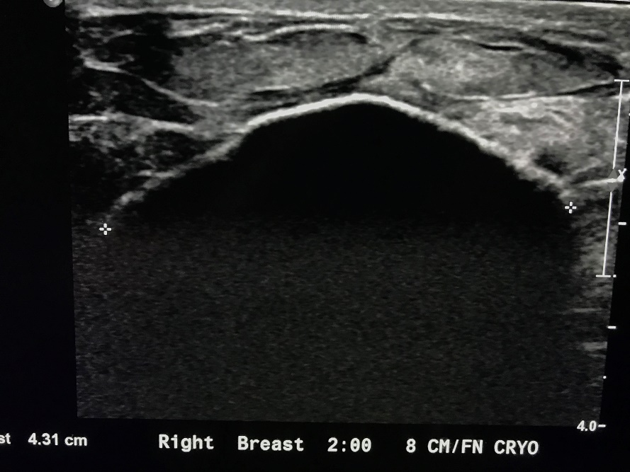
Case 2 invasive carcinoma

Slide 22
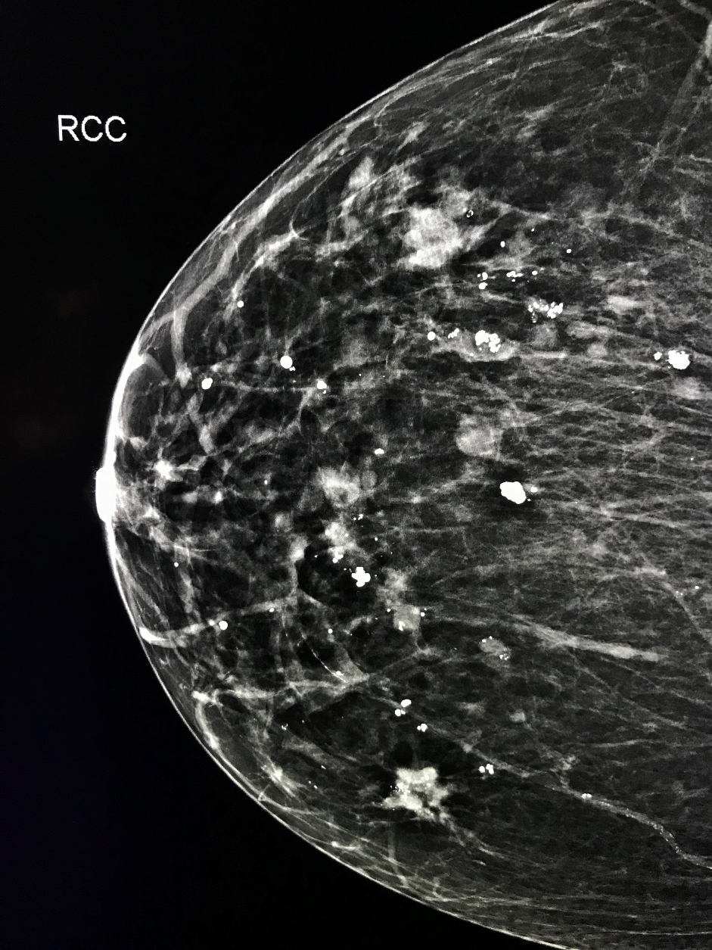
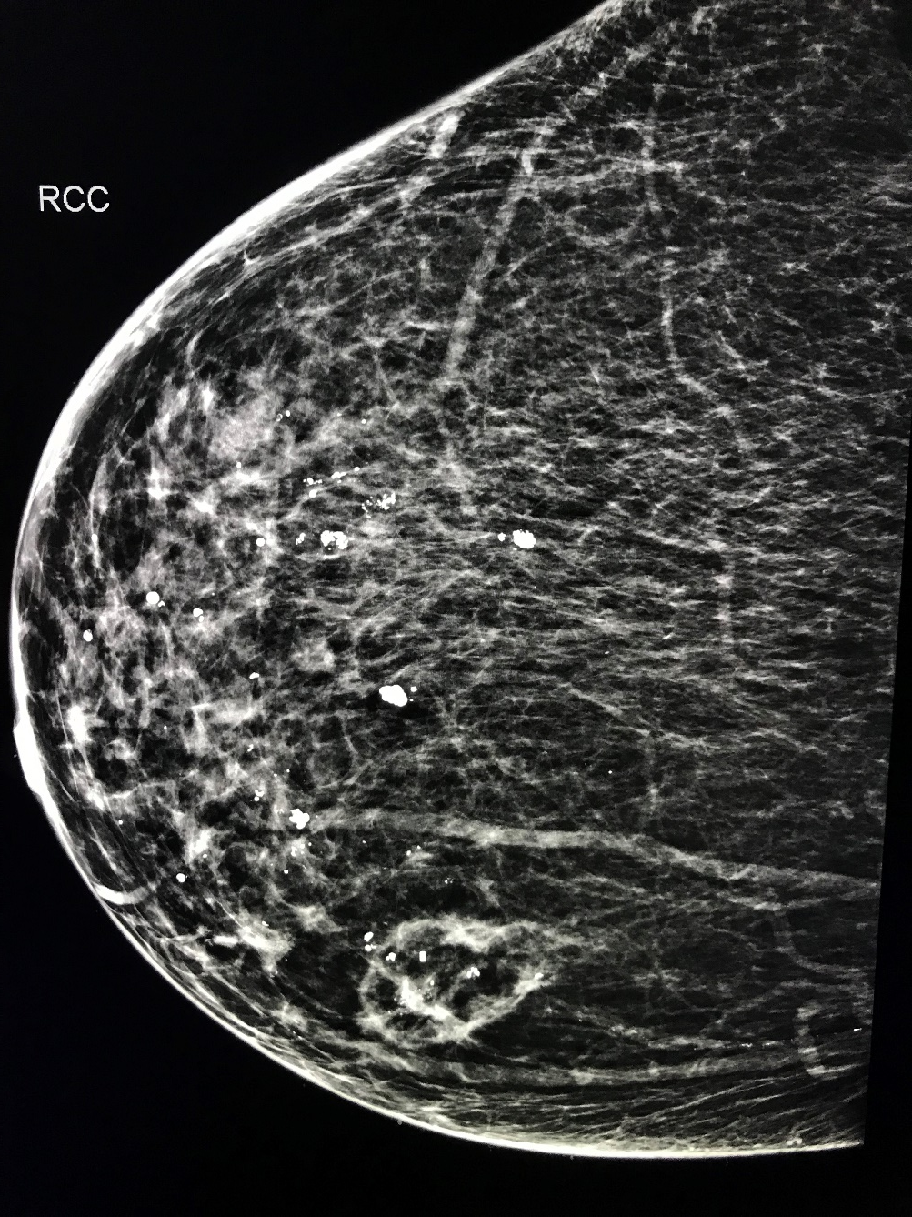
Case 2 Pre-ablation
Follow up at 6 months

Slide 23
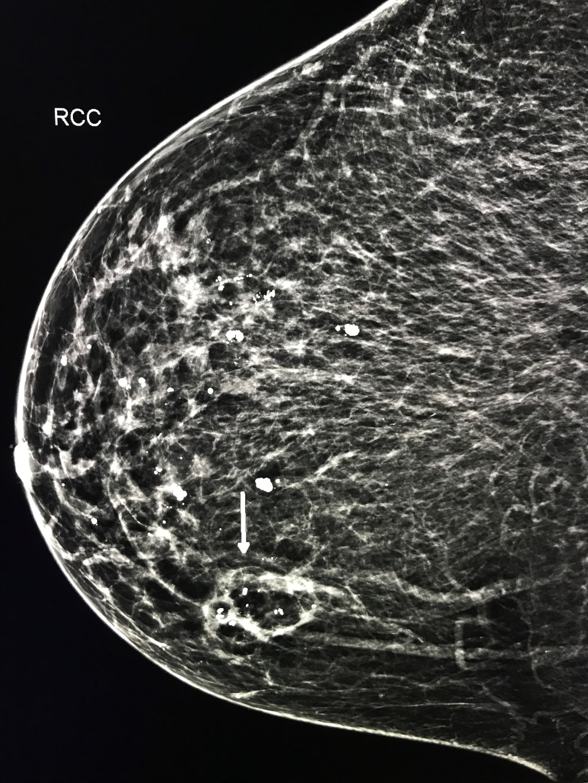
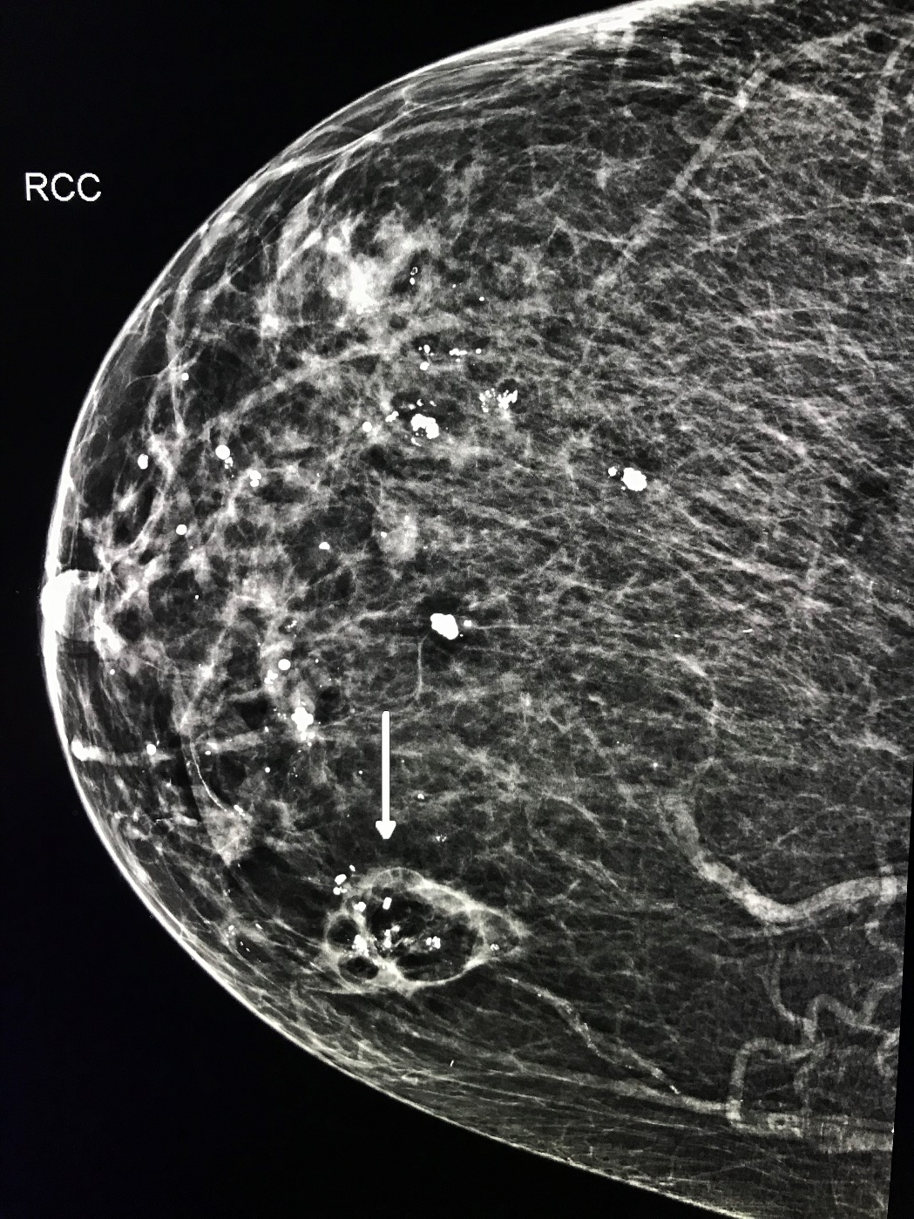
Follow up at 12 months
Case 2
Follow up at 24 months

Slide 24
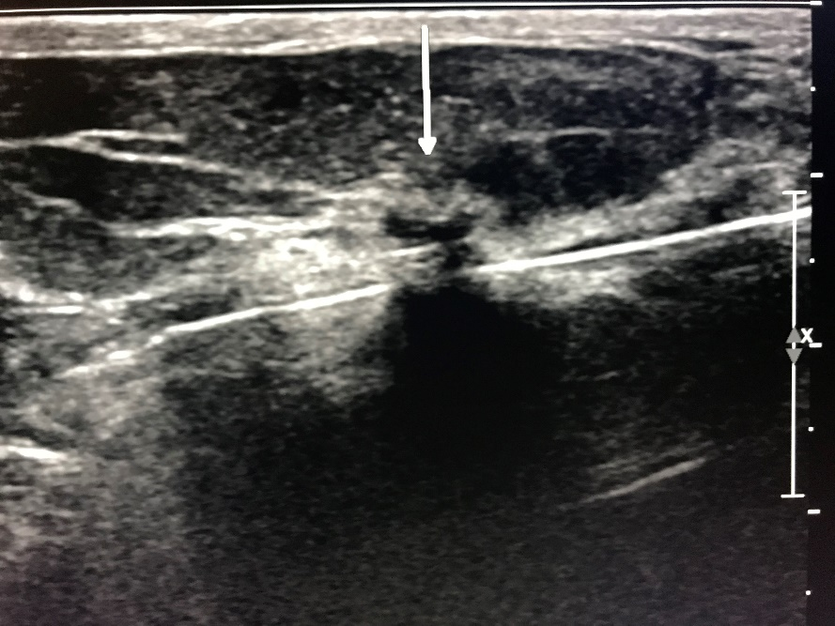
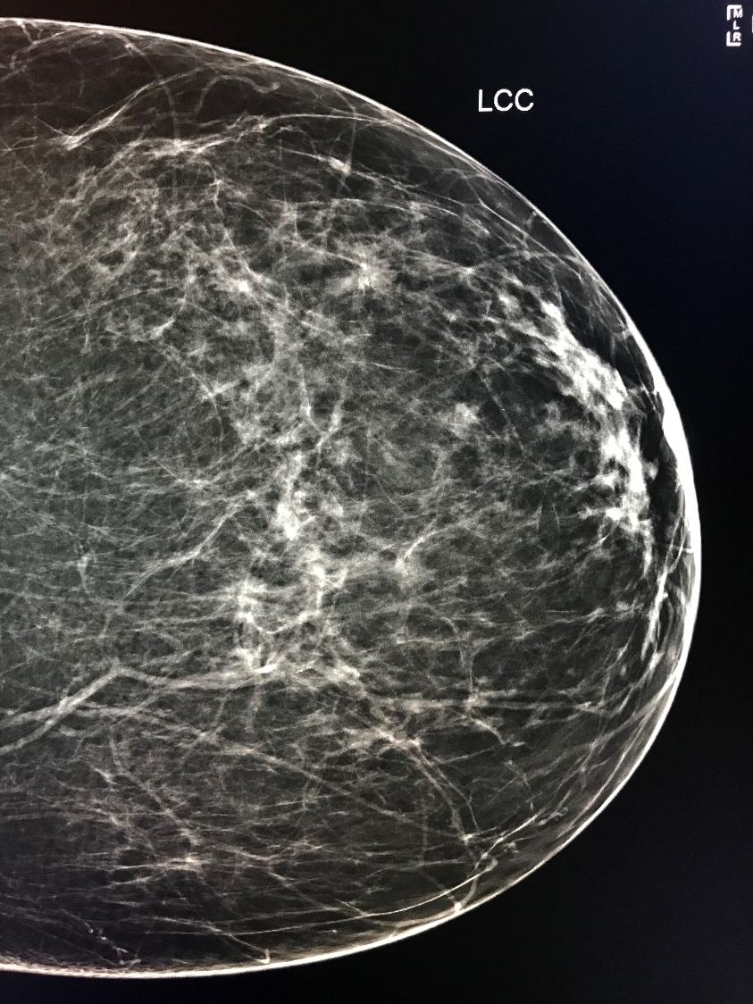
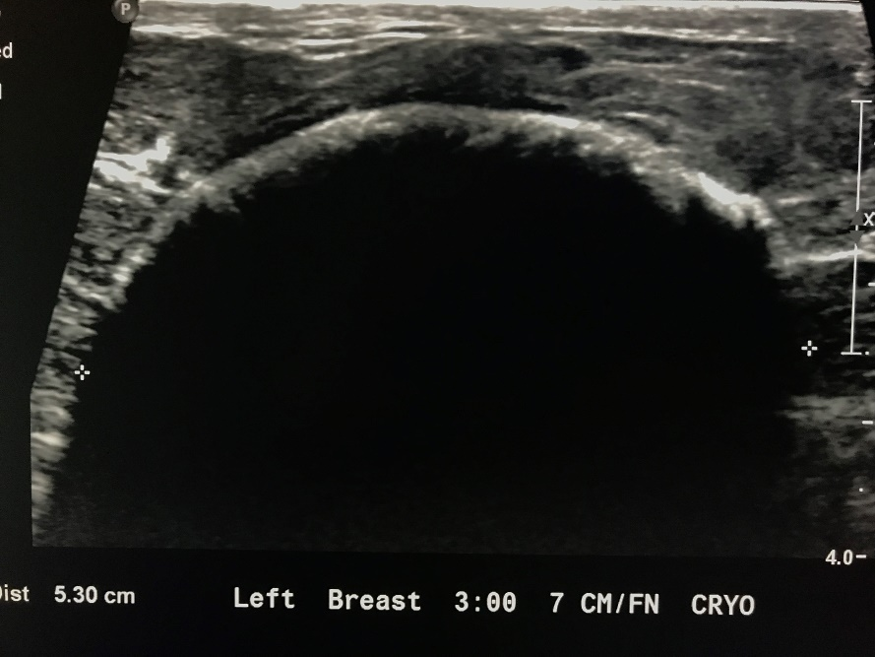
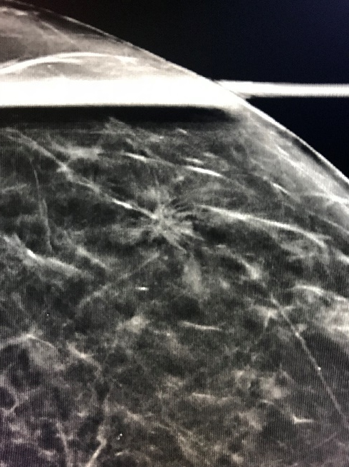
Case 3 invasive carcinoma

Slide 25

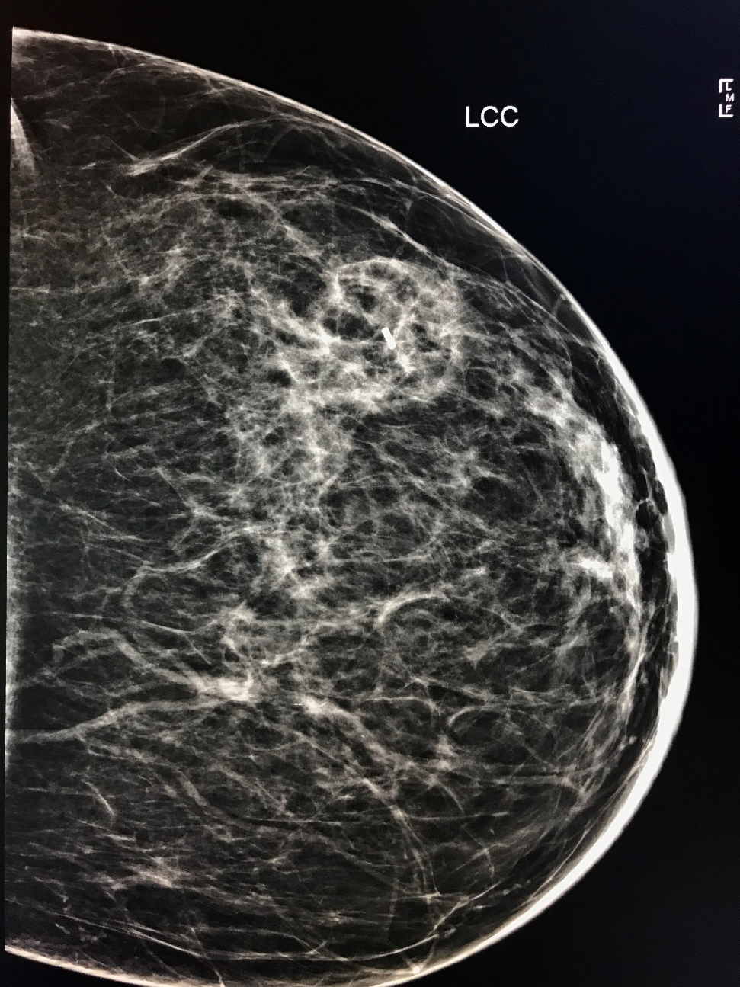
Case 3 Pre-ablation
Follow up at 6 months

Slide 26
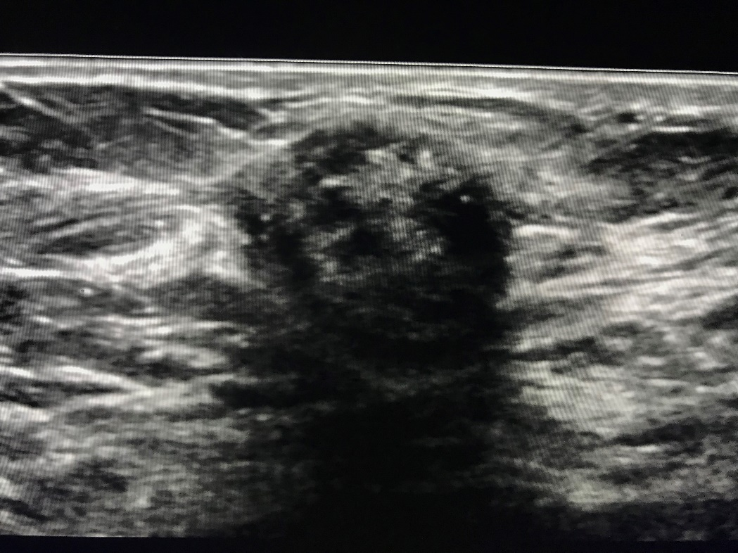
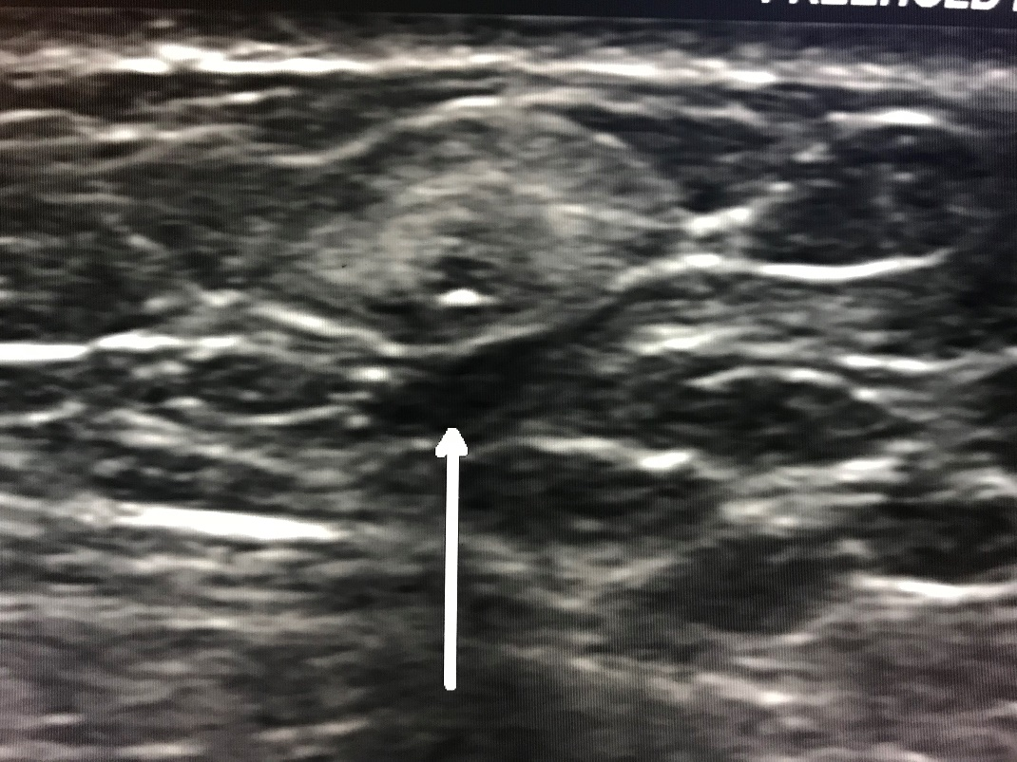
12 month follow up ultrasound images post cryoablation of breast cancer
Ovoid hypoechoic and echogenic area consistent with fat necrosis benign calcifications and scar
Ovoid echogenic structure
consistent with fat necrosis
(hyperechoic focus is marker)

Slide 27
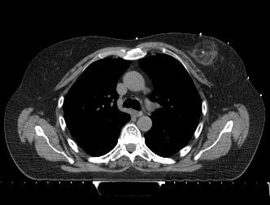
Radiation planning

Slide 28
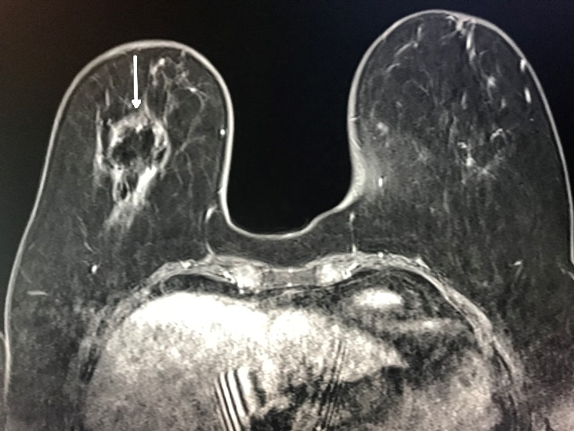
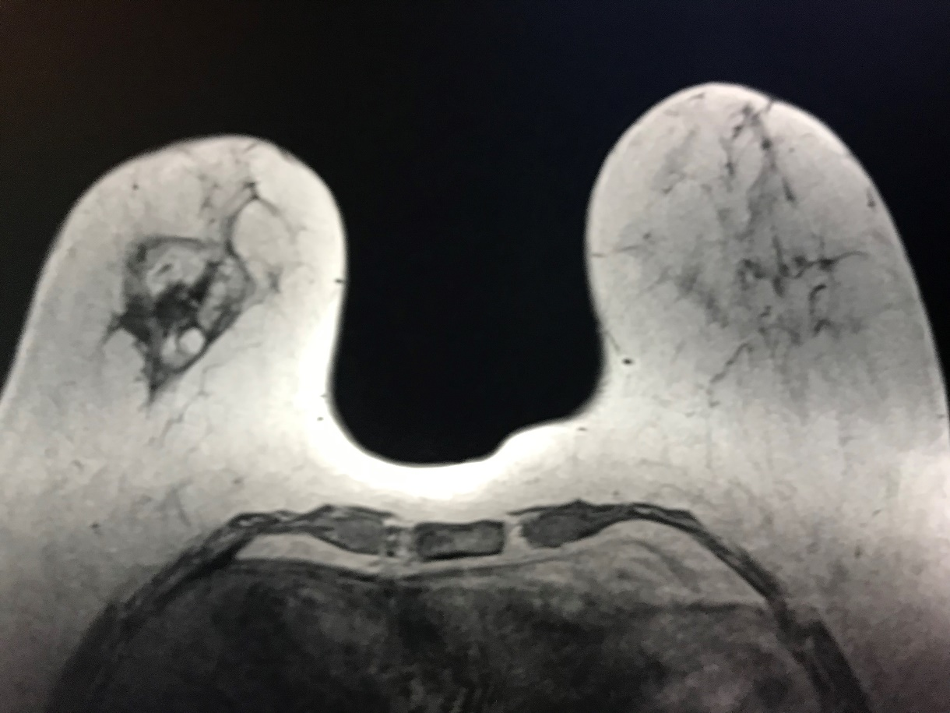
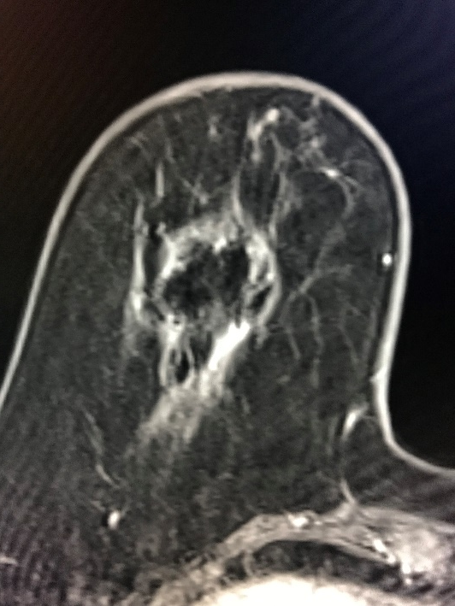
MRI breast 2 months post ablation
T1 image showing “cryohalo” and
central low signal ablation zone
T2 fat sat post gad showing “cryohalo”
with no central enhancement and
no residual evidence of tumor

Slide 29
Ice 3 Trial
Results
Trial began enrollment in October 2014
174 patients
20 sites throughout USA
Age range 60-90
100% procedural success
No serious adverse events related to device reported

Slide 30
Ice 3 Trial: Results
137 patients 6 month follow up
107 patients 12 month follow up
61 patients 24 month follow up
12 patients 36 month follow up
2 imaging and clinical recurrence
105 of 107 patients no recurrence = 98%
  (with at least 12 month follow up post ablation)

Slide 31
Ice 3 Trial: Conclusions
Cryoablation is safe, well tolerated and easily monitored
To date, there has been 100% initial procedural success
Most common imaging findings include fat necrosis and “cryo-halo” effect similar or less than the scarring and architectural distortion commonly seen in patients post lumpectomy and radiation
The current clinical success rate for patients with at least 12 months follow up is 98%
Understanding “new normal” imaging findings in patients post cryoablation for breast cancer is important to prevent unnecessary biopsy

Slide 32
Ice 3 Trial: Conclusions
Cryoablation is a safe and effective primary treatment option for women with low-risk invasive breast cancer and may result in a potential image guided alternative to surgical lumpectomy
This research and continued data evaluation is ongoing
Additional prospective multi-center trials by experienced operators in patients with specific selective criteria are encouraged
Radiologists, Interventional Radiologists and Breast Surgeons should participate in this research and development of these techniques as a non-surgical option to treat breast cancer

Slide 33
Thank You!
Kenneth Tomkovich, MD
Princeton Radiology
CentraState Medical Center
901 West Main Street
Freehold, New Jersey USA
07728
KTomkovich@princetonradiology.com

