Slide 1
Subconcussive head impacts may alter metrics associated with normal pruning in youth and high school football players
Gowtham Murugesan¹, Ryan Fisicario¹, Elizabeth Davenport¹, James Holcomb¹, Ben Wagner¹, Jillian Urban², Mireille Kelley², Derek Jones², Christopher Whitlow², Joel Stitzel², Joseph A. Maldjian¹,
¹University of Texas Southwestern; ²Wake Forest University

Slide 2
Disclosures
None

Slide 3
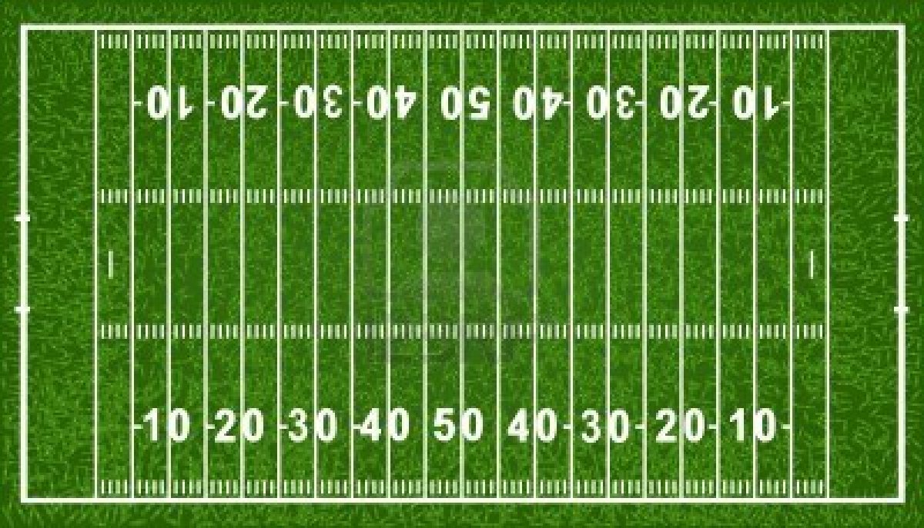
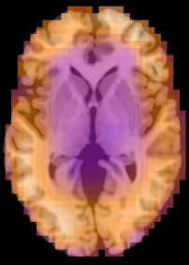
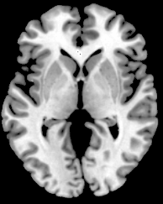
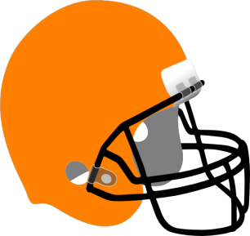
The purpose of this study is to determine if there are changes in the structure and function of the brain over a season of football in players who did not have a concussion.
Measurable Change?
Pre-Season
Post-Season
Cumulative Exposure to Hundreds of Impacts

Slide 4
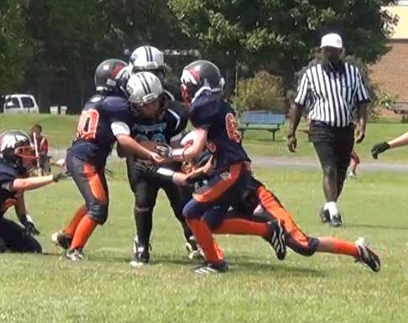
Significance
Collegiate and high school football players sustain a surprisingly high number of head impacts ranging from several hundred to well over 1,000 during the course of a season.
The vast majority of these do not result in concussion.
This is a highly understudied area at the youth and high school level.
Notes:
Athletes at the collegiate and high school levels sustain a surprisingly high number of head impacts ranging from several hundred to well over 1000 during the course of a season.
The associated cumulative impact burdens over the course of a career are equally important.
Recent autopsy data have shown that there are subsets of athletes in contact sports who do not have a history of known or identified concussions but nonetheless have neurodegenerative pathology consistent with chronic traumatic encephalopathy.
Such data suggest that subconcussive level impacts can lead to significant neurological alterations, especially if the blows are repetitive.
Youth constitute clear majority (~3.5 million). Effects of subconcussive effects on rapidly developing brains of Youth are understudied

Slide 5
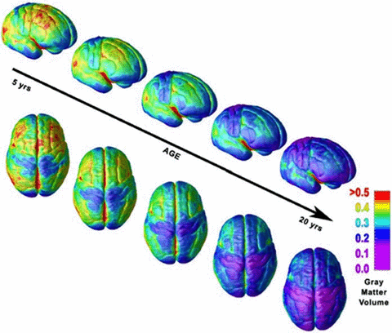
Hypothesis
During childhood development, pruning occurs to reduce unused connections in the brain, reducing the gray matter volume in these areas. By decreasing the synapses that are no longer used, the brain becomes more efficient. We hypothesized that a season of contact sports will change this relationship due to the repeated head impacts.
The Adolescent Brain, Volume: 1124, Issue: 1, Pages: 111-126, First published: 03 April 2008, DOI: (10.1196/annals.1440.010)

Slide 6
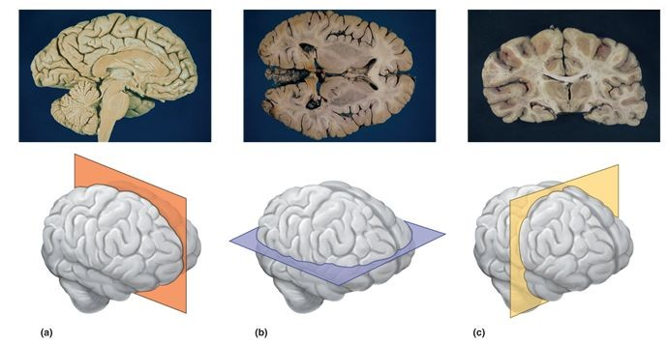
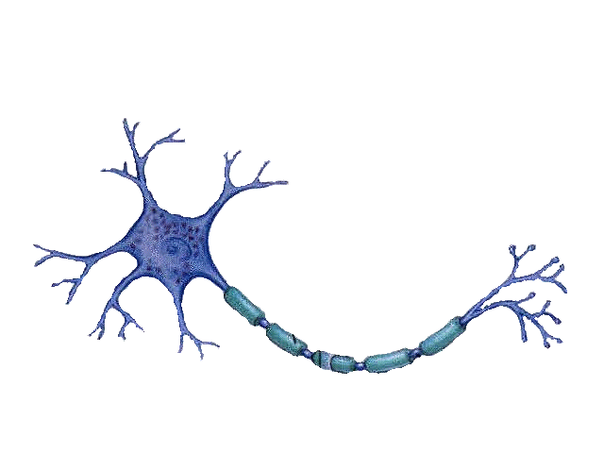
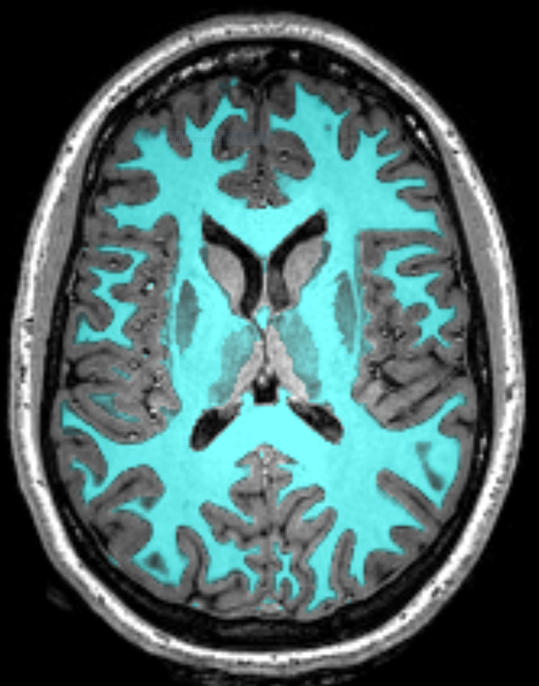
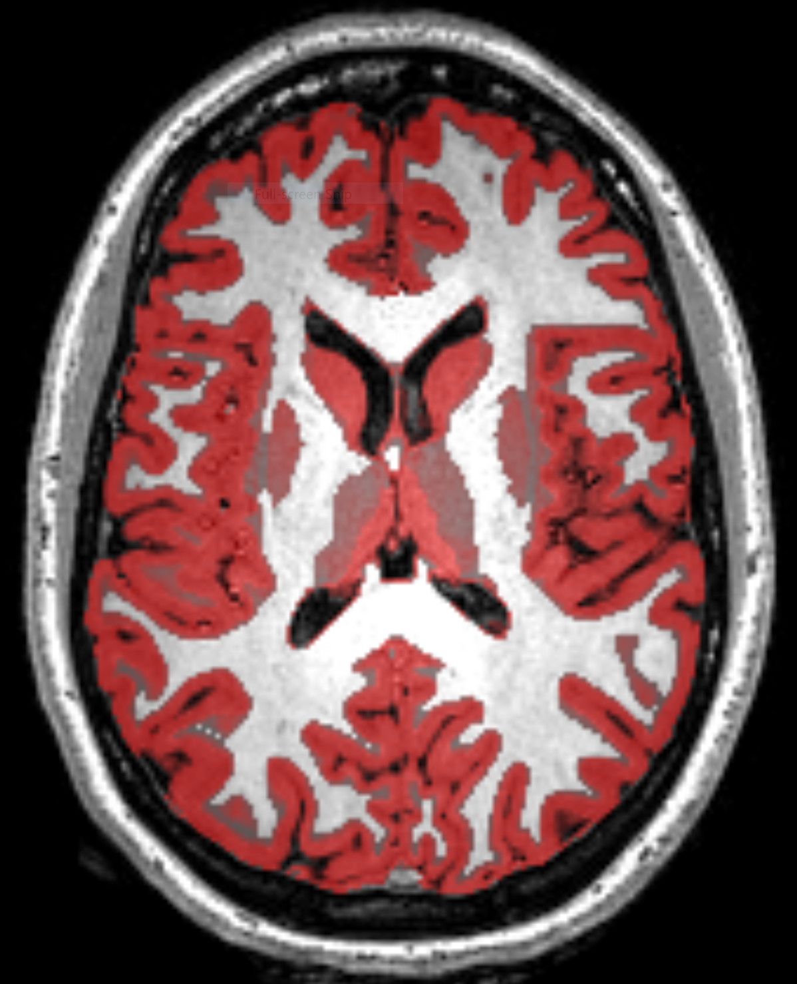
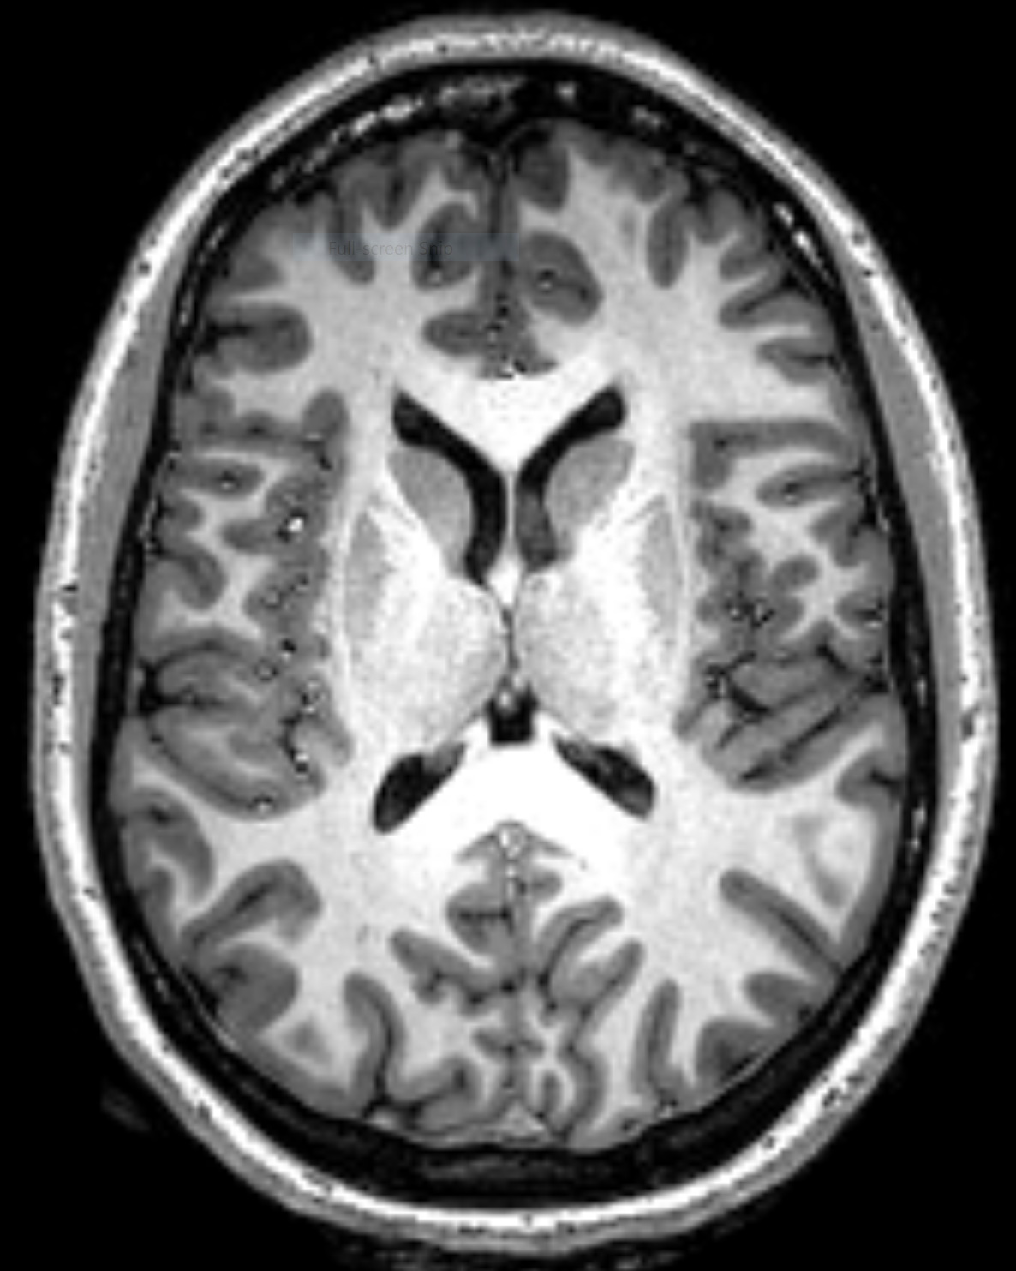
Gray Matter
Neuronal
Cell Bodies
White Matter
Axons
Myelin

Slide 7
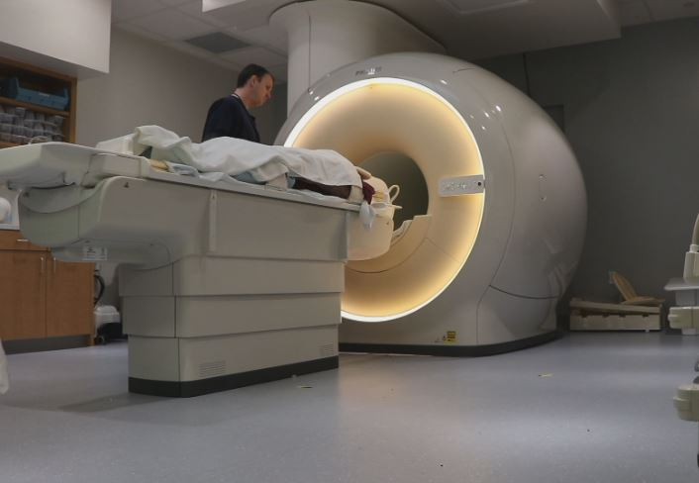
Resting State Functional MRI
Resting state fMRI (rsfMRI) is used in brain mapping to evaluate regional interactions that occur when an explicit task is not being performed.

Slide 8

Default mode network (DMN)
The DMN tends to be triggered when thinking about one's self, others, the past, or the future, and it has been implicated in daydreaming and mind wandering.
Abnormal activity in the DMN has been linked with a range of conditions, including Alzheimer's disease, attention deficit hyperactivity disorder, and schizophrenia.
In this study, we analyzed changes in DMN regions, using advanced signal processing techniques.
Kucyi, Aaron, and Karen D. Davis. "Dynamic functional connectivity of the default mode network tracks daydreaming." Neuroimage 100 (2014): 471-480.

Slide 9
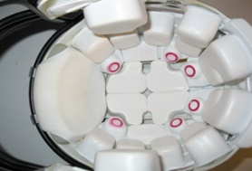
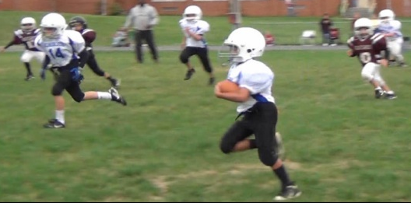
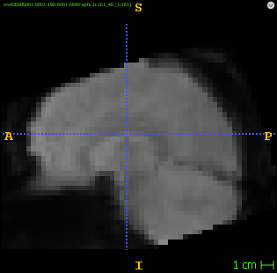
Subjects
60 youth and high school football players (ages 9-18).
No history of concussion, neurological or developmental disorders.
Pre-Season
During the Season
Post-Season
Rs-fMRI
Rs-fMRI
Measuring Head Impacts
Notes:
Resting state fMRI (rsfMRI or R-fMRI) is a method of functional magnetic resonance imaging (fMRI) that is used in brain mapping to evaluate regional interactions that occur in a resting or task-negative state, when an explicit task is not being performed

Slide 10
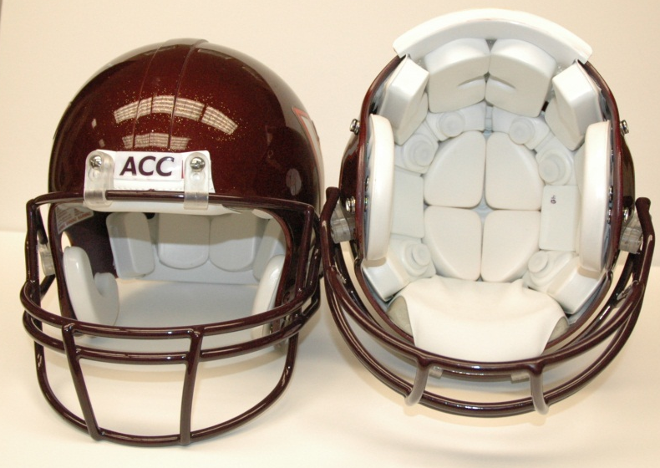
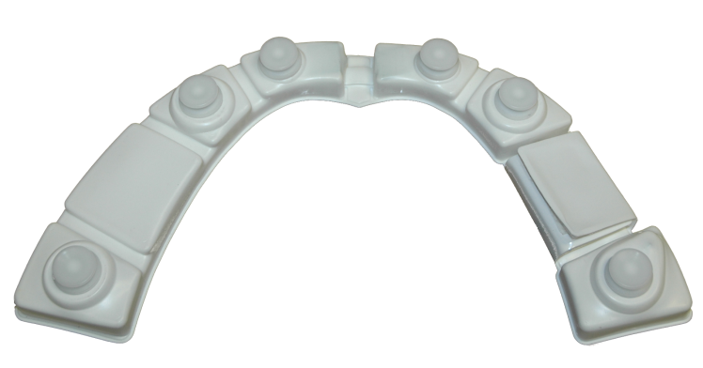
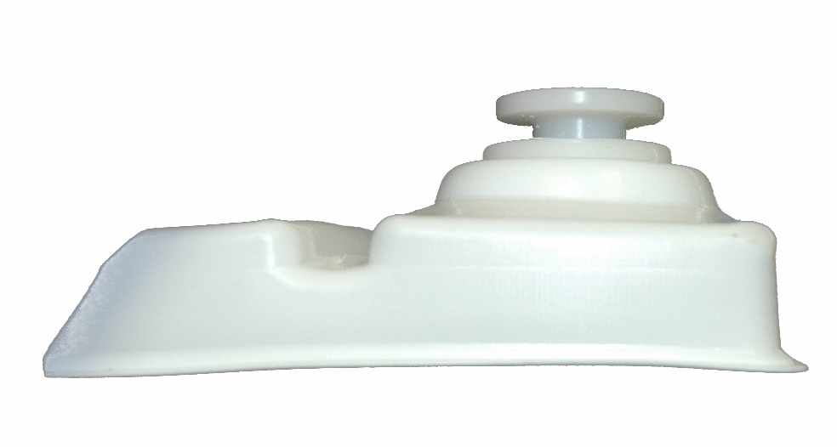
HIT System Hardware to Measure Head Impacts
6 accelerometer configuration
Measures linear and rotational acceleration
Spring-mounted accelerometers
remain in contact with head
Notes:
The HITS system consists of 6 sensors or accelerometers that fit within the natural gap of the helmet padding.
They measure linear and rotational acceleration.
And are spring mounted so that they always remain in contact with the head or skull.

Slide 11
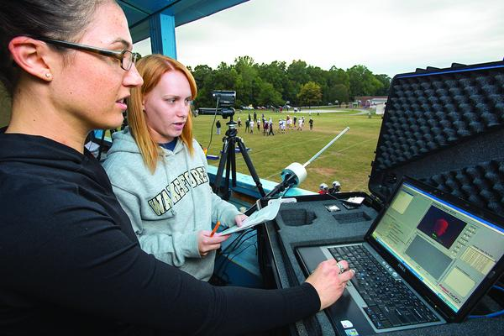
Data collected wirelessly for every game & practice

Slide 12
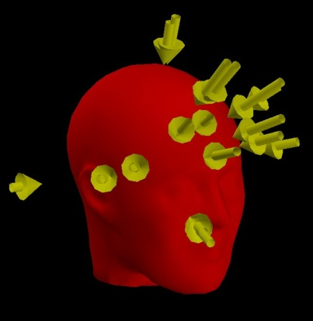
Risk Weighted Cumulative Exposure (RWE)
Risk of concussion associated with each impact for each player summed over the season
Linear acceleration
Rotational acceleration
Combined Probability
Linear + Rotational Acceleration
Distribution of Head Impacts
Urban et al, Annals of Biomedical Engineering, 2013.
Notes:
In order to quantify these impacts we use a metric known as RWE or Risk Weighted Cumulative Exposure
It is the risk of concussion…
It takes into account both the number and severity of the impacts.
It can be broken down into the linear or the rotational component of the impacts, or the combined probability of both.
This gives us a single number representing the biomechanical data for each subject for the season.

Slide 13
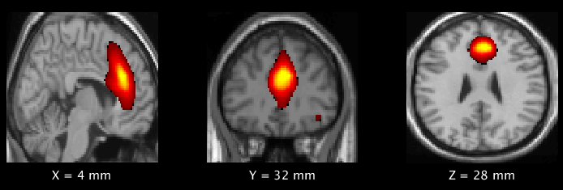
The frontal component of the DMN showed significant increases in power (activation) between low and high head impact groups.

Slide 14
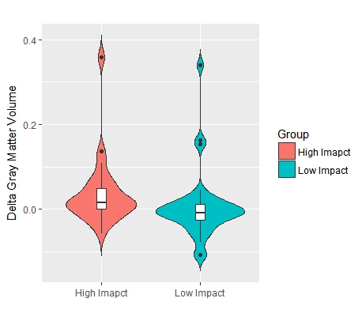
ΔGray Matter Volume
ΔGray Matter_{HI} > ΔGray Matter_{LI} (p-value: 0.005)
Violin plot showing statistically significant changes in GM Volume in High Impact (HI) group compared to Low Impact (LI) group.
HI – High Impact; LI-Low Impact

Slide 15
Conclusion
Our results suggest that normal pruning is affected in players with higher head impacts over a single season of contact sports.
Playing a season of contact sports may affect normal GM pruning in high school and youth football players.

Slide 16



Acknowledgments
UT Southwestern (ANSIR lab)
Joseph A Maldjian, MD
Ben Wagner
Elizabeth Davenport, PhD
Thomas O Neill, MD
Chandan Ganesh, MS
Sahil Nalawade, MS
Divya Reddy, MS
Wake Forest
Joel Stitzel, PhD
Christopher Whitlow, MD
NIH Grant
R01NS082453 (JAM,JDS)
RO1NS091602 (CTW,JAM,JDS)

