Slide 1
The Echogenic Appearance of the Diabetic Deltoid Muscle on Shoulder Ultrasound:
Is This Simply from Adipose Tissue Infiltration, Can This Appearance Predict Type 2 Diabetes and Be Used to Detect Pre-Diabetes?
Paul Williams MD, Kelli Rosen DO, Jessica Kim DO, Paul Spicer MD, Marnix van Holsbeeck MD, Steven Soliman DO

Slide 2
Introduction
Musculoskeletal ultrasound (MSK US) use has significantly increased over the past two decades¹
Ultrasound can be used to diagnose sources of pain in the shoulder ^{2,3}
Lower cost, high accessibility, and the opportunity for direct interaction with patients are reasons it has become the test of choice at multiple institutions

Slide 3
Diabetes
Approximately 9.4% of the U.S. population and 382 million people globally are affected by diabetes⁴
Diabetics are at increased risk for multiple problems affecting the muscles, tendons, nerves, and/or bones⁴⁻¹⁰
  Rotator cuff injury is especially common¹¹⁻¹³

Slide 4
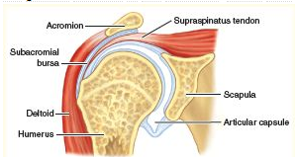

Ultrasound Findings
Ultrasound Field of View
“Subacromial Bursa.” Academic Dictionaries and Encyclopedias, Academic Dictionaries and Encyclopedias, 2011, medicine.academic.ru/93216/subacromial_bursa.
In type 2 diabetics, the deltoid shoulder muscle often appears brighter or more echogenic than the adjacent supraspinatus rotator cuff tendon
In non-diabetics, the deltoid shoulder muscle is typically darker or more hypoechoic than the adjacent supraspinatus tendon

Slide 5
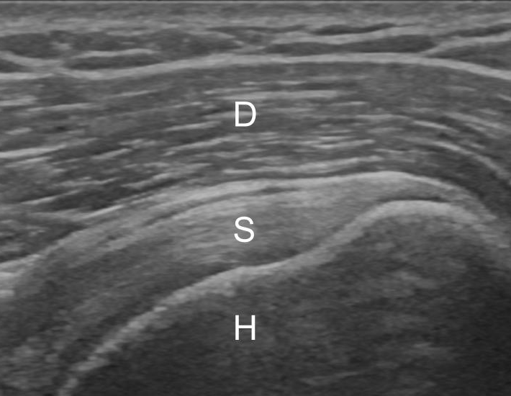
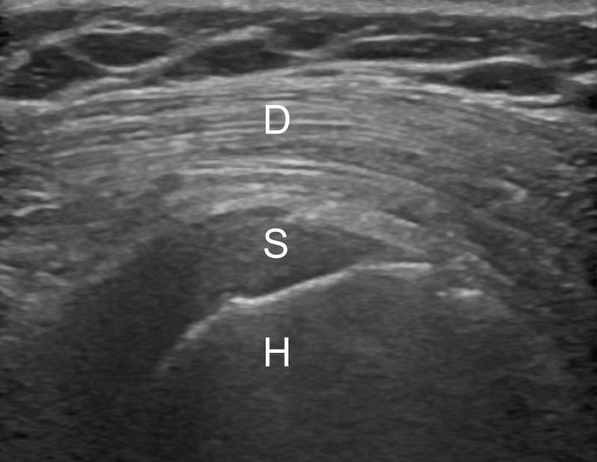
Reversal of the Deltoid Muscle to Rotator Cuff Tendon Gradient
A
B
Image A : Normal gradient of the darker deltoid muscle to the brighter supraspinatus tendon
Image B: Reversal of the normal gradient in a type 2 diabetic patient
Figure 1: US images of the shoulder in the modified long axis
D - Deltoid, S - Supraspinatus, H - Humerus

Slide 6
Obesity
Increased fat in the muscle has been shown to cause a brighter appearance of the muscle on US¹⁶⁻¹⁸
Our findings show that the deltoid muscle in type 2 diabetics was brighter than the deltoid muscle of obese non-diabetics¹⁹⁻²¹

Slide 7
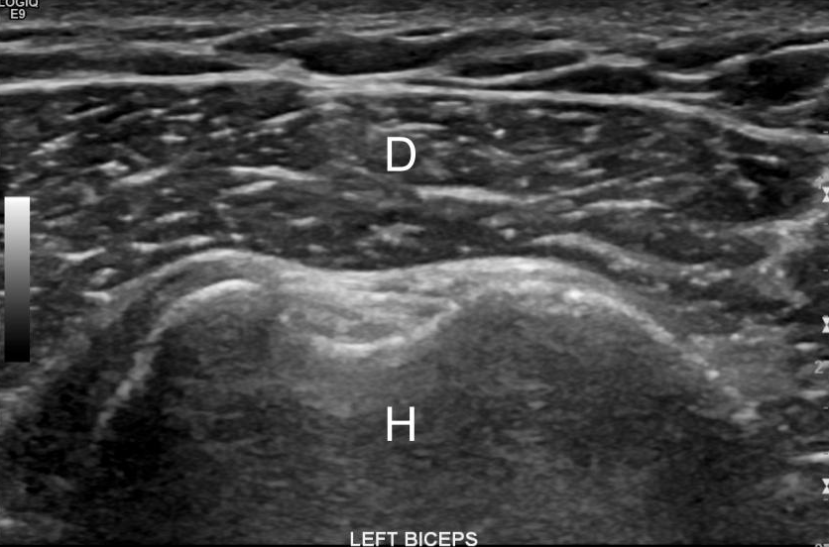
Normal Deltoid Muscle Brightness in an Obese Non-Diabetic Patient
Figure 2: US image of the normal deltoid muscle obtained in short axis
D - Deltoid, H - Humerus

Slide 8
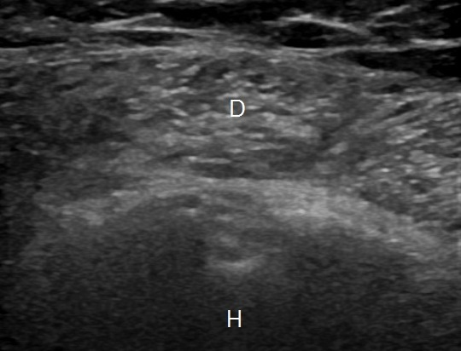
Brighter Deltoid Muscle in a Type 2 Diabetic Patient
Figure 3: Image of the brighter deltoid muscle in a type 2 diabetic patient
D - Deltoid, H - Humerus

Slide 9
Intramuscular Glycogen Levels
Glycogen is a key source of energy for the body
Glycogen is stored primarily in the liver and muscles
We predict that the brighter deltoid muscle in type in 2 diabetes is not only from increased fat in the muscle but also lower glycogen in the muscle
Research also shows muscles of athletes appear brighter on ultrasound following exercise, when their glycogen stores are depleted²³⁻²⁷

Slide 10
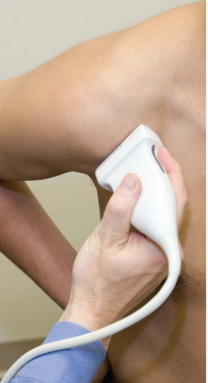
Methods- Selection of Patients
Review of prior shoulder ultrasound examinations from 2005-2017
137 patients with type 2 diabetes
  124 type 2 diabetics
  13 pre-diabetics
49 obese non-diabetics
Jacobson, Jon A. “Shoulder US: Anatomy, Technique, and Scanning Pitfalls.” Radiology, vol. 260, no. 1, July 2011, pp. 6–16., doi:10.1148/radiol.11101082.
Notes:
Inclusion criteria only discusses diabetics?

Slide 11
Blinded Image Review
Institutional Review Board approval was obtained
Uniform ultrasound images of the deltoid muscle from each of the 186 patients were randomly ordered and stripped of patient information
Two MSK radiologists independently analyzed the images and, using deltoid muscle brightness as criteria, assigned each patient to one of three categories:
  Normal
  Suspected diabetes
  Definite diabetes
In the event of a discrepancy, a third fellowship trained MSK radiologist served as an arbitrator

Slide 12
Results- Study Group
137 type 2 diabetic patients
  39 (28.5%) men, 98 (71.5%) women
  78 (57%) black, 59 (43%) white
  Average BMI 34.7 kg/m2
    100 (73%) obese, 37 (27%) non-obese
49 obese non-diabetic patients
  30 (61.2%) men, 19 (38.8%) women
  21 (42.9%) black, 28 (57.1%) white
  Average BMI 34.6 kg/m2

Slide 13
Results- MSK Radiologists’ Review
186 patients blindly reviewed by two MSK radiologists
Discrepant results present for 28 (15.1%) patients, requiring blind review by the third MSK radiologist

Slide 14
Results- Type 2 Diabetic Patients
Consensus diagnosis of ‘definite diabetes’, based on brightness of the deltoid muscle on US, proved a powerful predictor of positive diabetes status
Radiologists correctly predicted diabetes in 70 of 79 patients, or 89 percent (positive predictive value)
Radiologists correctly designated diabetic patients as ‘suspected’ or ‘definite diabetes’ in 106 of 137 patients, or 77 percent (sensitivity)
Notes:
89% Positive predictive value for accurate designation of ‘definite diabetes’ status
77% Sensitivity for, at a minimum, accurately suspecting diabetes
The results showed that a consensus diagnosis of “definite diabetes” by the radiologists was a powerful predictor of diabetic status. Using the shoulder ultrasounds, the radiologists correctly predicted diabetes in 70 of 79 patients, or 89 percent.

Slide 16
    106 of 137 diabetics designated ‘suspected’ or ‘definite diabetes’

Slide 17
Results- Pre-Diabetic Patients
A bright deltoid muscle on US was also a powerful predictor of pre-diabetes
Consensus diagnosis of ‘suspected’ or ‘definite diabetes’ was predicted in 13 of 13 pre-diabetics, or 100 percent (sensitivity)
Notes:
A hyperechoic, or unusually bright-looking, deltoid muscle was also a strong predictor of pre-diabetes. The musculoskeletal radiologists assigned all 13 pre-diabetic ultrasounds to either the “suspected diabetes” or “definite diabetes” categories.

Slide 18
Results- Obese Non-Diabetic Patients
MSK radiologists appropriately withheld diagnosis of ‘definite diabetes’ for 40 of 49 obese non-diabetic patients, or 82 percent (specificity)
BMI cannot solely explain the bright deltoid muscle on US

Slide 19
Discussion- Ultrasound to Diagnose Diabetes?
First large study demonstrating increased brightness (echogenicity) of the deltoid muscle as a strong predictor of type 2 diabetes
With increasing utilization of MSK US, there is new opportunity for detection of undiagnosed type 2 diabetes
  Nearly one in four diabetic individuals in America are left undiagnosed⁴
  Anecdotally, at our institution this has resulted in new diagnoses of diabetes

Slide 20
Discussion- Ultrasound to Diagnose Pre-Diabetes?
Study showed that increased brightness of the deltoid muscle can be used to detect early insulin resistance or pre-diabetes
  An estimated 84.1 million American adults are pre-diabetic
    90% are completely unaware of their pre-diabetic status^{4,10}
  Earlier identification could help delay or halt progression of disease

Slide 21
Discussion- Fat Infiltration
Studies have shown that US can be used to detect increased fat in muscle¹⁶⁻¹⁸
Other studies have shown that diabetic individuals are more likely to be obese and have increased fat in muscle
Despite these confounders, our study demonstrates muscle brightness is more pronounced in type 2 diabetics whether non-obese or obese

Slide 22
Discussion- Glycogen Storage
Glucose (stored as glycogen) in the liver and muscles is the body’s primary source of energy and aids in prevention of low blood sugar or hypoglycemia³¹
  In non-diabetics, 85% of glycogen is stored in muscle^{25,26}
Insulin regulates glycogen storage and synthesis
Muscle is believed to represent the principal site of insulin resistance in type 2 diabetics^{32,33}

Slide 23
Discussion- Glycogen Storage
Muscle biopsies in diabetics have shown glycogen levels in muscle are decreased by up to 65%³⁴
Studies utilizing MuscleSound (MuscleSound, LLC, Denver), an US technology, have also shown lower glycogen level in muscle in the post-exercise state and critically ill by demonstrating a brighter or hyperechoic muscle²³
These studies support our hypothesis

Slide 24
Limitations
Our findings rely on subjective determination of deltoid muscle brightness
  This was mitigated by the use of three musculoskeletal radiologists
Brighter or hyperechoic muscle is also observed in post-exercise and dehydration states and are thus confounders, as this study did not evaluate for these conditions
Type 1 diabetics were not included in the study

Slide 25
Conclusion
The brighter or more hyperechoic US appearance of the deltoid muscle is a strong predictor of type 2 diabetes and pre-diabetes (early insulin resistance)
Lower muscle glycogen levels due to insulin resistance is the likely cause of the brighter appearance of the deltoid muscle
Additional questions arise regarding appropriate time to initiate treatment for pre-diabetes in the presence of this sub-clinical finding

Slide 26
References
1. Lee MH, Sheehan SE, Orwin JF, Lee KS. Comprehensive shoulder US examination: a standardized approach with multimodality correlation for common shoulder disease. Radiographics. 2016; 36(6):1606-27.
2. Alves TI, Girish G, Kalume Brigido M, Jacobson JA. US of the knee: scanning techniques, pitfalls, and pathologic conditions. Radiographics. 2016; 36(6):1759-75.
3. Soliman SB, Spicer PJ, van Holsbeeck MT. Sonographic and radiographic findings of posterior tibial tendon dysfunction: a practical step forward. Skeletal Radiol. 2018 May 25.
4. Centers for Disease Control and Prevention. National Diabetes Statistics Report, 2017. Atlanta, GA: Centers for Disease Control and Prevention, US Department of Health and Human Services; 2017. https://www.cdc.gov/diabetes/data/statistics/statistics-report.html
5. Park M, Park JS, Ahn SE, Ryu KN, Park SY, Jin W. Sonographic Findings of Common Musculoskeletal Diseases in Patients with Diabetes Mellitus. Korean Journal of Radiology. 2016;17(2):245-254.
6. Jonathan C. Baker, Diabetic Musculoskeletal Complications and Their Imaging Mimics. RadioGraphics Vol. 32, No. 7
7. M. Merashli, T.A. Chowdhury, A.S.M. Jawad; Musculoskeletal manifestations of diabetes mellitus. QJM: An International Journal of Medicine, Volume 108, Issue 11, 1 November 2015, Pages 853–57.
8. Riazi S, Bril V, Perkins BA, et al. Can ultrasound of the tibial nerve detect diabetic peripheral neuropathy? A cross-sectional study. Diabetes Care 2012;35:2575–2579
9. Schafer AL, Vittinghoff E, Lang TF, et al. Fat Infiltration of Muscle, Diabetes, and Clinical Fracture Risk in Older Adults. The Journal of Clinical Endocrinology and Metabolism. 2010;95(11):E368-E372.
10. https://www.nih.gov/research-training/accelerating-medicines-partnership-amp/type-2-diabetes
11. Van Holsbeeck MT, Introcaso J. Musculoskeletal ultrasound. 3rd ed. Philadelphia: Jaypee Brothers Medical Publishers; 2016.
12. Garcilazo C, Cavallasca JA, Musuruana JL. Shoulder manifestations of diabetes mellitus. Curr Diabetes Rev. 2010 Sep;6(5):334-40.

Slide 27
References
13. Hsu C, Sheu WH. Diabetes and shoulder disorders. Journal of Diabetes Investigation. 2016;7(5):649-651.
14. Michele Abate, Cosima Schiavone, Vincenzo Salini. Sonographic evaluation of the shoulder in asymptomatic elderly subjects with diabetes BMC Musculoskeletal Disorders. 2010 11:278
15. Jacobson JA. Fundamentals of musculoskeletal ultrasound. 3rd ed. Philadelphia: Elsevier; 2018. Pg 88. Chapter 3 “Shoulder Ultrasound”
16. Sigrid Pillen. Skeletal muscle ultrasound. European Journal Translational Myology 2010; 1 (4): 145-155
17. Viviane Khoury, Étienne Cardinal, and Paul Brassard Atrophy and Fatty Infiltration of the Supraspinatus Muscle: Sonography Versus MRI. American Journal of Roentgenology 2008 190:4, 1105-1111
18. Dow DF, Mehta K, Xu Y, England E. The Relationship Between Body Mass Index and Fatty Infiltration in the Shoulder Musculature.
19. Miljkovic-Gacic I, Wang X, Kammerer CM, et al. Fat Infiltration in Muscle: New Evidence for Familial Clustering and Associations with Diabetes. Obesity (Silver Spring, Md). 2008;16(8):1854-1860.
20. Hilton TN, Tuttle LJ, Bohnert KL, Mueller MJ, Sinacore DR. Excessive Adipose Tissue Infiltration in Skeletal Muscle in Individuals With Obesity, Diabetes Mellitus, and Peripheral Neuropathy: Association With Performance and Function. Physical Therapy. 2008;88(11):1336-1344.
21. Iva Miljkovic-Gacic, Christopher L Gordon, Bret H Goodpaster, Clareann H Bunker, Alan L Patrick, Lewis H Kuller. Adipose tissue infiltration in skeletal muscle: age patterns and association with diabetes among men of African ancestry.
22. Reimers, K., Reimers, C. D., Wagner, S., Paetzke, I. and Pongratz, D. E. (1993), Skeletal muscle sonography: a correlative study of echogenicity and morphology. Journal of Ultrasound in Medicine, 12: 73–77.
23. Nieman DC, Shanely RA, Zwetsloot KA, Meaney MP, Farris GE. Ultrasonic assessment of exercise-induced change in skeletal muscle glycogen content. BMC Sports Science, Medicine and Rehabilitation. 2015;7:9.
24. Jacob Greene, Julien Louis, Olga Korostynska and Alex Mason. State-of-the-Art Methods for Skeletal Muscle Glycogen

Slide 28
References
25. Hill JC, Millán IS. Validation of musculoskeletal ultrasound to assess and quantify muscle glycogen content. A novel approach. Phys Sportsmed. 2014 Sep;42(3):45-52.
26. Millan IS, Hill J, Wischmeyer P. Measurement of skeletal muscle glycogen status in critically ill patients: a new approach in critical care monitoring. Critical Care. 2015;19 (Suppl 1):P400.
27. Verbeek, Renate J. et al. Muscle Ultrasound in Patients with Glycogen Storage Disease Types I and III. Ultrasound in Medicine and Biology, Volume 42 , Issue 1 , 133 – 142.
28. ADA Guidelines: Diabetes Care, Vol. 34, Supplement 1, S62
29. Koenig RJ, Peterson CM, Kilo C, Cerami A, Williamson JR. Hemoglobin AIc as an indicator of the degree of glucose intolerance in diabetes. Diabetes. 1976 Mar;25(3):230-2.
30. https://www.nhlbi.nih.gov/health/educational/lose_wt/BMI/bmi_dis.htm
31. Groop L, Orho-Melander M (2008) New Insights into Impaired Muscle Glycogen Synthesis. PLoS Med5(1): e25.
32. Jensen J, Rustad PI, Kolnes AJ, Lai Y-C. The Role of Skeletal Muscle Glycogen Breakdown for Regulation of Insulin Sensitivity by Exercise. Frontiers in Physiology. 2011;2:112.
33. Gerald I. Shulman, M.D., Douglas L. Rothman, Ph.D., Thomas Jue, Ph.D., Peter Stein, M.D., Ralph A. DeFronzo, M.D., and Robert G. Shulman, Ph.D. Quantitation of Muscle Glycogen Synthesis in Normal Subjects and Subjects with Non-Insulin-Dependent Diabetes by 13C Nuclear Magnetic Resonance Spectroscopy. N Engl J Med 1990; 322:
34. Jing He and David E. Kelley. Muscle glycogen content in type 2 diabetes mellitus. American Journal of Physiology-Endocrinology and Metabolism 2004 287:5, E1002-E1007 223-228.

