Slide 1
Visionaries in Practice (VIP)
Giving Program
Practice groups investing
in Radiology’s future
1

Slide 2
Table of Contents
Slide 3: RSNA R&E Foundation mission and history
Slide 7: VIP Giving Program description
Slide 9: Recognition and benefits
2

Slide 3
Our Mission is Your Mission
The R&E Foundation upholds the same principle that you do: to promote the highest standard of patient care.
RSNA R&E Foundation Mission
To fund grants and awards to individuals and institutions that will advance radiologic research, education and practice.
Invest in the future of your practice, your specialty, and the patients you serve.
3

Slide 4
Types of R&E Grants
Research is funded in several areas that advance the specialty, including:
Breast/Mammography
Diagnostic Radiology
Interventional Radiology
Neuroradiology
Cardiac Radiology
Quality Improvement
and many more
Research Scholar: To help prepare junior faculty to become fully-funded, independent investigators.
Research Seed: To support the preliminary or pilot phases of scientific projects.
Research Resident / Fellow: To allow trainees to devote time to a research project under the guidance of a scientific advisor.
Education Scholar: To support any area of radiologic education or education research.
4

Slide 5
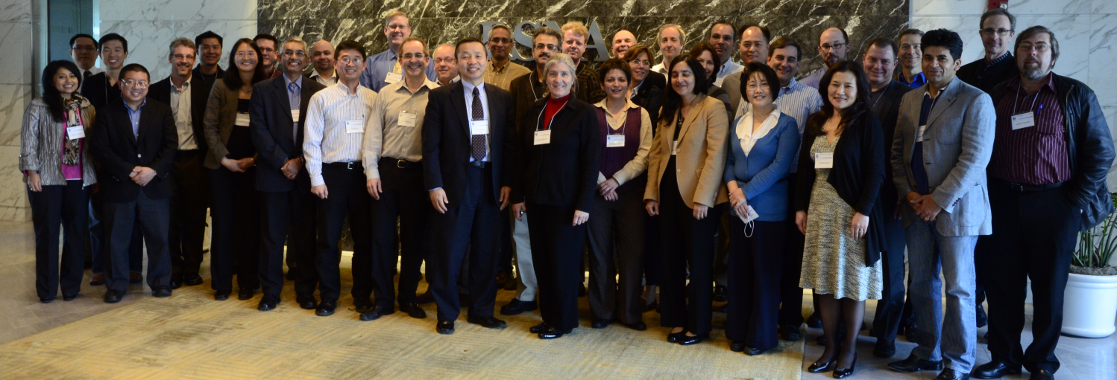
Grant Application and Review
The RSNA R&E Foundation models its grant applications and review process on those used by the NIH. The rigorous peer-review system ensures only the best science is funded.
The Radiology Research Study Section at RSNA Headquarters
5

Slide 6
Grant Funding Decisions
The Foundation’s Board of Trustees makes grant funding decisions based on scientific merit, available funds and programmatic balance.
Input from study section chairs help the Board determine the quality line for each grant program.
Minimum funding rate goal of 25%.
6

Slide 7
Visionaries in Practice (VIP)
Giving Program
Established in 2005, the VIP Giving Program recognizes private practice groups and academic institutions making valuable investments in radiologic research and development with group donations to the RSNA R&E Foundation.
Over $5.5 million in funding has been dedicated to advancing research and education in medical imaging.
With your generous gifts we
all can continue to invest in the future!
7

Slide 8
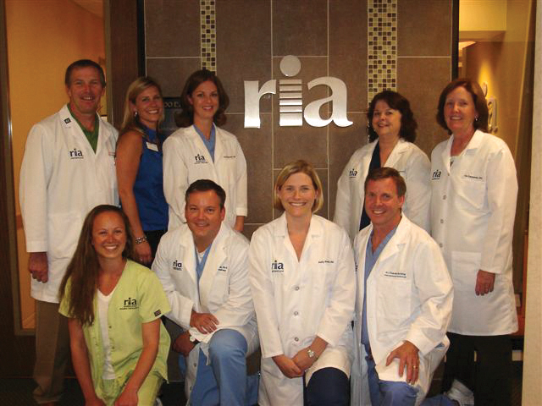
Annual VIP Giving Levels
Gifts of $10,000 + receive recognition at the RSNA annual meeting and in publications.
“Our specialty’s survival depends on the ability of radiology collectively, and radiologists individually, to demonstrate our relevance. RIA donates through the VIP Giving Program to support the research that demonstrates our collective value.”
- Peter Ricci, MD
Radiology Imaging Associates
8

Slide 9
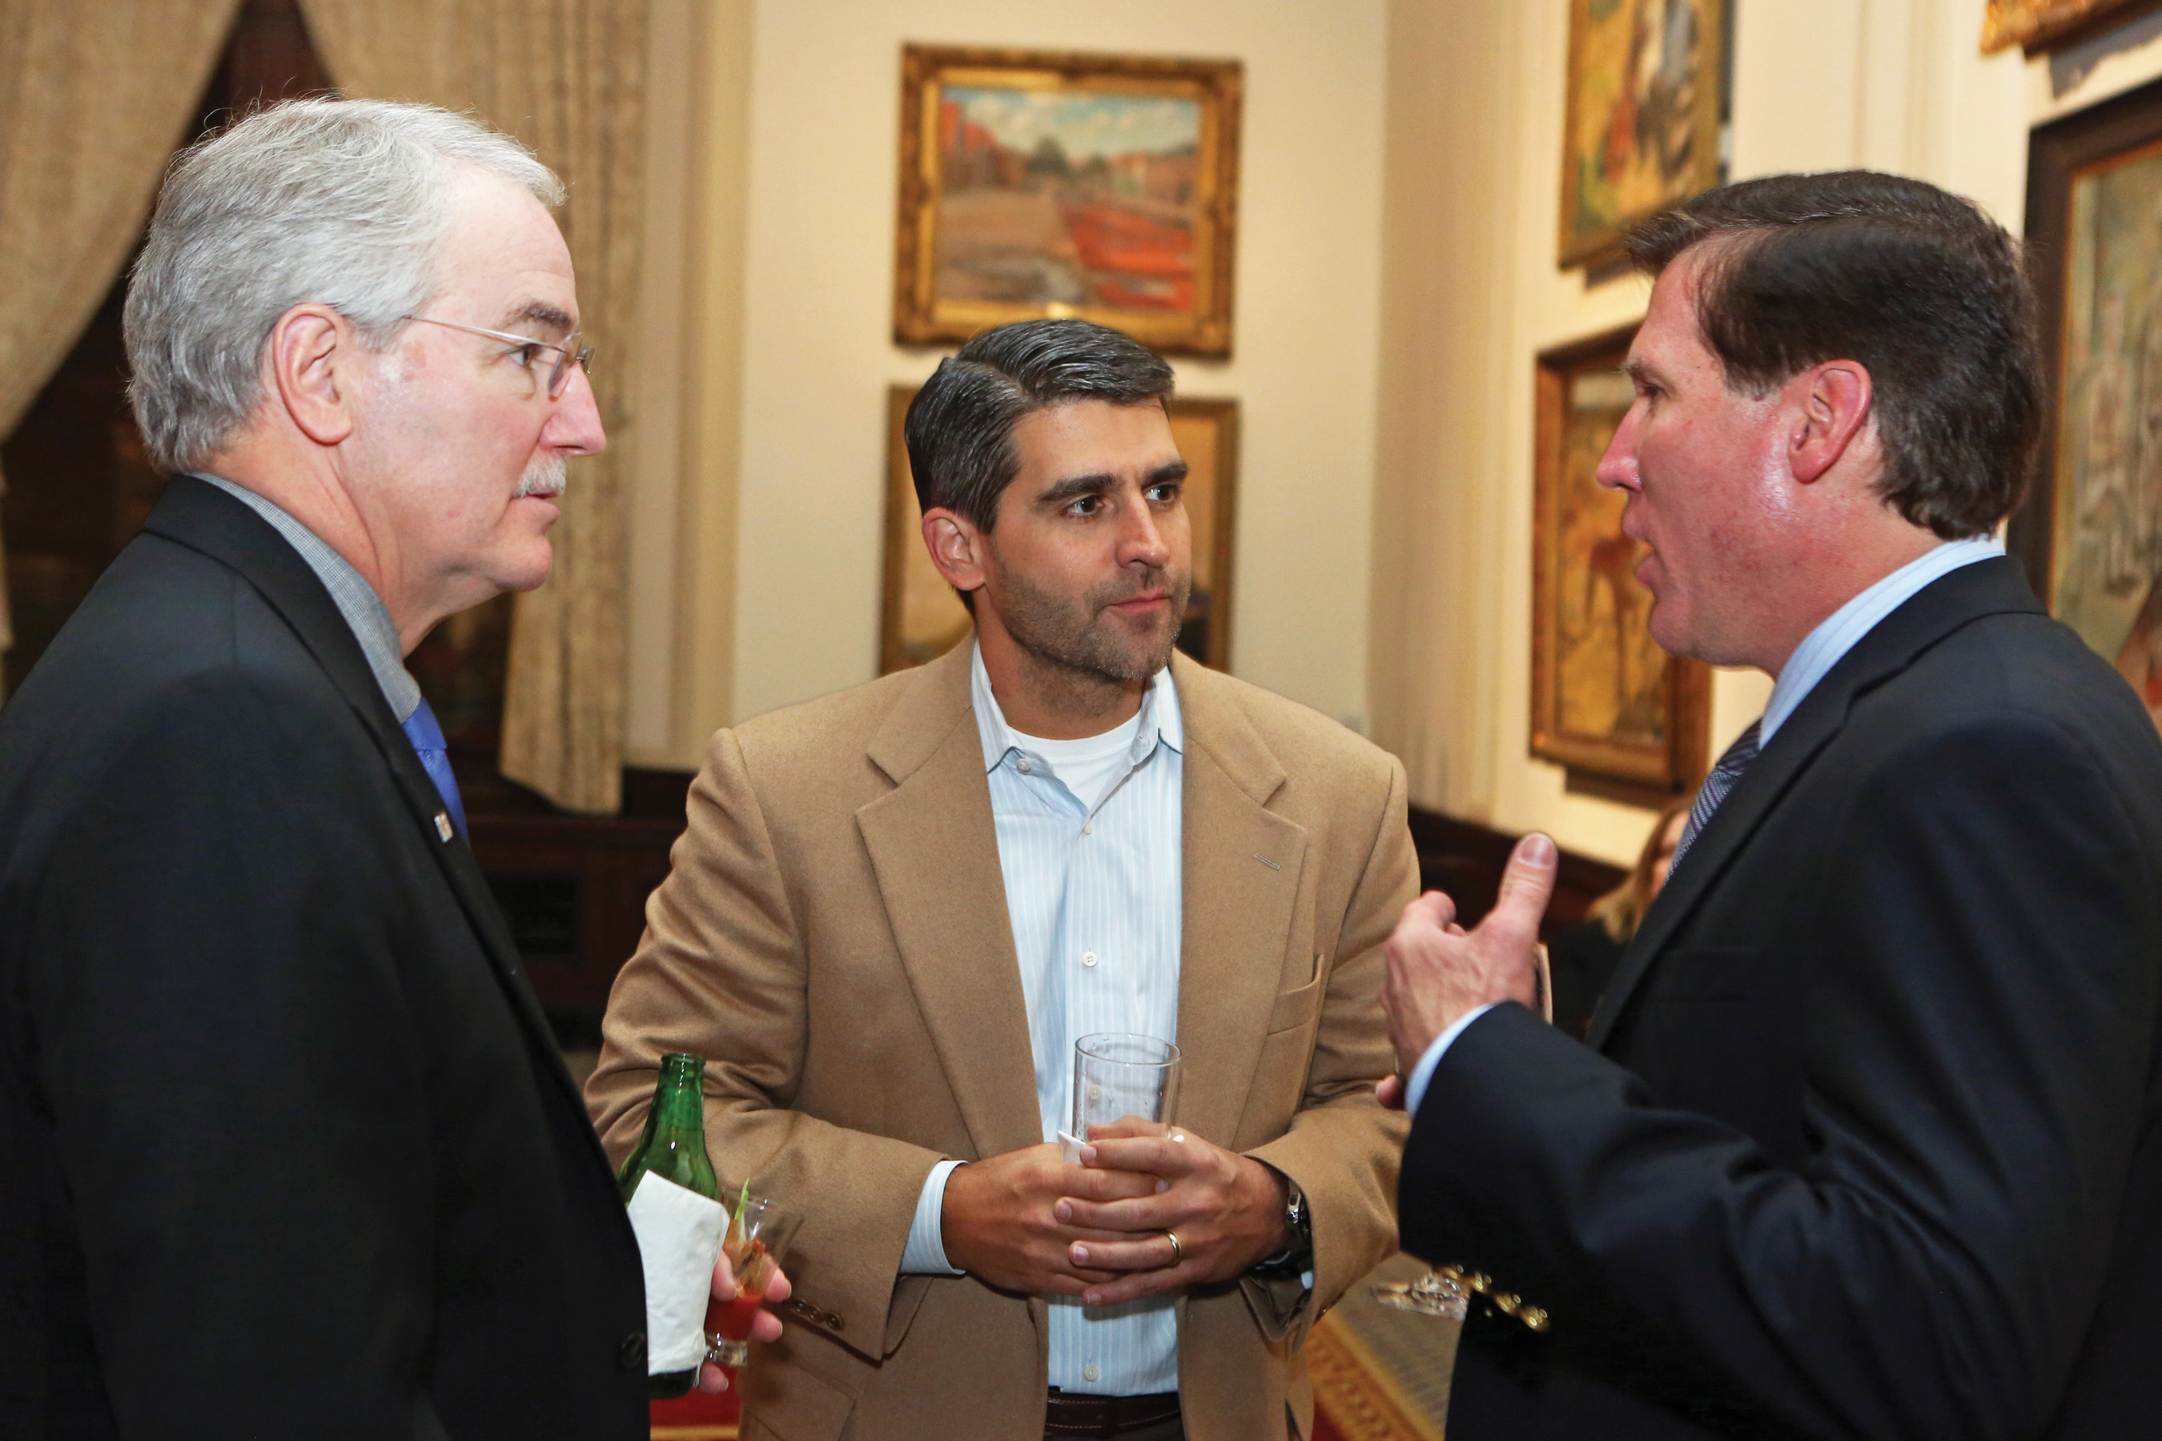
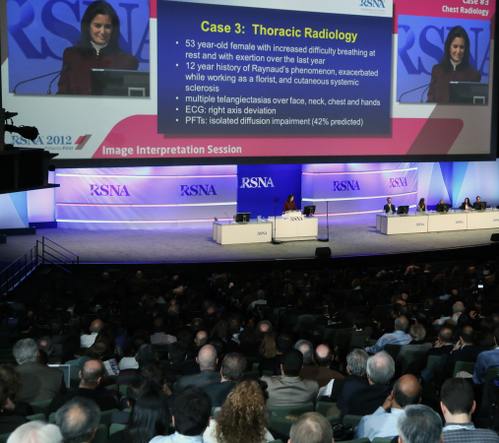
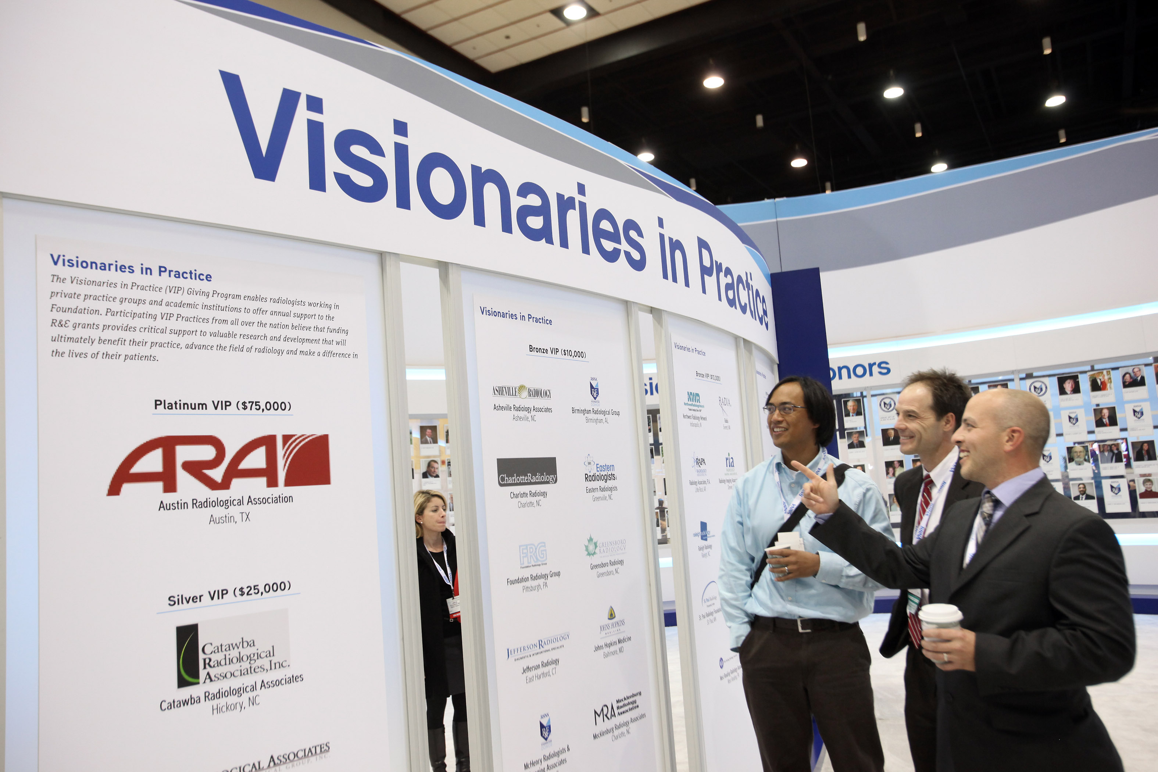
Recognition and Benefits –
at the RSNA annual meeting
Special recognition in signage and in meeting publications
Access to R&E Donor Suite
Early registration hotel rooms prior to RSNA annual meeting (Silver level and up)
Network with leaders in the field at the Distinguished Donor Reception
Access to the front of taxi and shuttle bus lines from McCormick Place to your destination (Silver level and up)
Complimentary ground transportation for up two practice members (Gold level and up)
Complimentary lunch at Bistro RSNA (Platinum level)
*Donation deadline for annual meeting
recognition and benefits is September 30, 2020
9

Slide 10
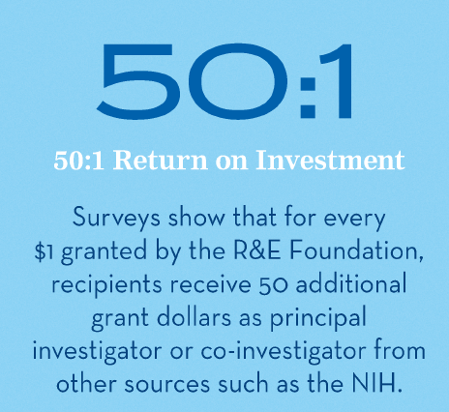
$50:$1 Return on Your Investment
On average, each $1 awarded by the R&E Foundation generates more than $50 in subsequent funding to Principal Investigators and Co-Investigators from other sources including the NIH. This ROI translates to more than $3 billion in research funding.
Based on results from a survey of grant recipients
10

Slide 11
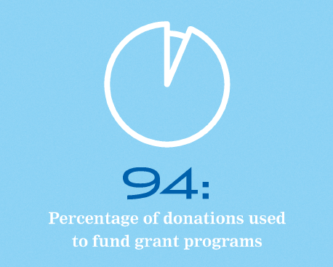
Maximum Impact
Donors gifts will to be used where the need is greatest
94% of our expenses support grant programs
11

Slide 12
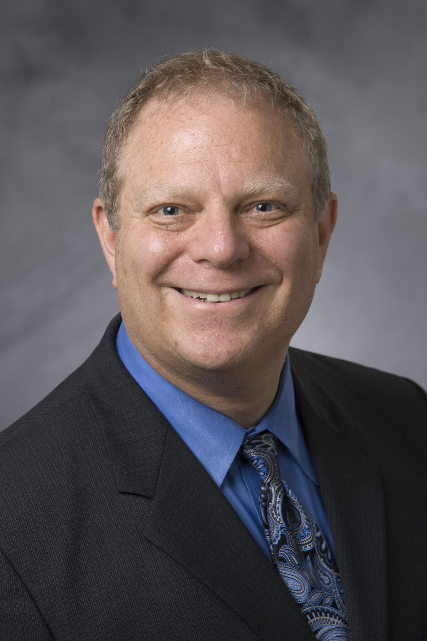
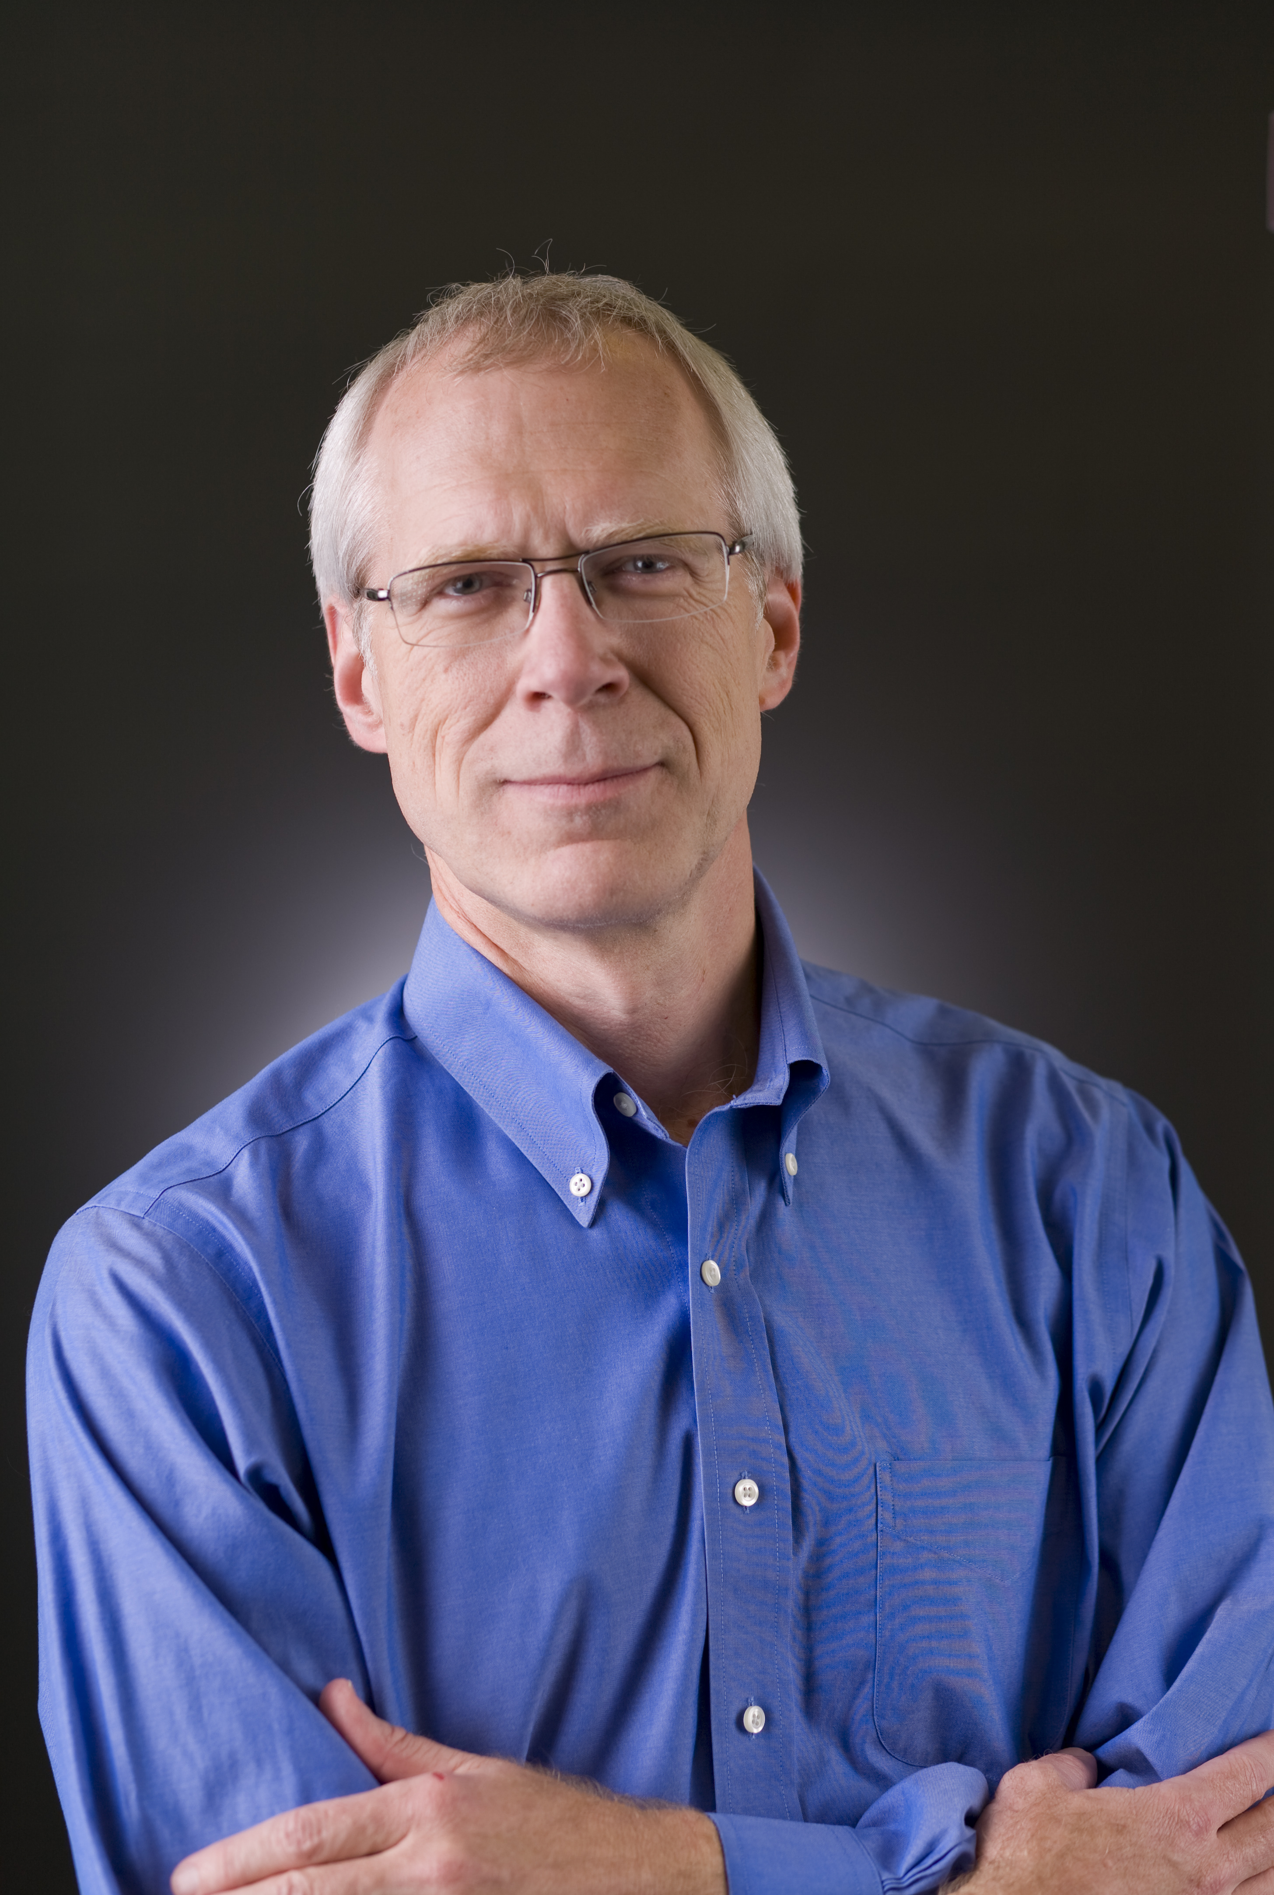
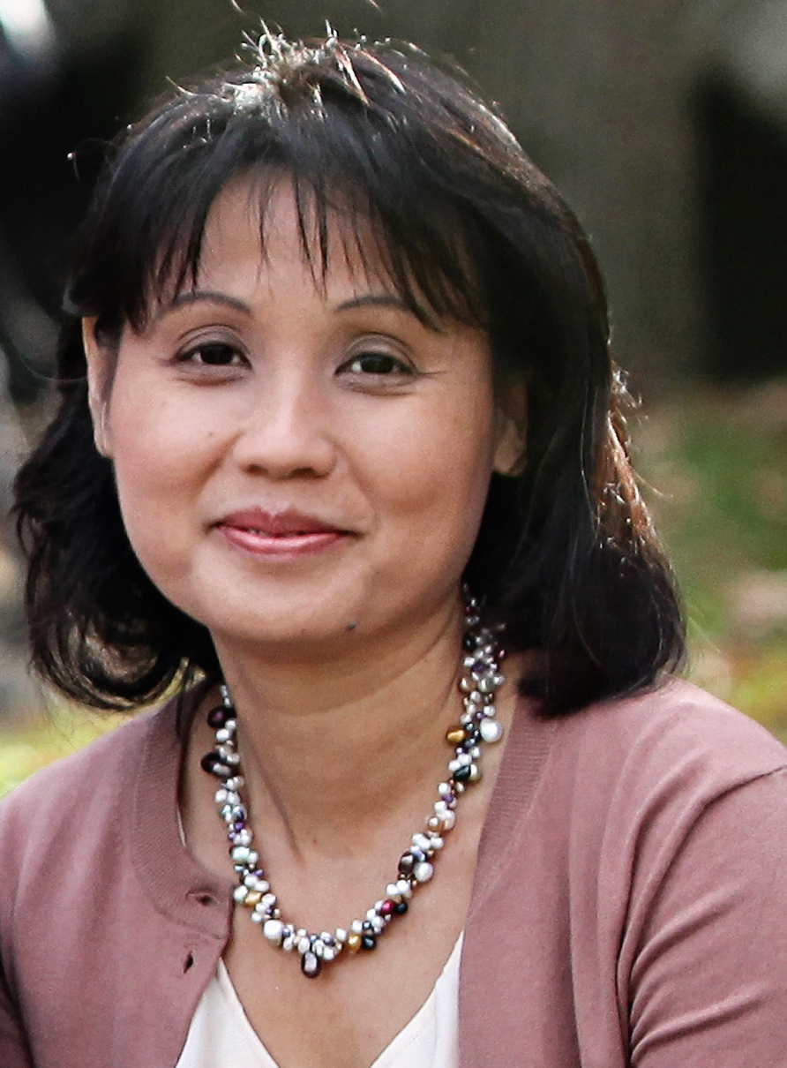
Your R&D Department
Practice group donations fund research and development that makes an impact on clinical care.
Dr. Rubin’s research led to the development and improvement of CT angiography as the principal means for assessing aortic disease.
His team’s work included refinement of MDCT techniques, invention of vessel measurement tools, and insights into aortic stent-grafts.
Dr. Mintun’s research developed functional brain imaging with PET that laid the groundwork for functional MRI which is now in common use in neuroradiology.
His research around amyloid imaging of the brain assisted in creating a better understanding of the biology of Alzheimer’s disease.
Geoffrey D. Rubin, MD
1994 RSNA Research Scholar Grant recipient
Mark A. Mintun, MD
1998 RSNA Research Scholar Grant recipient
Dr. Vo’s research on high resolution MR venography of occult venous malformations.
Her research assessed the clinical utility of a novel MR sequence that was developed at her MIR institution. This BOLD Venography sequence is now known as the SWI (susceptibility sequence) and is widely used in clinical practice.
Katie D. Vo, MD
1998 RSNA Research Fellow Grant recipient
12

Slide 13
Recognition and Benefits –
Throughout the Year
Special recognition in RSNA publications like RSNA News and RadioGraphics
Press release indicating your support for patient care
Complimentary preferred job postings in Radiology and on Career Connect
13

Slide 14
Join a growing number of VIP Practices!
Over 30 practice groups from around the nation support the Foundation.
Here are some of the VIP donors funding Radiology’s future:
Advanced Radiology Services Foundation
$25,000 Platinum VIP
Radiology Partners $25,000 Silver VIP
Inland Imaging Professional Services
$10,000 Bronze VIP
Austin Radiological Association
$75,000 Platinum VIP
MEDNAX Radiology Solutions $50,000 Gold VIP
14

Slide 15
Ready to make a VIP commitment
or need more information?
We appreciate your consideration for support. If you would like to make a donation, schedule a web meeting, or need additional information, please contact:
Bob Leigh
Senior Manager, Fund Development
RSNA R&E Foundation
(630) 590-7760
Central Standard Time
rleigh@rsna.org
15

